Slide 1
Introduction to the Course
The Need for Communication
Trends and Advancements
What is taught in this course?
What is NOT taught in this course?
Tips and Tricks to do well
Text and References

Slide 2
Introduction to Data Communications
Communication: Sharing of Information (Local or remote)
Telecommunications: Communication at a Distance (includes telephony, telegraph, and television etc.)
Data communications: Exchange of data between two devices via some form of transmission media

Slide 3
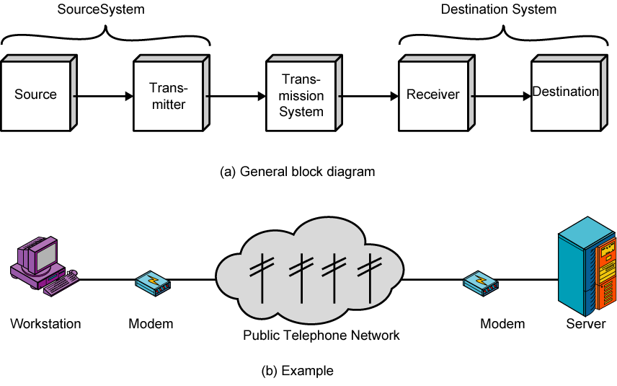
A Simple Communication Model

Slide 4
Characteristics of a Data Communication System
Effectiveness of a Data Communication System:
Delivery
Accuracy
Timeliness
Jitter

Slide 5
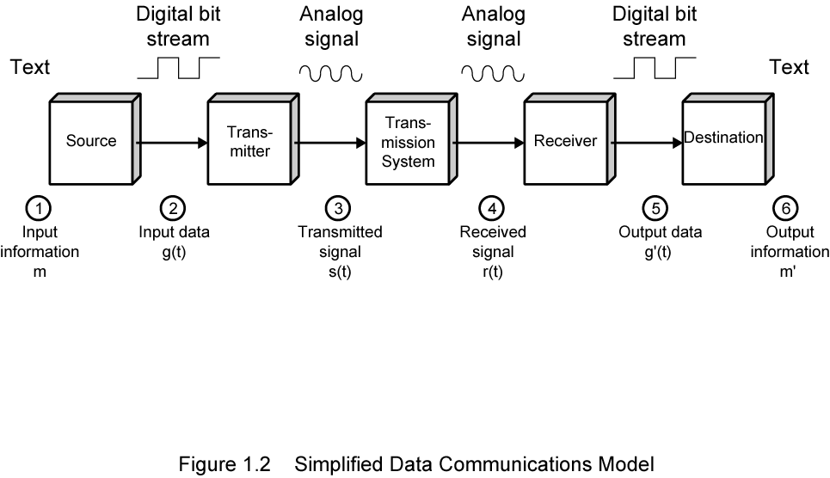
Characteristics of a Data Communication System

Slide 6
Components of a Data Communication system
A data communications system has five components

Slide 7
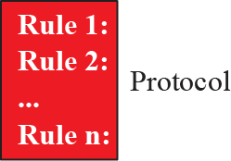
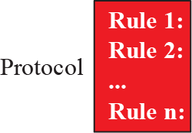
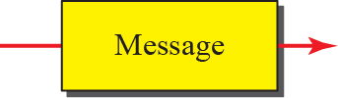


Components of Data Communication system

Slide 8
Data Representation and Data Flow
Forms of Information
Text
Numbers
Images
Audio
Video

Slide 9
Data Representation and Data Flow
Data Flow between two devices:
Simplex
Half-Duplex
Full-Duplex

Slide 10
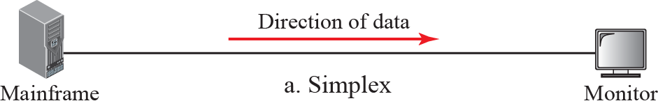
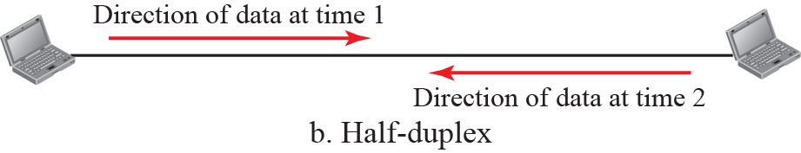
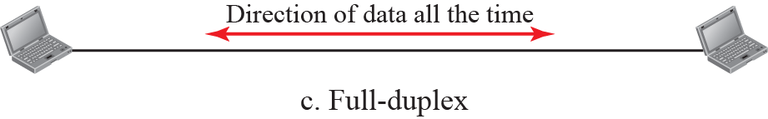
Data Flow

Slide 11
Networks
Network:
  Interconnection of a set of devices capable of communication
Host
Connecting Device

Slide 12
Network Criteria
A network must be able to meet a certain number of criteria:
Performance
  Throughput
  Delay
Reliability
Security

Slide 13
Physical Structures
Physical Network Attributes
Link
Type of Connection
  Point-to-Point
  Multipoint

Slide 14
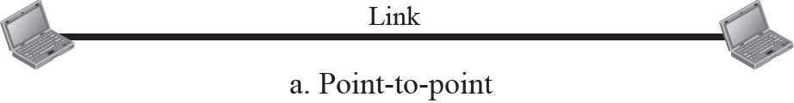
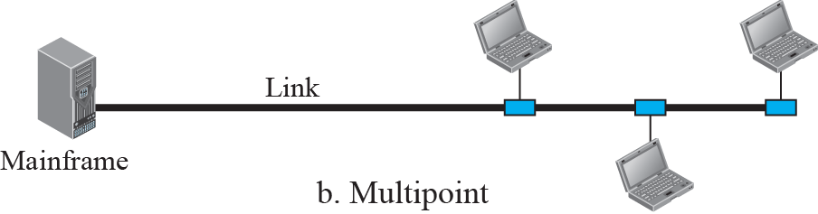
Physical Structures

Slide 15
Physical Topologies
Physical Layout of Network
Links + Nodes = Topology
Physical Topologies:
  Mesh
  Star
  Bus
  Ring

Slide 16
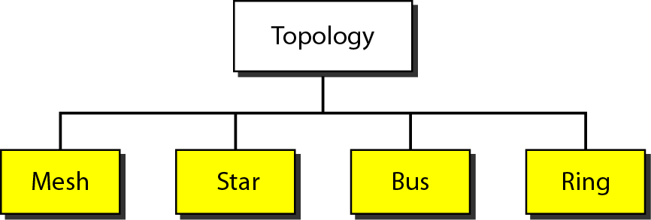
Physical Topologies

Slide 17
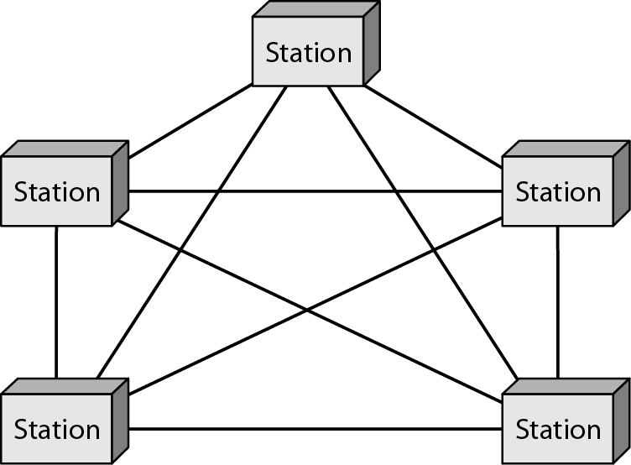
Mesh Topology

Slide 18
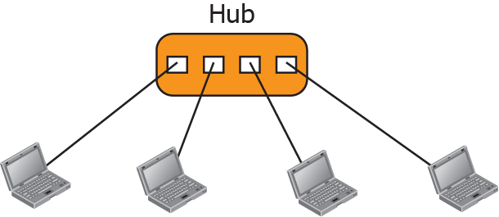
Star Topology

Slide 19
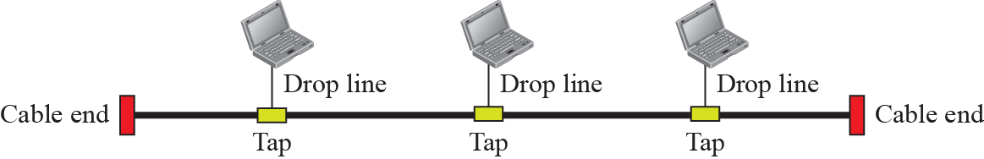
Bus Topology

Slide 20
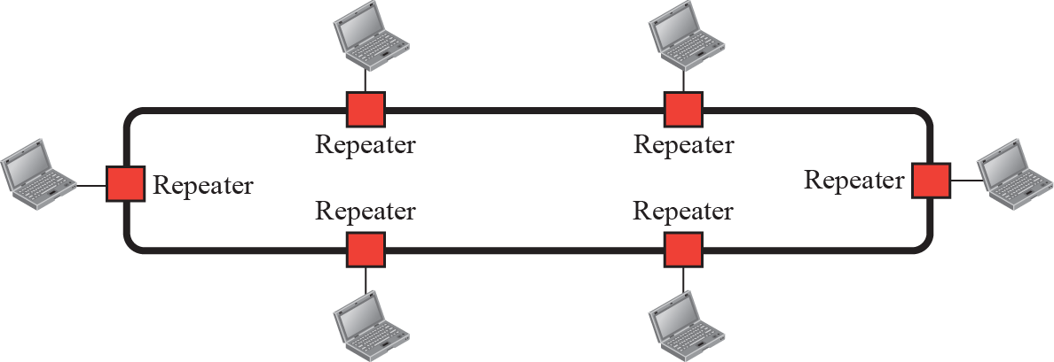
Ring Topology

Slide 21
Networks Types
Network classification:
  Size
  Geographical
  Coverage
  Ownership
Local Area Networks
(LANs)
Wide Area Networks (WANs)

Slide 22
Local Area Networks
Usually Privately owned
Connects some hosts in a single office, building, or campus
Can be as simple as two PCs and a printer in someone’s home office
Can extend throughout a company
Host Address

Slide 23
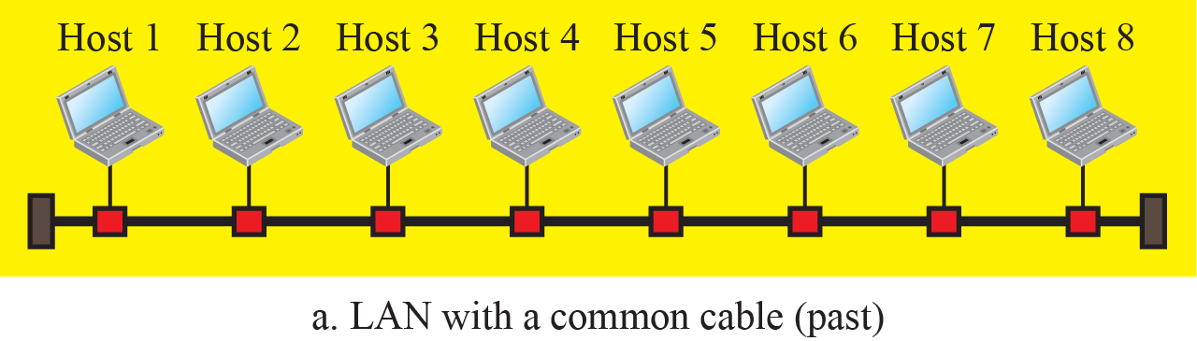
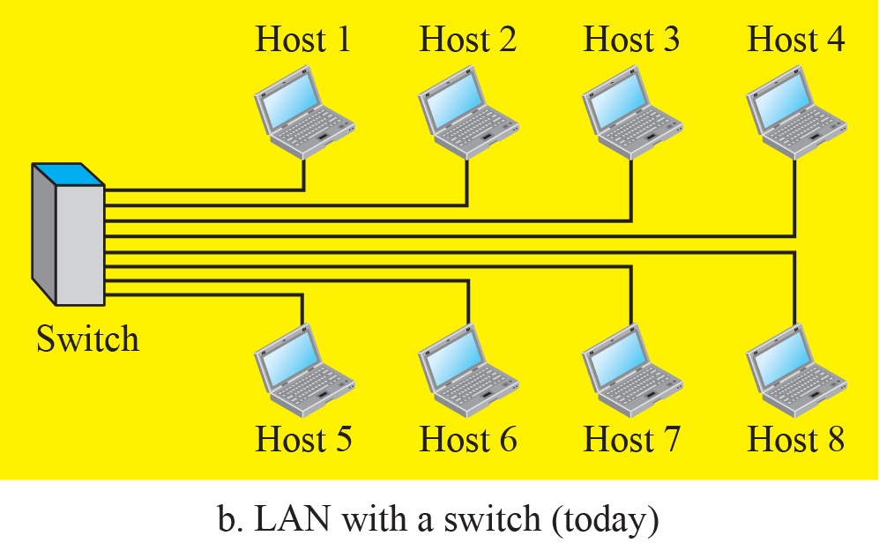
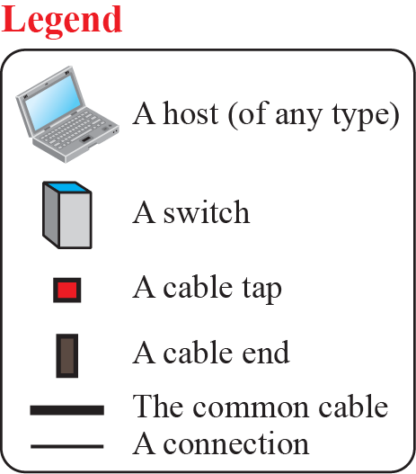
Local Area Networks

Slide 24
Wide Area Network
Wider geographical span than a LAN
Spans a town, a state, a country, or even the world
Interconnects connecting devices such as switches, routers, or modems
Normally created and run by communication companies

Slide 25
Wide Area Network
Point-to-Point WAN
Switched WAN
Internetwork

Slide 26

Point-to-Point WANs

Slide 27
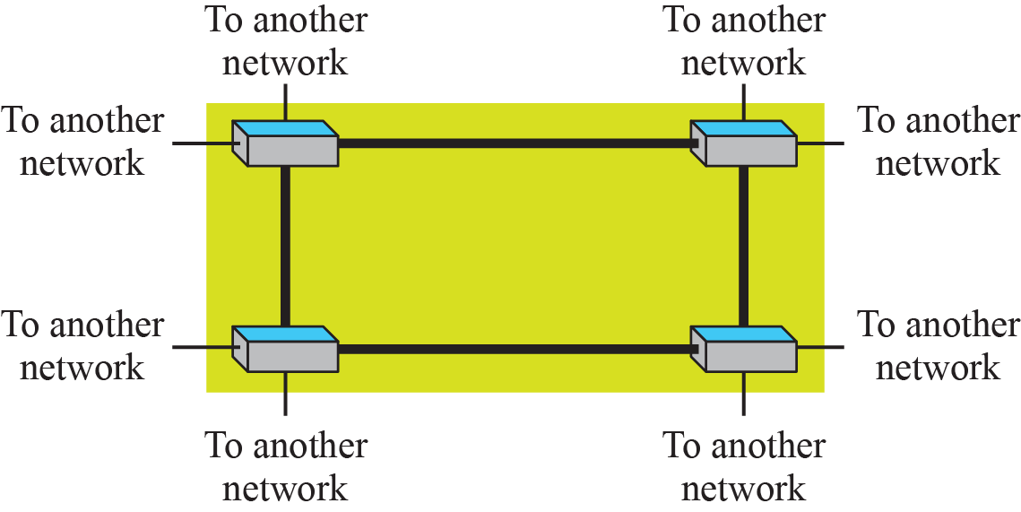
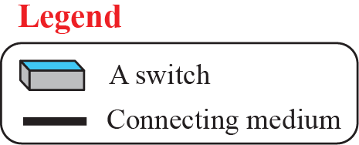
Switched WANs

Slide 28
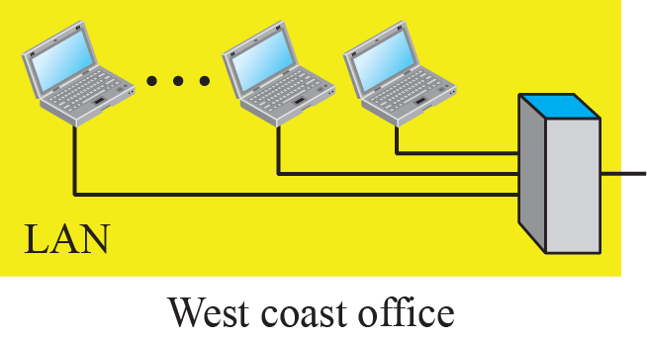
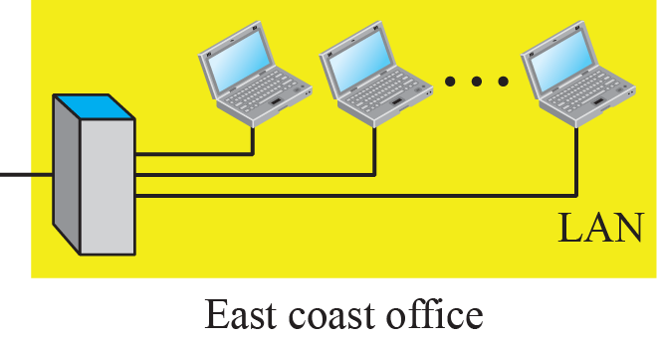
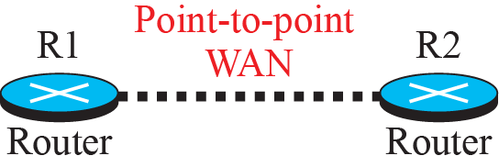
Internetwork

Slide 29
Switching
Switching
  Circuit-Switched Network
  Packet- Switched Network

Slide 30

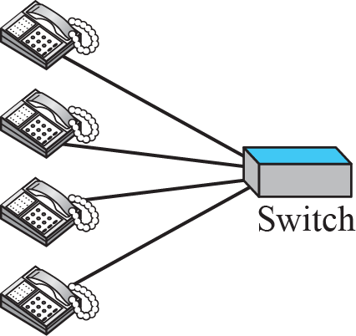
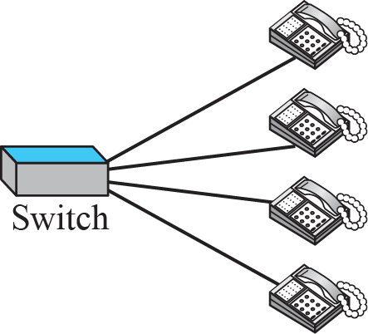
Circuit Switched Network

Slide 31

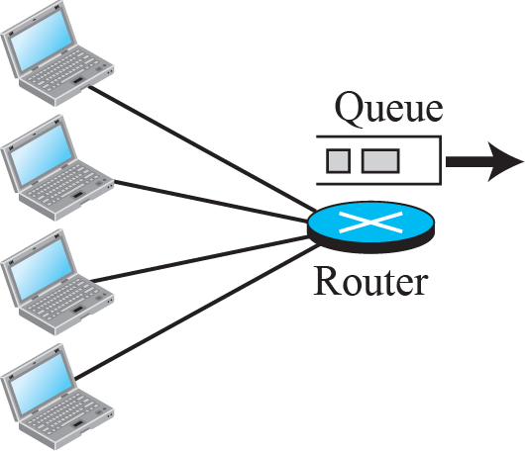
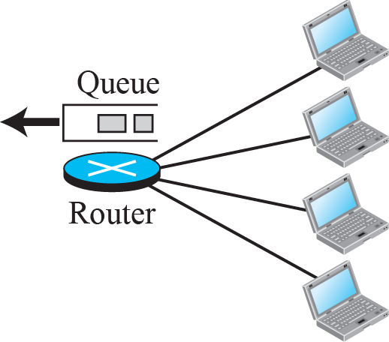
Packet Switched Network

Slide 32
The Internet
An internet (note the lowercase i) is two or more networks that can communicate with each other
The Internet (uppercase I ), and is composed of thousands of interconnected networks.
Accessing the Internet

Slide 33
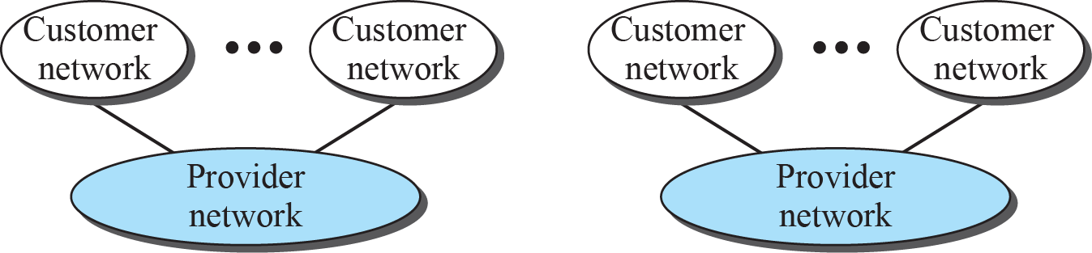

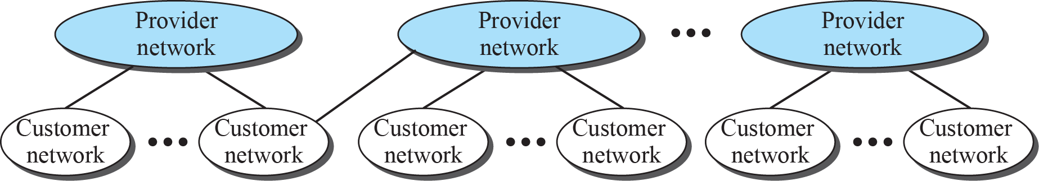
The Internet

Slide 34
Internet History
Telegraph and Telephone networks, before 1960:
  Constant-rate communication only
ARPANET- Packet Switched
Birth of the Internet &TCP/IP
MILNET
CSNET
NSFNET
Internet Today

Slide 35
Internet Standards and Administration
Internet draft
Request for Comments (RFC)
  Proposed Standard
  Draft Standard
  Internet Standard
  Historic
  Experimental
  Informational

Slide 36
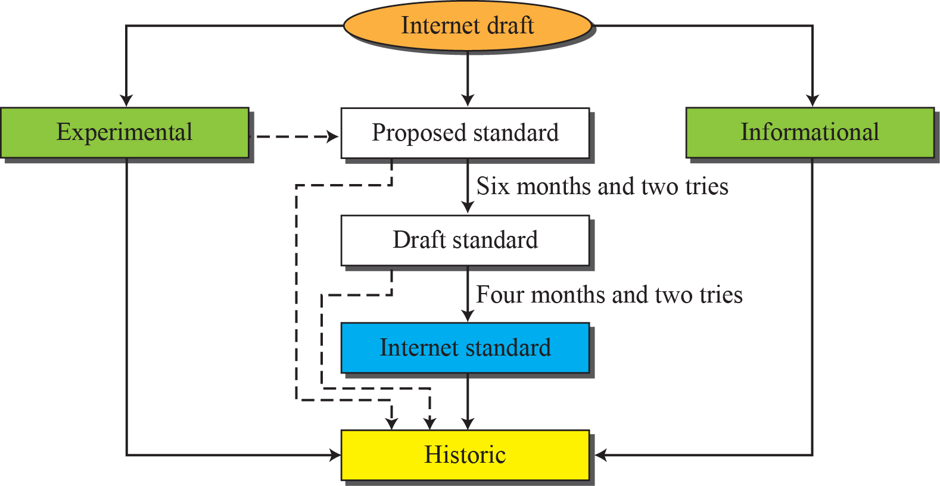
Internet Standards

Slide 37
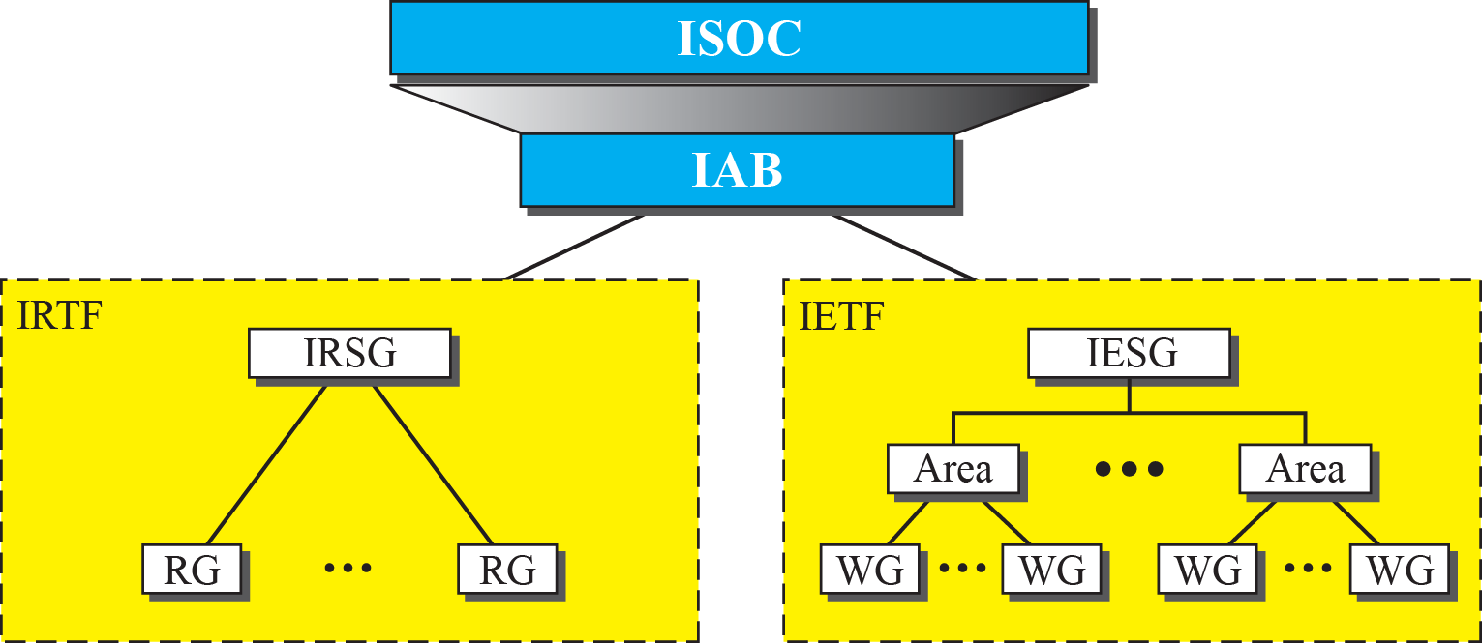
Internet Administration

