Slide 1
Protocol Layering - Introduction
Protocol
  Rules that both the sender and receiver and all intermediate devices need to follow to be able to communicate effectively
Protocol Layering
  Simple Communication: only one simple protocol
  Complex Communication, we need a protocol at each layer, or Protocol Layering

Slide 2
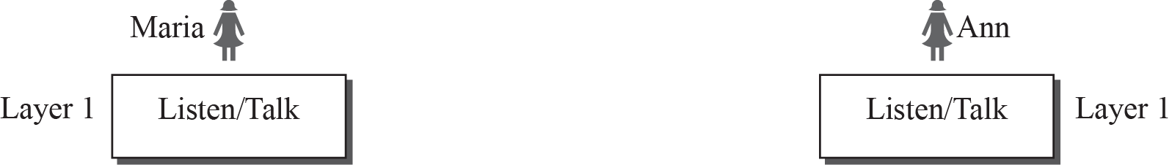
Protocol Layering - Example Scenario 1

Slide 3
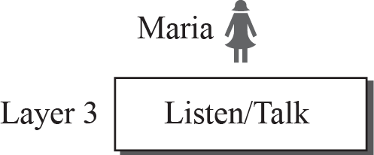
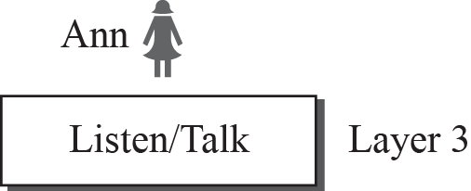

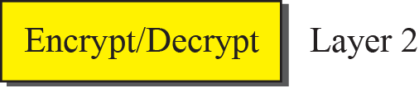
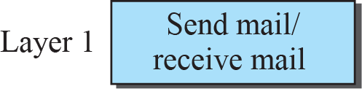
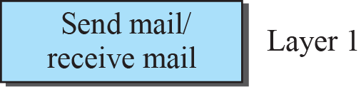
Protocol Layering - Example Scenario 2

Slide 4
Protocol Layering - Advantages and Disadvantages
Advantages
  Modularity
  Separation of Service & Implementation
  Reduced Complexity &
  Cost
Disadvantages
  None Really!

Slide 5
Protocol Layering - Principles
Two Principles
  Bidirectional Communication → Each Layer performs two opposite tasks in each direction
  Two objects under each layer at both sites should be identical

Slide 6
Protocol Layering - Logical Connections
Logical Connections
  Imaginary connection between each layer

Slide 7
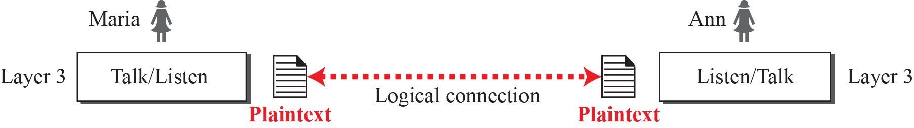
Protocol Layering

Slide 8
TCP/IP Protocol Suite
TCP/IP Protocol Suite
  Protocol suite used in Internet today
  Each Layer provides specific functionality
  Hierarchical Protocol
  Presented in 1973 and chosen to be the official protocol of Internet in 1983

Slide 9
TCP/IP Protocol Suite

Slide 10
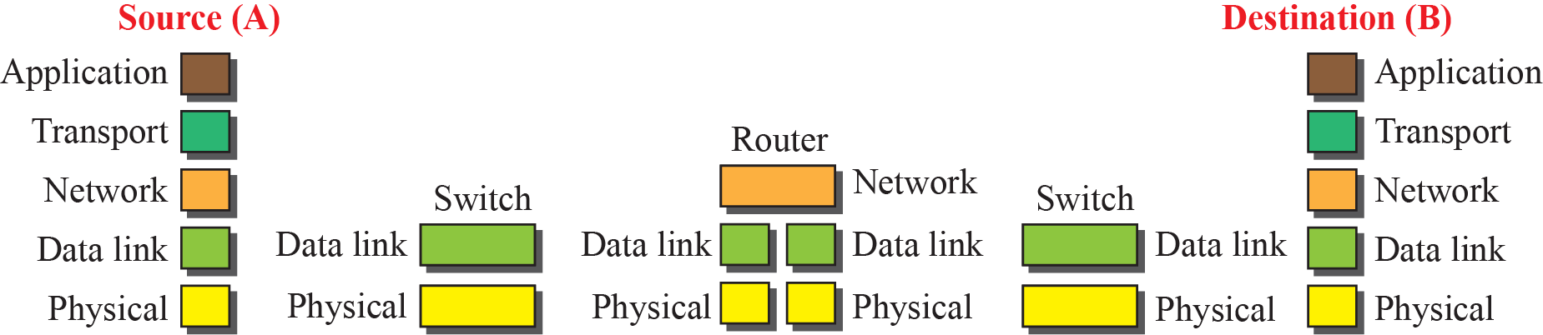
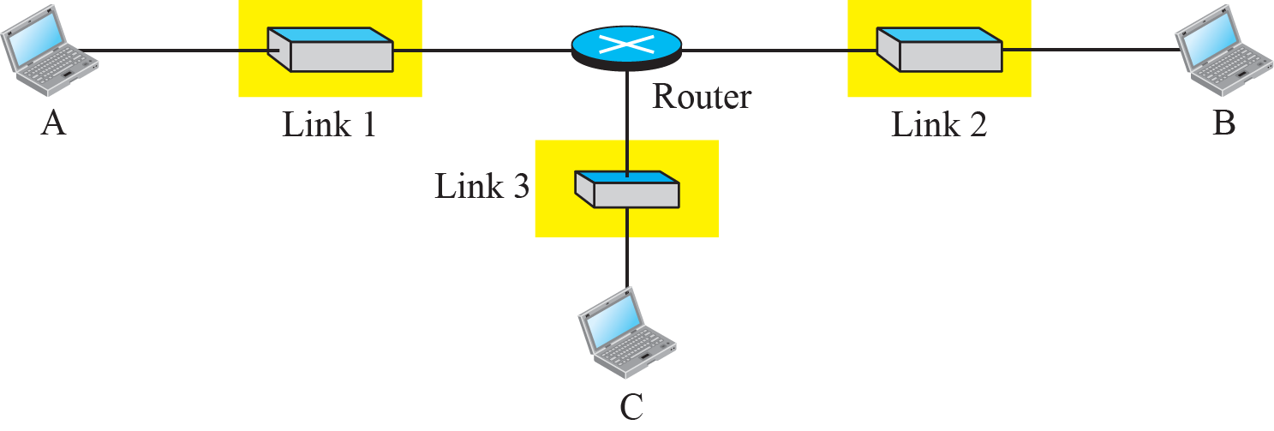
TCP/IP Protocol Suite - Layered Architecture

Slide 11
TCP/IP Protocol Suite – Function of Layers
Logical Connections between TCP/IP Layers

Slide 12
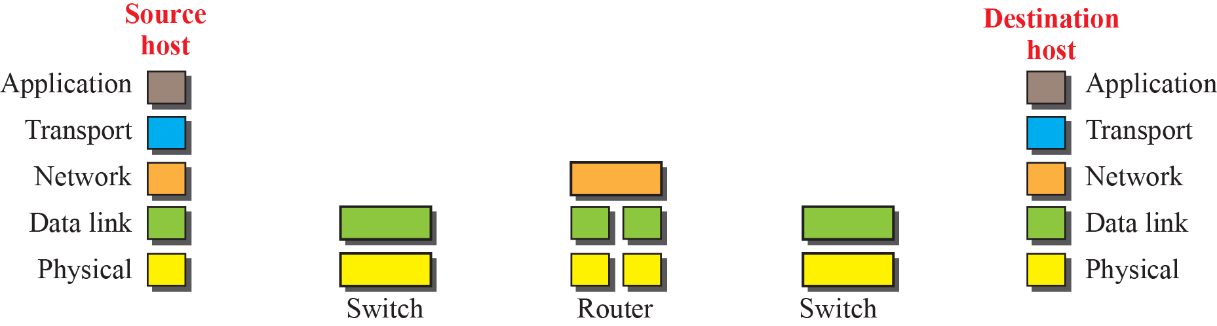
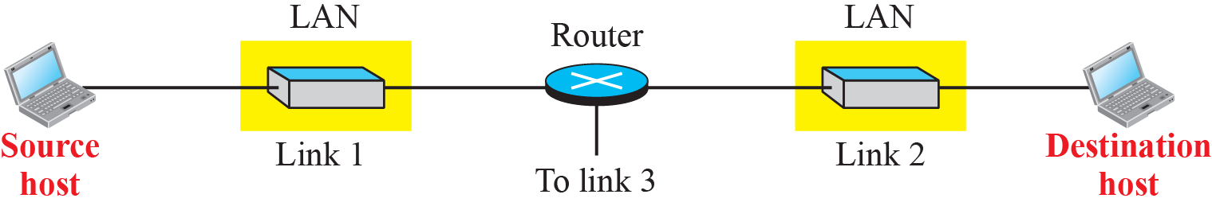
TCP/IP Protocol Suite – Function of Layers
Logical connections

Slide 13
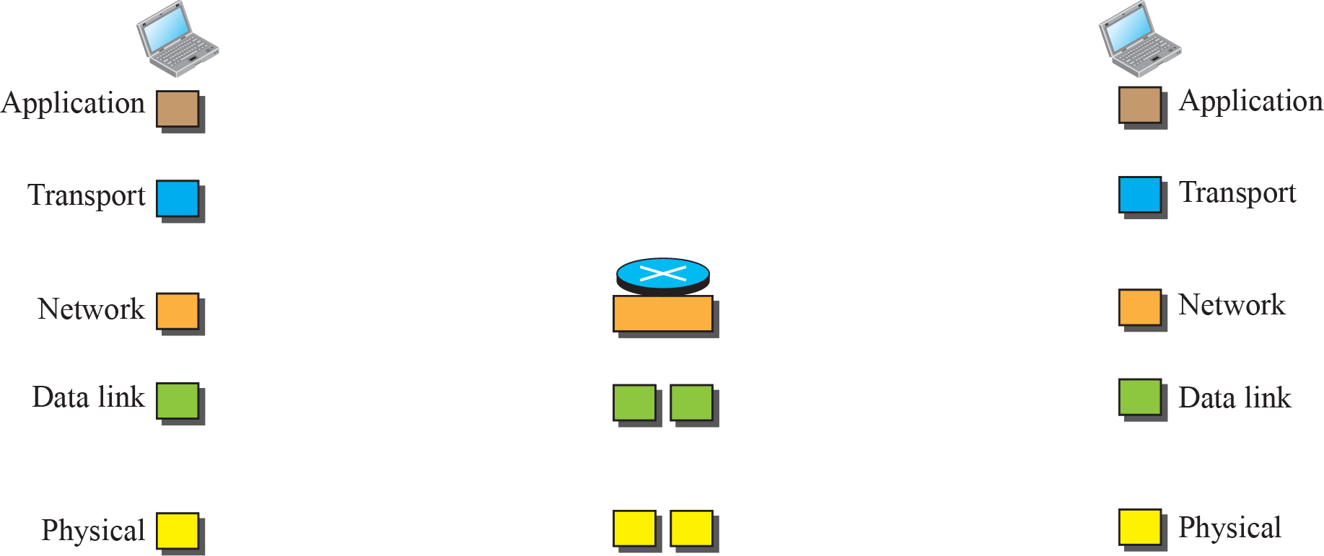
TCP/IP Protocol Suite – Function of Layers
Identical objects (messages)
Identical objects (segment or user datagram)
Identical objects (datagram)
Identical objects (datagram)
Identical objects (frame)
Identical objects (frame)
Identical objects (bits)
Identical objects (bits)

Slide 14
TCP/IP Protocol Suite – Layer Description

Slide 15
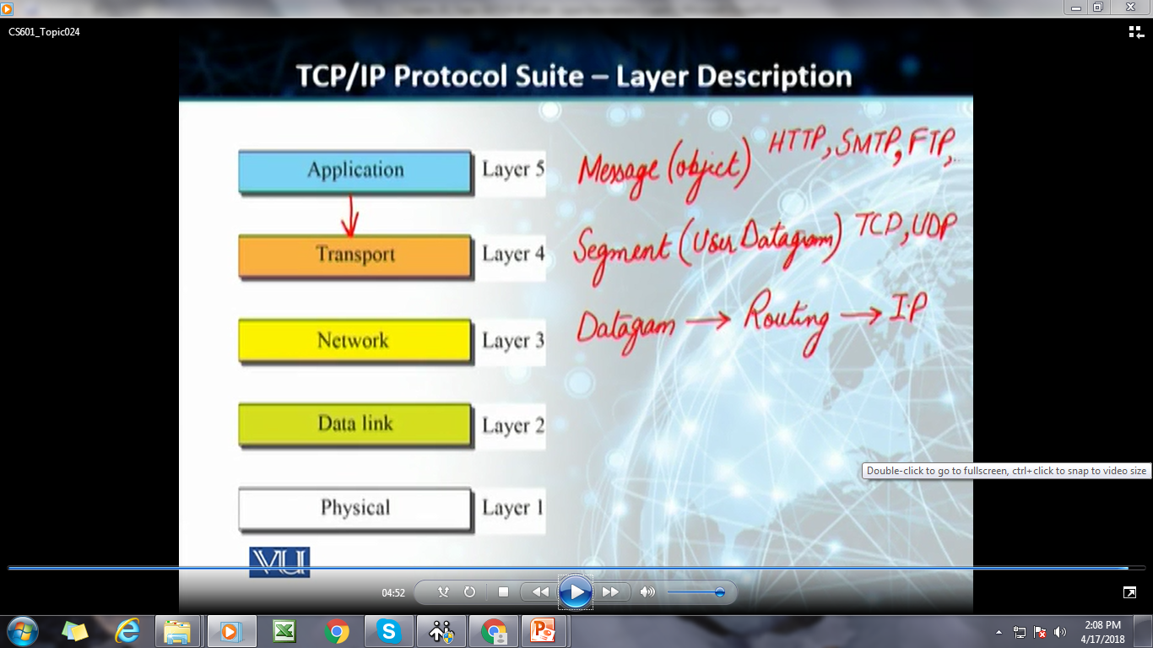

Slide 16
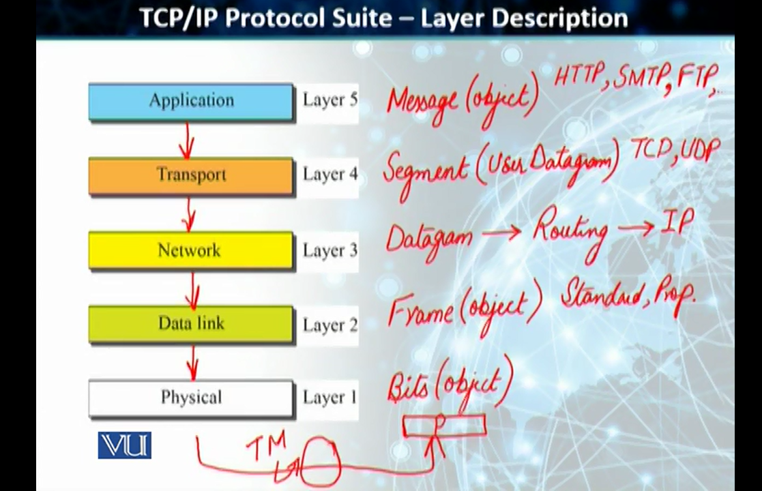

Slide 17
Encapsulation & Decapsulation
Important Concept in Internet Protocol Layering
Layer Header

Slide 18
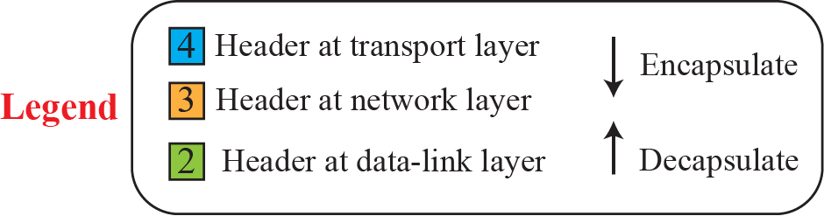
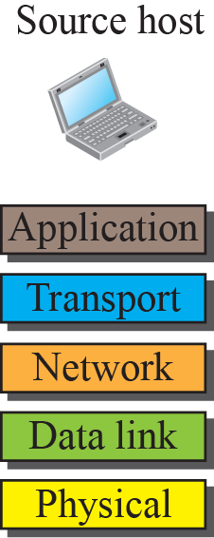
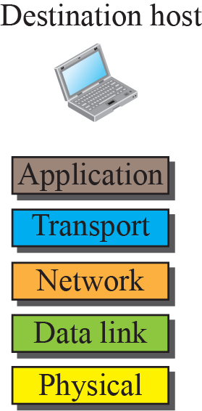
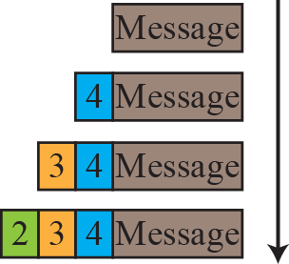
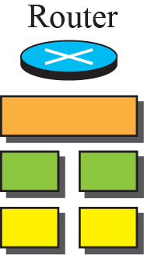
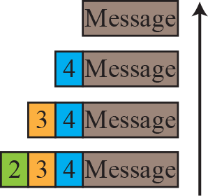
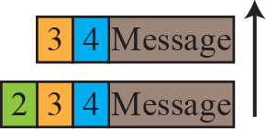
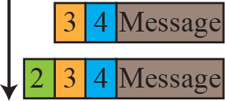
Encapsulation & Decapsulation

Slide 19
Addressing in TCP/IP Protocol Suite
Every communication needs at least two addresses:
  Source Address &
  Destination Address
Addressing by Layer
Physical Layer is an exception

Slide 20


Addressing in TCP/IP Protocol Suite

Slide 21
The Open System Interconnection (OSI) Model
International Organization for Standardization (ISO)
ISO established in 1947
Close to three-fourths of countries represented
Introduced OSI Model in late 1970s
OSI: a 7-Layer Model

Slide 22
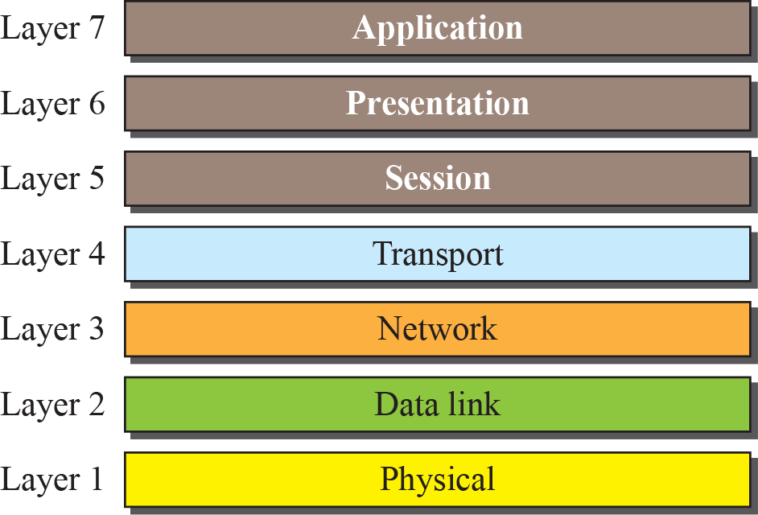
The Open System Interconnection (OSI) Model

Slide 23
OSI Model vs TCP/IP Protocol suite
Two Layers of OSI missing from TCP/IP
Application (TCP/IP) = Application + Presentation + Session (OSI)

Slide 24
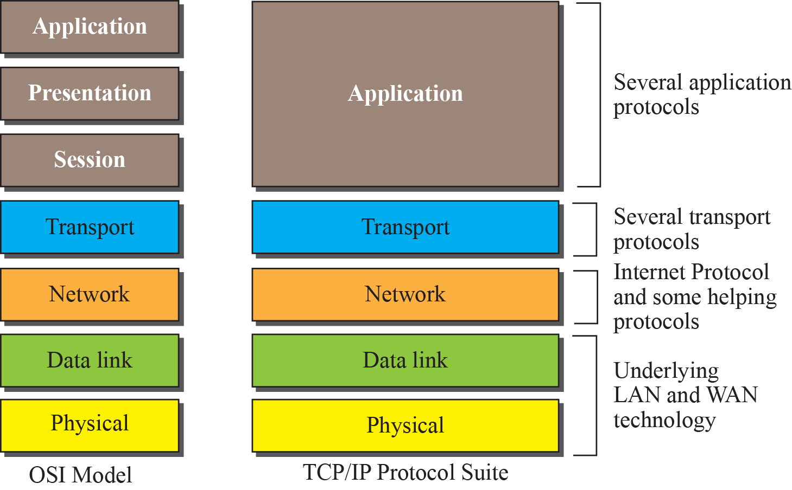
OSI Model vs TCP/IP Protocol suite

Slide 25
Lack of OSI Model’s Success
Three reasons OSI did not replace TCP/IP:
  OSI was completed when TCP/IP was fully in place
  Some layers in OSI not fully defined
  Performance of TCP/IP better than that of OSI

Slide 26
Data Communication versus Computer Networks

Slide 27
Data Communication versus Computer Networks
Analog & Digital Transmission
Transmission Media
Switching
Error Detection and Correction
Media Access and Data Link Control
Wired and Wireless LANs

