Slide 1
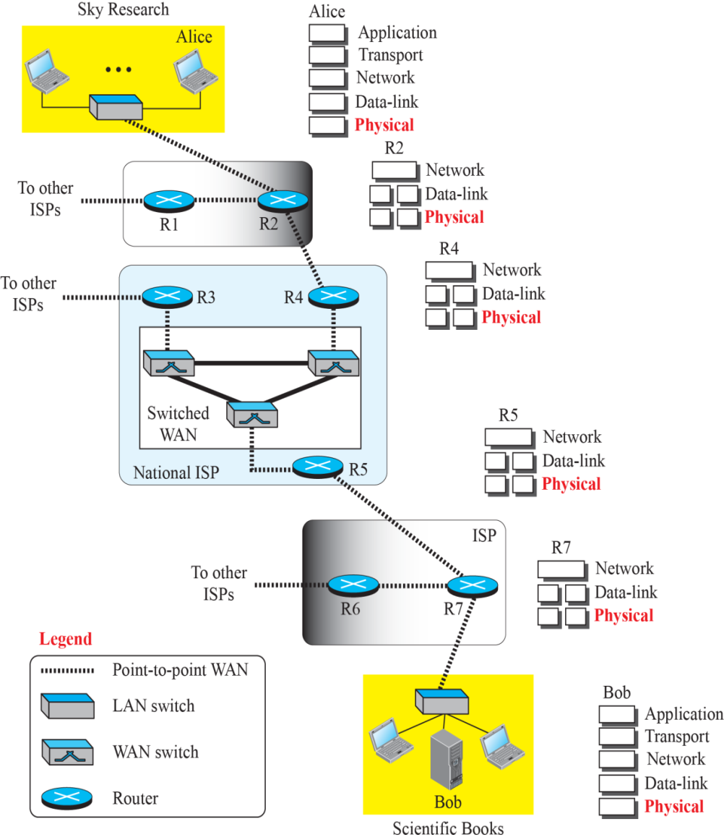
Communication at Physical Layer

Slide 2
Analog & Digital Data
Data → Analog or Digital
Analog Data → Continuous
Digital Data → Discrete
Examples: Analog Clock vs. Digital Clock
Human voice vs. Data in Computer

Slide 3
Analog & Digital Signals
Signals represent Data
Signals → Analog or Digital
Analog Signal → Infinite Levels of Intensity over time
Digital Signal → Limited number of defined values

Slide 4
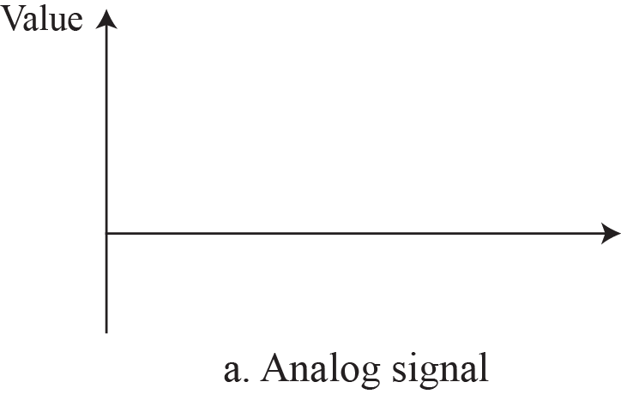
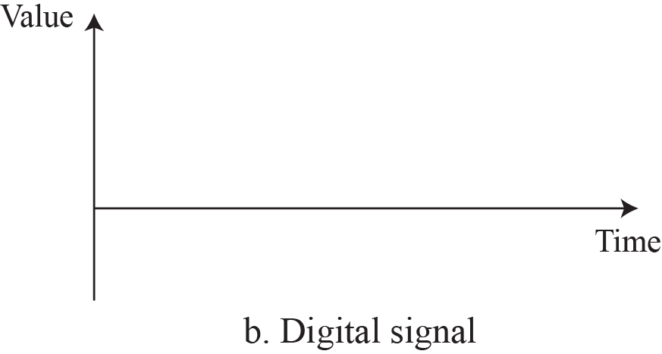
Analog & Digital Signals

Slide 5
Periodic & Non-periodic Signals
Analog/Digital Signal → Periodic or Non-periodic
Periodic Signal → Pattern
Period and Cycle
Non-Periodic → No Pattern
Periodic ANALOG Signals and Non-periodic DIGITAL Signals

Slide 6
Periodic Analog Signals
Periodic Analog Signals → Simple or Composite
Simple Periodic Analog signal→ Sine wave
Composite Periodic Analog signal→ Composed of multiple sine waves

Slide 7

Sine Wave

Slide 8
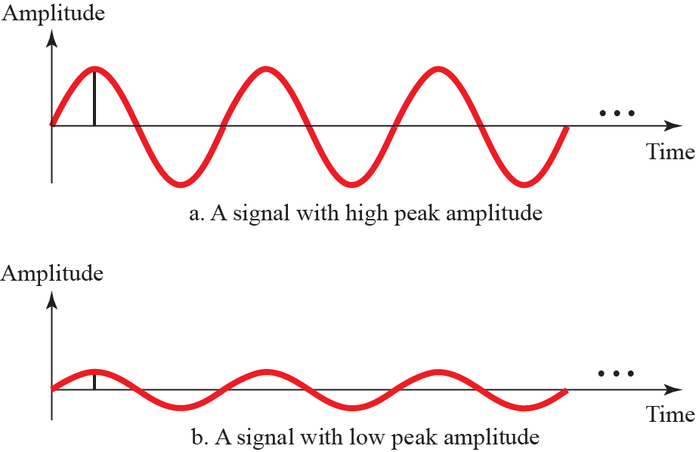
Sine Wave – Peak Amplitude

Slide 9
Sine Wave –Frequency
Period (T) → Amount of time required to complete 1 cycle
Frequency (f) → No. of Periods in 1 sec
f = 1/T or T = 1/f

Slide 10
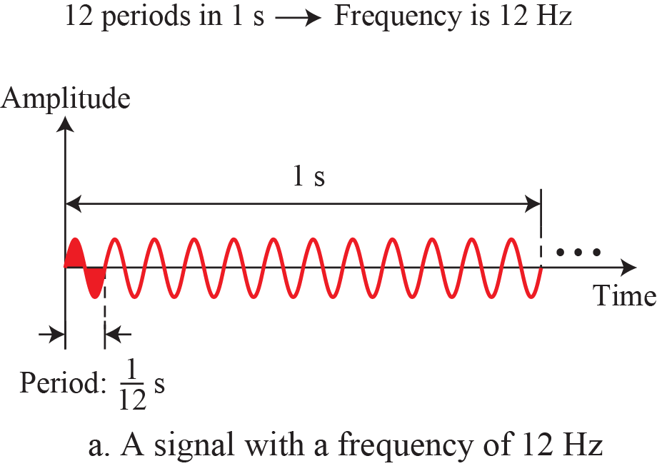
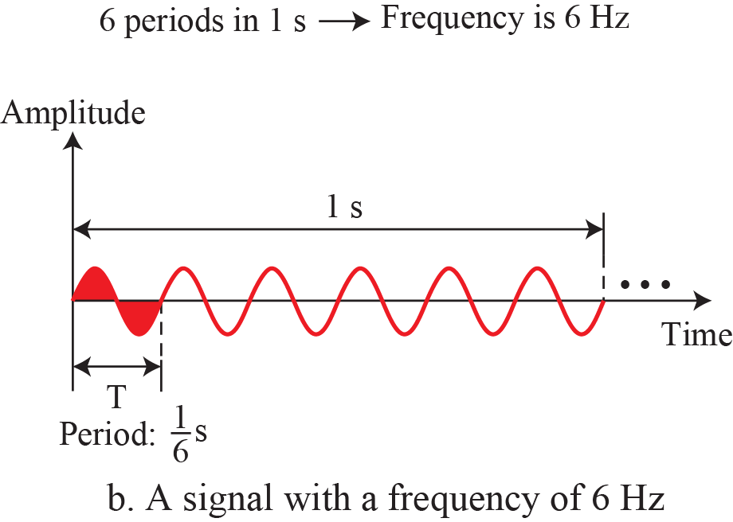
Sine Wave –Frequency

Slide 11
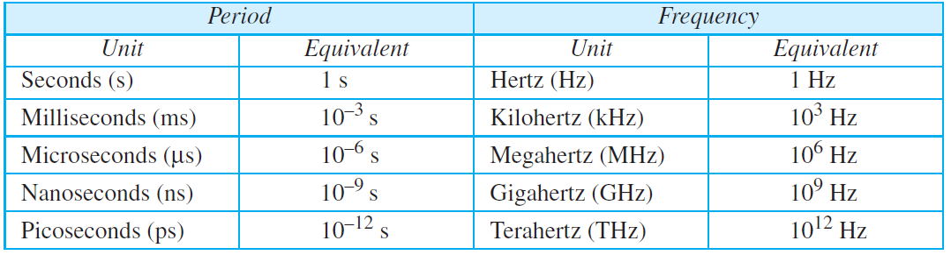
Sine Wave –Frequency

Slide 12
Example
The power we use at home has a frequency of 60 Hz. The period of this sine wave can be determined as follows:

Slide 13
Example
The period of a signal is 100 ms. What is its frequency in kilohertz?.

Slide 14
Phase (or Phase Shift)
Position of waveform relative to time 0
Phase describes the amount of shift of the wave
Indicates start of the first cycle

Slide 15
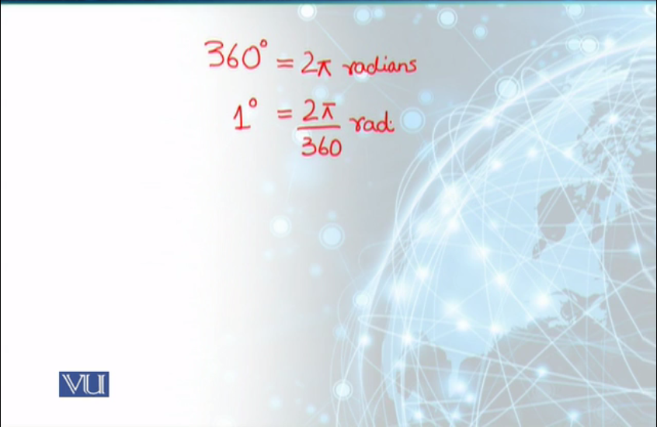
Phase

Slide 16
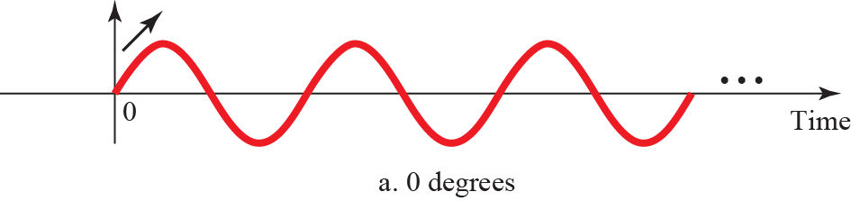
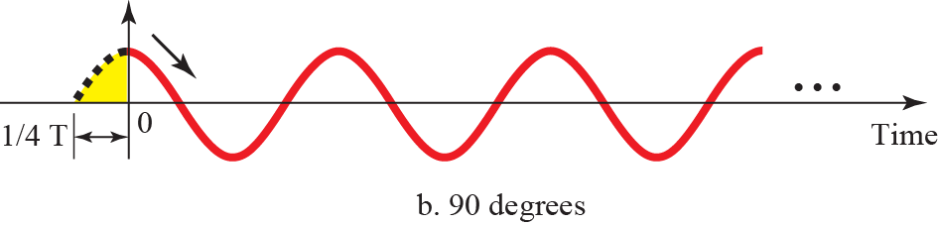
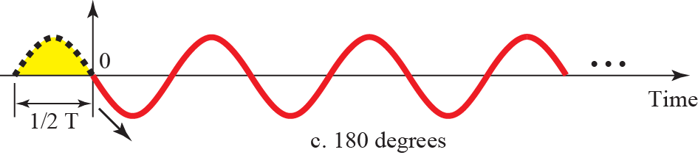
Phase

Slide 17
Example
A sine wave is offset 1/6 cycle with respect to time 0. What is its phase in degrees and radians?

Slide 18
Wavelength
Wavelength is another characteristic of a signal traveling through a transmission medium. Wavelength binds the period or the frequency of a simple sine wave to the propagation speed of the medium (see Figure 3.7).

Slide 19
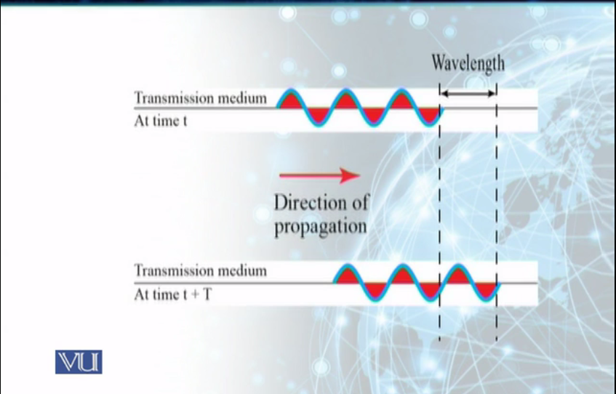
Wavelength
Figure 3.7

Slide 20
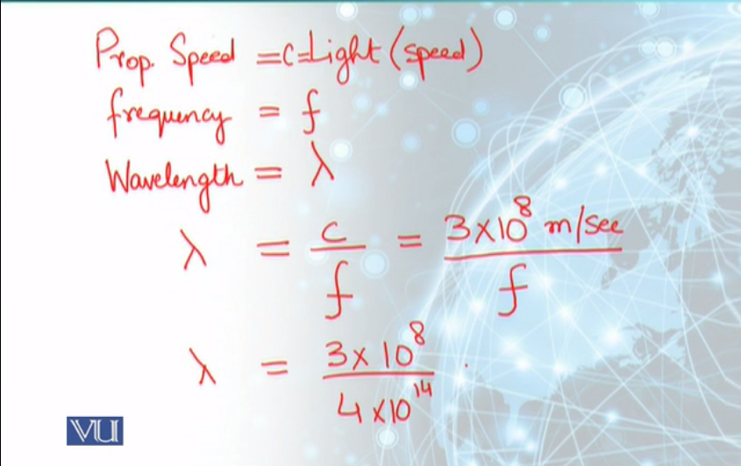
Wavelength

Slide 21
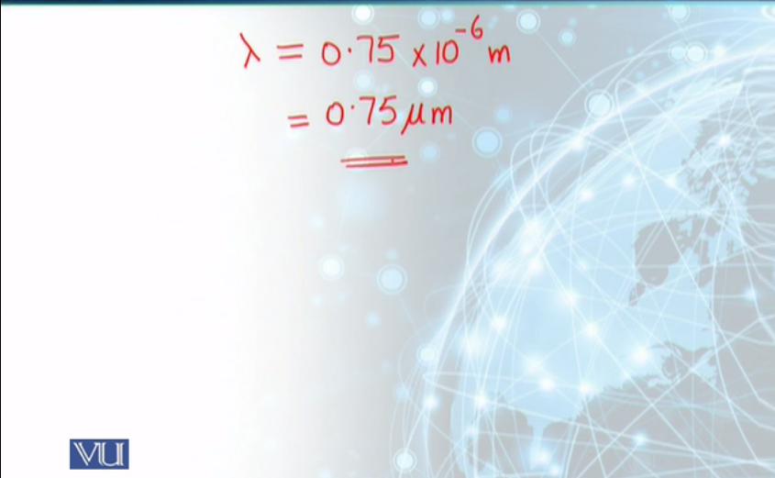
Wavelength
Figure 3.7

Slide 22
Time & Frequency Domains
A sine wave is comprehensively defined by its amplitude, frequency, and phase. We have been showing a sine wave by using what is called a time domain plot. The time-domain plot shows changes in signal amplitude with respect to time (it is an amplitude-versus-time plot). Phase is not explicitly shown on a time-domain plot.

Slide 23
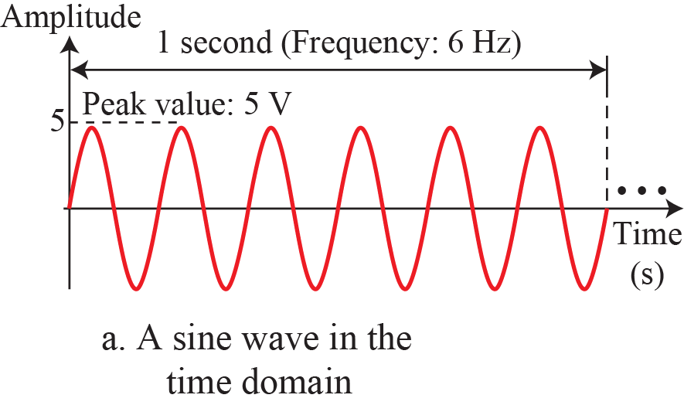
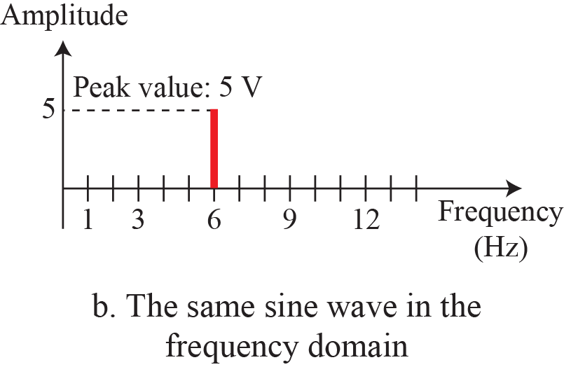
Time & Frequency Domains

Slide 24
Example 3.7
The frequency domain is more compact and useful when we are dealing with more than one sine wave. For example, Figure 3.9 shows three sine waves, each with different amplitude and frequency. All can be represented by three spikes in the frequency domain.

Slide 25
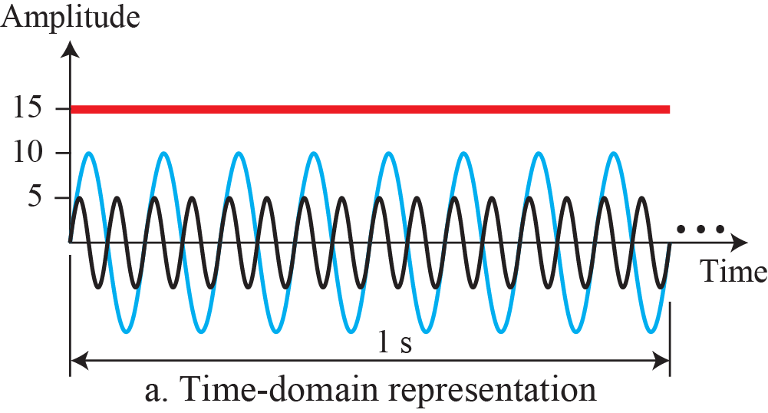
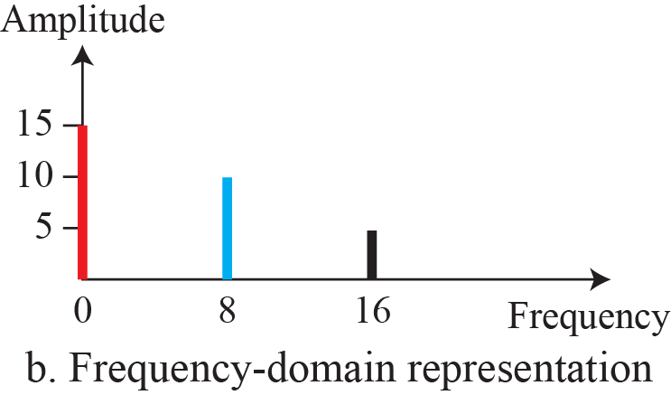
Time & Frequency Domains
Figure 3.9

Slide 26
Composite Signals
So far, we have focused on simple sine waves. Simple sine waves have many applications in daily life. We can send a single sine wave to carry electric energy from one place to another. For example, the power company sends a single sine wave with a frequency of 60 Hz to distribute electric energy to houses and businesses.

Slide 27
Composite Signals
Single Sine Wave can only carry limited information
Composite Signal is made up of multiple simple sine waves
Can be periodic or non-periodic

Slide 28
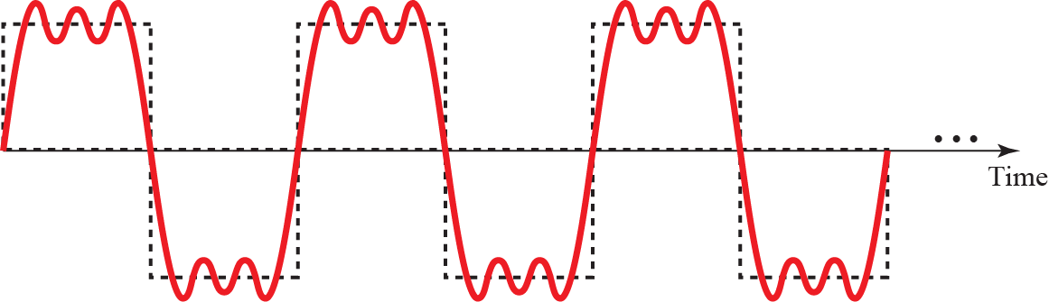
A Composite Periodic Signal

Slide 29
Decomposition of Composite Periodic Signal

Slide 30
Bandwidth
An important characteristic that measures Network Performance
Bandwidth can be used in two different contexts with two different measuring values:
  Bandwidth in Hertz
  Bandwidth in bits per second

Slide 31
Bandwidth
Bandwidth
Bandwidth in Hertz
Bandwidth in bps
Range of frequencies
in a composite signal
No. of bits a channel, link
or network can transmit

Slide 32
Bandwidth
Range of frequencies contained in a Composite Signal
The bandwidth is normally a difference between two frequencies (the highest and the lowest)

Slide 33
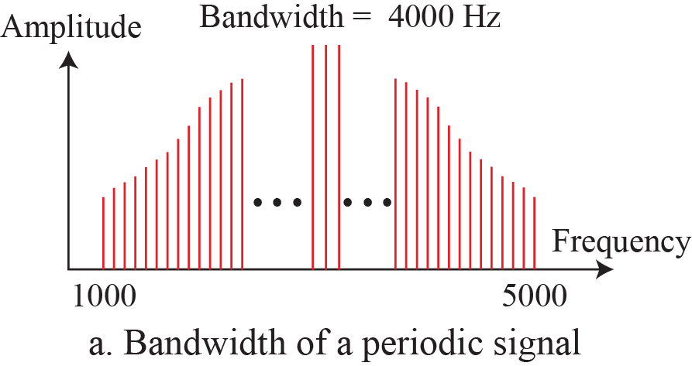
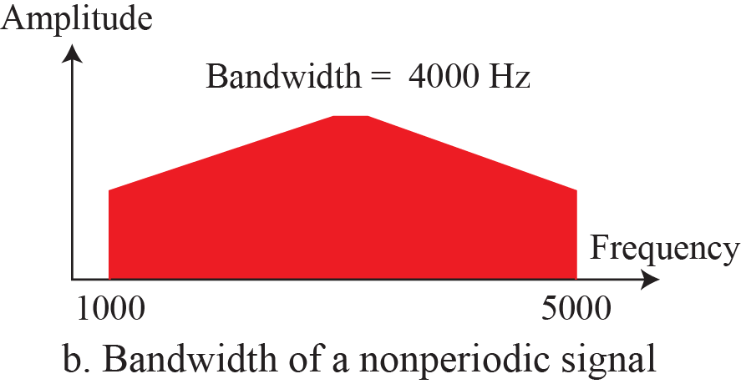
Bandwidth of a composite signal

Slide 34
Example
If a periodic signal is decomposed into five sine waves with frequencies of 100, 300, 500, 700, and 900 Hz, what is its bandwidth? Draw the spectrum, assuming all components have a maximum amplitude of 10 V.

Slide 35
Digital Signals
In addition to being represented by an analog signal, information can also be represented by a digital signal. For example, a 1 can be encoded as a positive voltage and a 0 as zero voltage. A digital signal can have more than two levels.

Slide 36
Digital Signals
Information can also be represented by a digital signal
For example, a 1 can be encoded as a positive voltage and a 0 as zero voltage
A digital signal can have more than two levels so that we can send more than one bit for each level

Slide 37
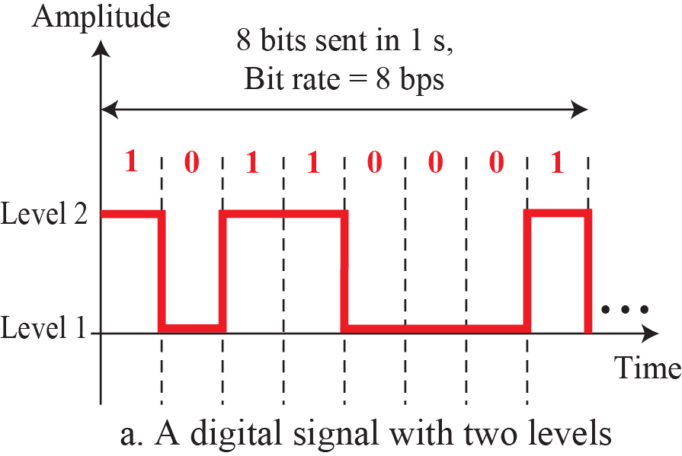
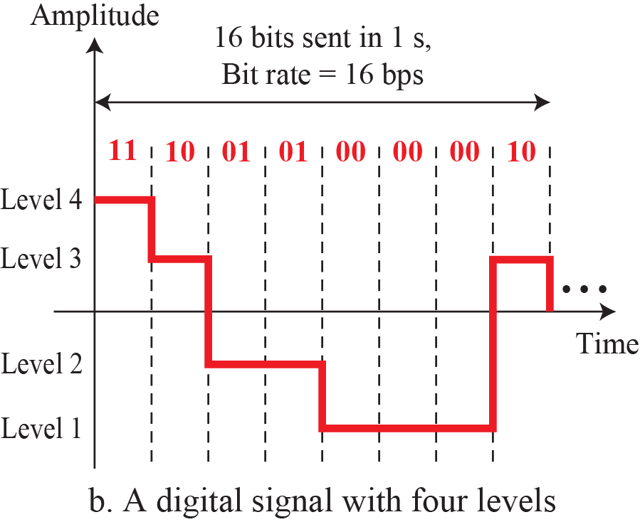
Digital Signals
In general, if a signal has L levels, each level needs log2 L bits. So, we can send log2 2 = 1 bit per level
log2 4 = 2 bits

Slide 38
Digital Signals
In this case, we can send more than 1 bit for each level. Figure 3.17 shows two signals, one with two levels and the other with four.

Slide 39

Example 3.16
A digital signal has eight levels. How many bits are needed per level? We calculate the number of bits from the following formula. Each signal level is represented by 3 bits.

Slide 40
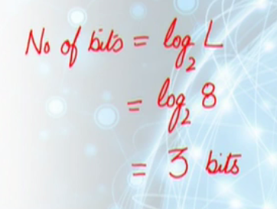
Example
A digital signal has eight levels. How many bits are needed per level?

Slide 41
Example 3.17
A digital signal has nine levels. How many bits are needed per level? We calculate the number of bits by using the formula. Each signal level is represented by 3.17 bits. However, this answer is not realistic. The number of bits sent per level needs to be an integer as well as a power of 2. For this example, 4 bits can represent one level.

Slide 42

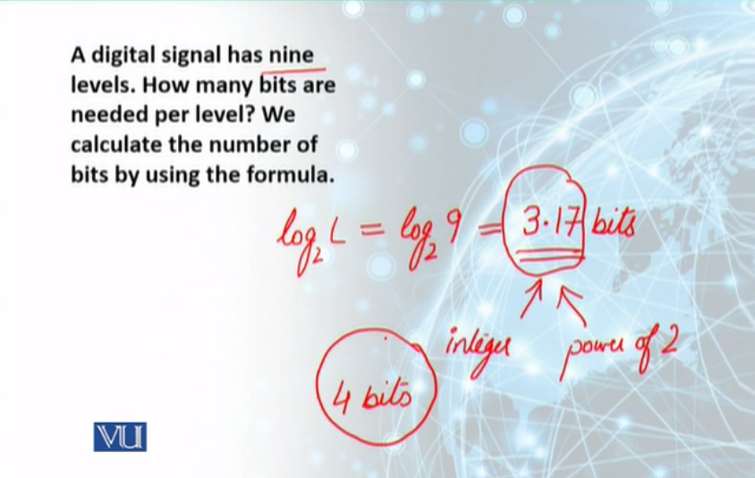
Example
A digital signal has nine levels. How many bits are needed per level? We calculate the number of bits by using the formula.

Slide 43
Bit Rate
Number of bits sent in 1 second
Bit Rate is expressed in bits per second (bps)
Most digital signals are non-periodic, and thus period and frequency are not appropriate characteristics

Slide 44
Bit Rate

Slide 45
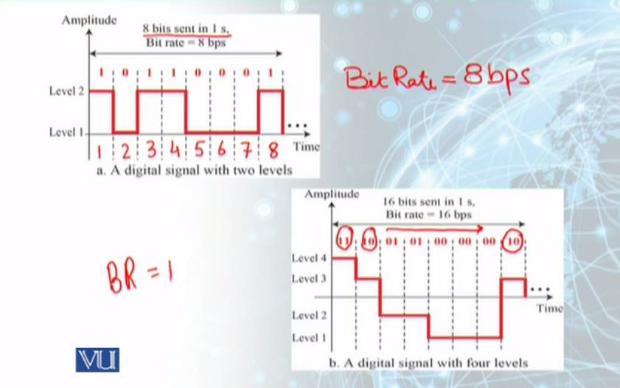
Bit Rate

Slide 46
Bit Rate
Most digital signals are nonperiodic, and thus period and frequency are not appropriate characteristics. Another term—bit rate (instead of frequency)—is used to describe digital signals. The bit rate is the number of bits sent in 1s, expressed in bits per second (bps). Figure 3.17 shows the bit rate for two signals.

Slide 47
Bit Rate
Number of bits sent in 1 second
Bit Rate is expressed in bits per second (bps)
Most digital signals are non-periodic, and thus period and frequency are not appropriate characteristics

Slide 48
Bit Rate

Slide 49
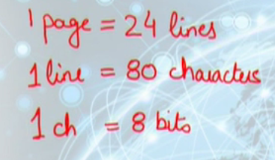
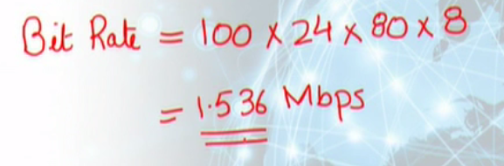
Example
Assume we need to download text documents at the rate of 100 pages per second. What is the required bit rate of the channel?

Slide 50

Example 3.18
Solution
From Table 3.1 we find the equivalents of 1 ms (1 ms is 10–3 s) and 1 s (1 s is 106 μs). We make the following substitutions:

Slide 51
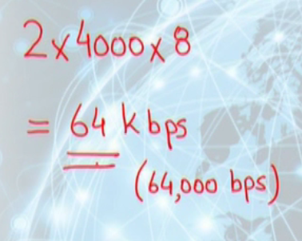
Example
A digitized voice channel is made by digitizing a 4-kHz bandwidth analog voice signal. We need to sample the signal at twice the highest frequency (two samples per hertz). We assume that each sample requires 8 bits. What is the required bit rate?

Slide 52

Example 3.19
Solution
A page is an average of 24 lines with 80 characters in each line. If we assume that one character requires 8 bits, the bit rate is

Slide 53
Example 3.20
What is the bit rate for high-definition TV (HDTV)?
Solution
HDTV uses digital signals to broadcast high quality video signals. The HDTV screen is normally a ratio of 16 : 9 (in contrast to 4 : 3 for regular TV), which means the screen is wider. There are 1920 by 1080 pixels per screen, and the screen is renewed 30 times per second.

Slide 54
Example 3.20
Solution
Twenty-four bits represents one color pixel. We can calculate the bit rate as
The TV stations reduce this rate to 20 to 40 Mbps through compression.

Slide 55

Bit Length
We discussed the concept of the wavelength for an analog signal: the distance one cycle occupies on the transmission medium. We can define something similar for a digital signal: the bit length. The bit length is the distance one bit occupies on the transmission medium.

Slide 56
Digital Signal as Composite Analog Signal
Based on Fourier analysis, a digital signal is a composite analog signal
A digital signal, in the time domain, comprises connected vertical and horizontal line segments
Infinite Bandwidth

Slide 57
Digital As Composite Analog
A vertical line in the time domain means a frequency of infinity: a horizontal line in the time domain means a frequency of zero. Going from a frequency of zero to a frequency of infinity implies all frequencies in between are part of the domain.

Slide 58
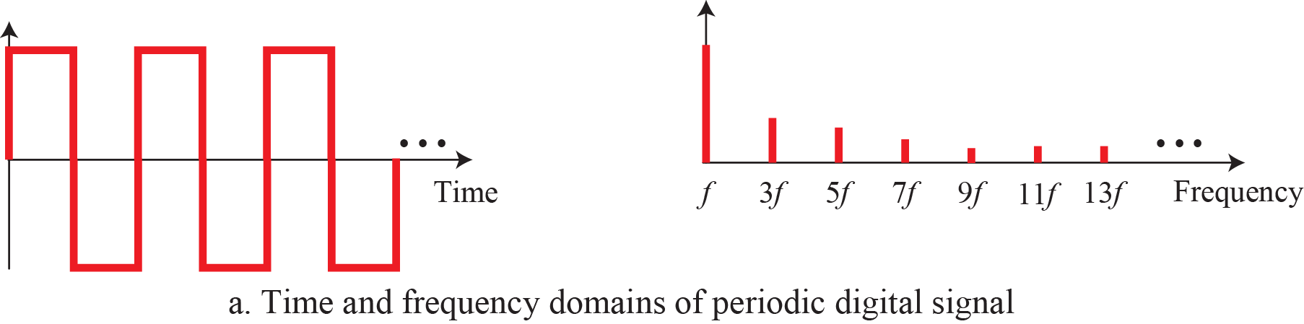
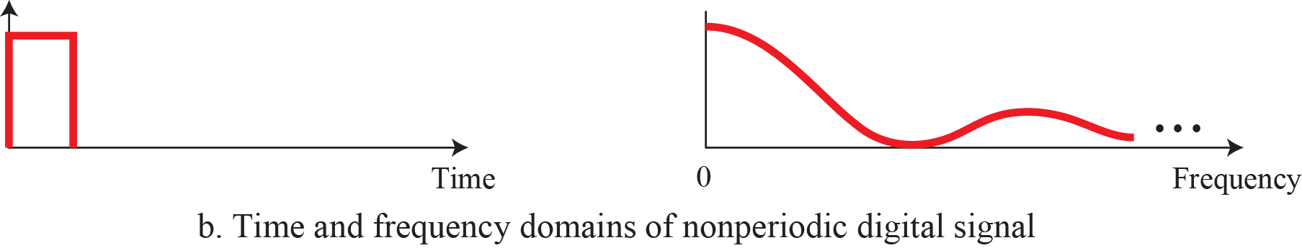
Digital Signal as Composite Analog Signal
Vertical line in the time domain: Frequency of infinity
Horizontal line in the time domain: Frequency of zero

Slide 59
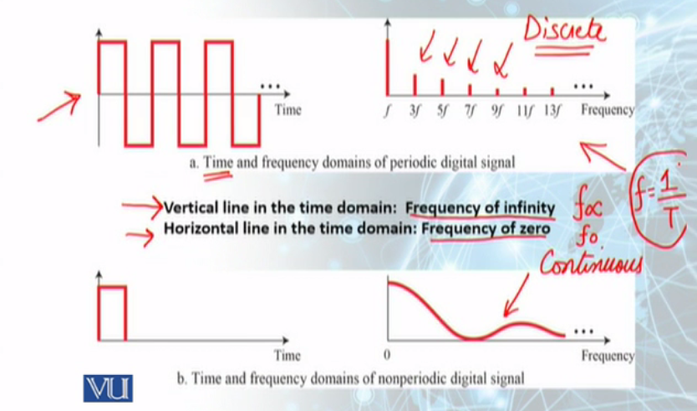
Digital Signal as Composite Analog Signal

Slide 60
Transmission of Digital Signals
Digital signal, periodic or non-periodic, is a composite analog signal with frequencies between zero and infinity (Infinite Bandwidth)
Two approaches for transmission:
  Baseband Transmission
  Broadband Transmission

Slide 61
Transmission of Digital Signals
A vertical line in the time domain means a frequency of infinity: a horizontal line in the time domain means a frequency of zero. Going from a frequency of zero to a frequency of infinity implies all frequencies in between are
part of the domain.

Slide 62
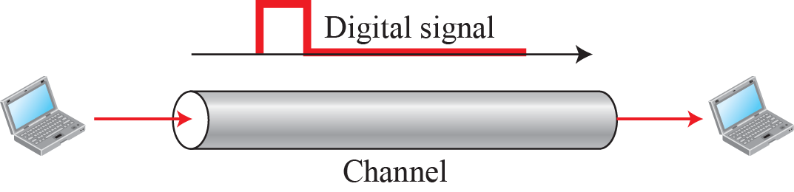
Baseband Transmission
Low Pass Channel
Sending a Digital Signal without changing it to an Analog Signal

Slide 63
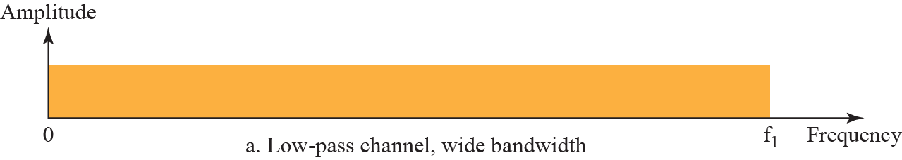
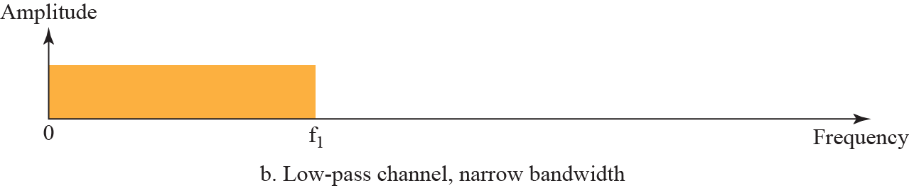
Baseband Transmission

Slide 64
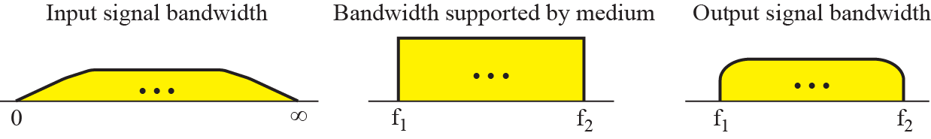
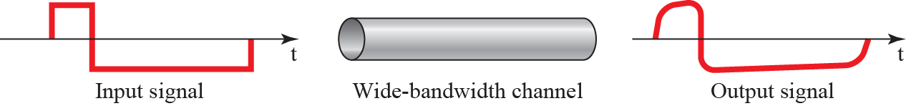
Baseband Transmission

Slide 65
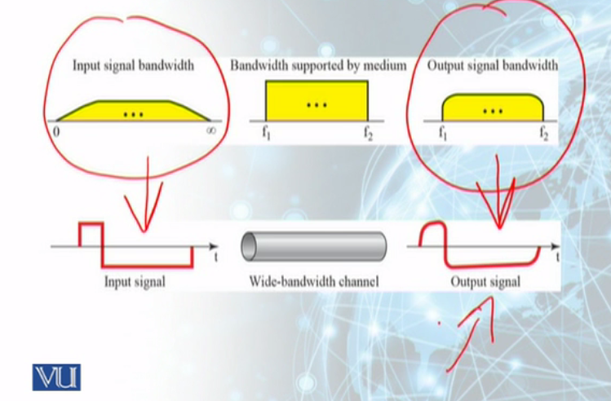
Baseband Transmission

Slide 66
Broadband Transmission (Modulation)
Changing the Digital signal to an Analog signal for transmission
Modulation allows us to use a bandpass channel—a channel with a bandwidth that does not start from zero
More available than a low-pass channel

Slide 67
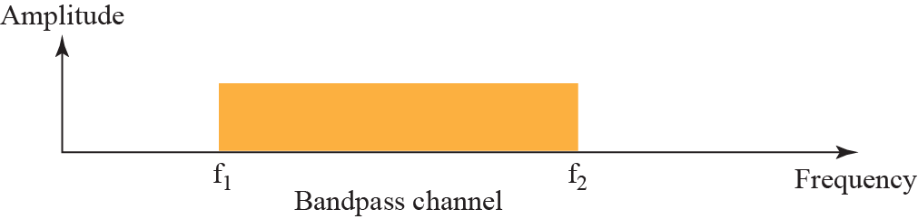
Broadband Transmission (Modulation)

Slide 68
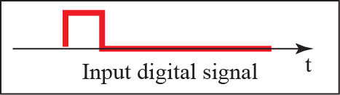
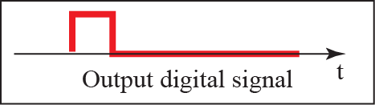
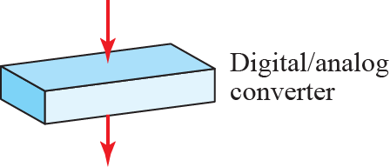
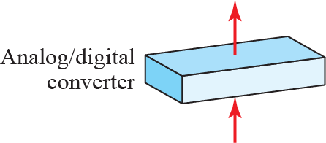
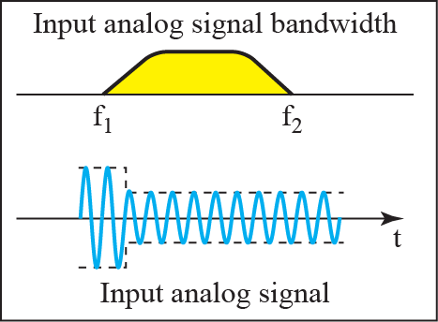
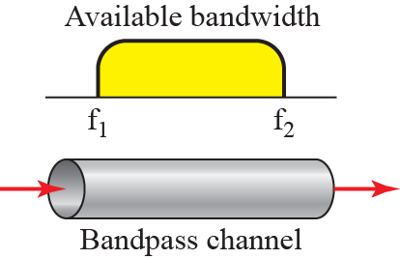
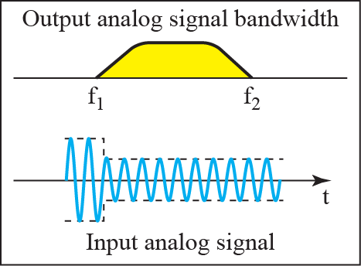
Broadband Transmission (Modulation)

Slide 69
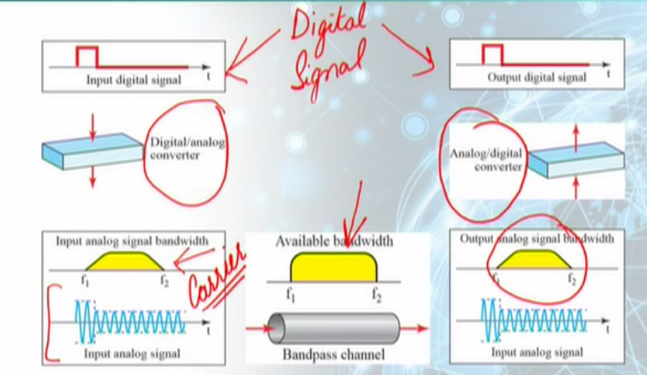
Broadband Transmission (Modulation)

Slide 70
Transmission Impairments
Transmission media are not perfect
Cause Signal impairments
Signal sent is not the same as the signal received

Slide 71
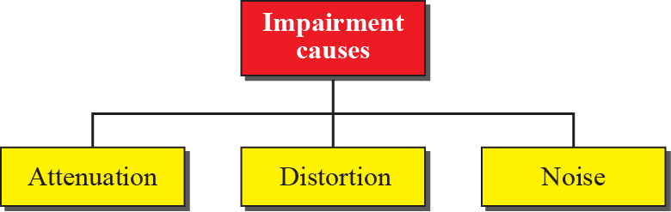
Causes of Transmission Impairment

Slide 72
Transmission Impairment
What is sent is not what is received. Three causes of impairment are attenuation, distortion, and noise (see Figure 3.26).

Slide 73
Transmission Impairment
Signals travel through transmission media, which are not perfect. The imperfection causes signal impairment. This means that the signal at the beginning of the medium is not the same as the signal at the end of the medium.

Slide 74
Attenuation
Attenuation means a loss of energy. When a signal, simple or composite, travels through a medium, it loses some of its energy in overcoming the resistance of the medium. That is why a wire carrying electric signals gets warm, if not hot, after a while. Some of the electrical energy in the signal is converted to heat.

Slide 75
Attenuation
To compensate for this loss, amplifiers are used to amplify the signal. Figure 3.27 shows the effect of attenuation and amplification..

Slide 76
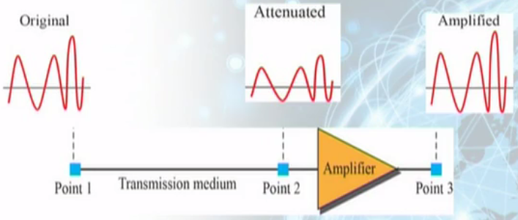
Attenuation and amplification
Figure 3.27

Slide 77
Example 3.26
Suppose a signal travels through a transmission medium and its power is reduced to one half. This means that P2 = 0.5 P1. In this case, the attenuation (loss of power) can be calculated as
A loss of 3 dB (−3 dB) is equivalent to losing one-half the power.

Slide 78

Example 3.27
A signal travels through an amplifier, and its power is increased 10 times. This means that P₂ = 10P1. In this case, the amplification (gain of power) can be calculated as

Slide 79
Example 3.28
One reason that engineers use the decibel to measure the changes in the strength of a signal is that decibel numbers can be added (or subtracted) when we are measuring several points (cascading) instead of just two. In Figure 3.28 a signal travels from point 1 to point 4. The signal is attenuated by the time it reaches point 2.

Slide 80

Example 3.28
Between points 2 and 3, the signal is amplified. Again, between points 3 and 4, the signal is attenuated. We can find the resultant decibel value for the signal just by adding the decibel measurements between each set of points. In this case, the decibel value can be calculated as

Slide 81
Example 3.29
Sometimes the decibel is used to measure signal power in milliwatts. In this case, it is referred to as dB_{m} and is calculated as dBm = 10 log10 Pm, where Pm is the power in milliwatts. Calculate the power of a signal if its dB_{m} = −30.

Slide 82
Example 3.29
Solution
We can calculate the power in the signal as

Slide 83
Example 3.30
Sometimes the decibel is used to measure signal power in milliwatts. In this case, it is referred to as dB_{m} and is calculated as dBm = 10 log10 Pm, where Pm is the power in milliwatts. Calculate the power of a signal if its dB_{m} = −30.

Slide 84
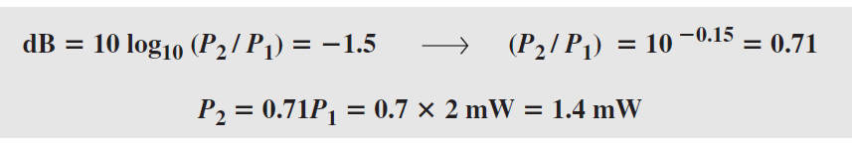
Example 3.30
Solution
The loss in the cable in decibels is 5 × (−0.3) = −1.5 dB. We can calculate the power as

Slide 85
Attenuation and Amplification - Decibel
Unit of Signal strength is Decibel or dB
Decibel (dB) measures the relative strengths of two signals or one signal at two different points
Decibel is negative if a signal is attenuated and positive if signal is amplified

Slide 86



Example
Suppose a signal travels through a transmission medium and its power is reduced to one half. This means that P2 = 0.5 P1. In this case, the attenuation (loss of power) can be calculated as

Slide 87

Example
A signal travels through an amplifier, and its power is increased 10 times. This means that P₂ = 10P1. In this case, the amplification (gain of power) can be calculated as

Slide 88
Distortion
Distortion means that the signal changes its form or shape.
Distortion can occur in a composite signal made of different frequencies.
Each signal component has its own propagation speed (see the next section) through a medium and, therefore, its own delay in arriving at the final destination.

Slide 89
Distortion
Differences in delay may create a difference in phase if the delay is not exactly the same as the period duration.

Slide 90

Distortion
Figure 3.29

Slide 91
Noise
Noise is another cause of impairment.
Several types of noise, such as thermal noise, induced noise, crosstalk, and impulse noise, may corrupt the signal.
Thermal noise is the random motion of electrons in a wire, which creates an extra signal not originally sent by the transmitter.

Slide 92
Noise
Induced noise comes from sources such as motors.
Crosstalk is the effect of one wire on the other.

Slide 93

Noise

Slide 94
Noise
Figure 3.31

Slide 95
Noise – Signal to Noise Ratio (SNR)
Signal to Noise Ratio (SNR) is used to find the theoretical bit rate limit of a signal

Slide 96


Noise – Signal to Noise Ratio (SNR)

Slide 97

Noise – Signal to Noise Ratio (SNR)

Slide 98

Example
The power of a signal is 10 mW and the power of the noise is 1 μW; what are the values of SNR and SNR_{dB?}

Slide 99


Example
The values of SNR and SNR_{dB} for a noiseless channel are calculated as

Slide 100
Example 3.31
The power of a signal is 10 mW and the power of the noise is 1 μW; what are the values of SNR and SNR_{dB?}
Solution
The values of SNR and SNR_{dB} can be calculated as follows:

Slide 101
Example 3.32
The values of SNR and SNR_{dB} for a noiseless channel are
Solution
The values of SNR and SNRdB for a noiseless channel are
We can never achieve this ratio in real life; it is an ideal.

Slide 102
Data Rate Limits
How fast we can send data, in bits per second, over a channel?
Data Rate depends on 3 factors:
  The Bandwidth available
  The level of the signals we use
  The level of noise

Slide 103
Data Rate Limits
Two theoretical formulas developed to calculate the data rate:
  one by Nyquist for a noiseless channel
  another by Shannon for a noisy channel

Slide 104


Noiseless Channel : Nyquist Rate
For a noiseless channel, the Nyquist bit rate formula defines the theoretical maximum bit rate
Finding balance between Bit rate and System Reliability

Slide 105

Example
Consider a noiseless channel with a bandwidth of 3000 Hz transmitting a signal with two signal levels. The maximum bit rate can be calculated as

Slide 106



Example
Consider the same noiseless channel transmitting a signal with four signal levels (for each level, we send 2 bits). The maximum bit rate can be calculated as

Slide 107

Noisy Channel : Shannon Capacity
In reality, we cannot have a noiseless channel; the channel is always noisy
In 1944, Claude Shannon introduced a formula, to determine the theoretical highest data rate for a noisy channel:

Slide 108


Example
Consider an extremely noisy channel in which the value of the signal-to-noise ratio is almost zero. In other words, the noise is so strong that the signal is faint. For this channel the capacity C is calculated as

Slide 109

Example
Theoretical highest bit rate of a Telephone line with a Bandwidth of 3000 Hz assigned for data communication. SNR is usually 3162. The capacity is calculated as:

Slide 110
Using Both Limits
In practice, we need to use both methods to find the limits and signal levels
Shannon’s formula gives us the upper limit while the Nyquist formula gives us the signal levels

Slide 111
Example 3.37
Consider an extremely noisy channel in which the value of the signal-to-noise ratio is almost zero. In other words, the noise is so strong that the signal is faint. For this channel the capacity C is calculated as

Slide 112
Example 3.37
This means that the capacity of this channel is zero regardless of the bandwidth. In other
words, we cannot receive any data through this channel.

Slide 113
Example 3.38
This means that the capacity of this channel is zero regardless of the bandwidth. In other
words, we cannot receive any data through this channel.

Slide 114
Example 3.38
This means that the highest bit rate for a telephone line is 34.860 kbps. If we want to send data faster than this, we can either increase the bandwidth of the line or improve the signal-to-noise ratio.

Slide 115
Example 3.39
The signal-to-noise ratio is often given in decibels. Assume that SNR_{dB} = 36 and the channel bandwidth is 2 MHz. The theoretical channel capacity can be calculated as

Slide 116

Example 3.39

Slide 117

Example 3.40
When the SNR is very high, we can assume that SNR + 1 is almost the same as SNR. In these cases, the theoretical channel capacity can be simplified to C 5 B 3 SNR_{dB.} For example, we can calculate the theoretical capacity of the previous example as

Slide 118
Using Both Limits
In practice, we need to use both methods to find the limits and signal levels. Let us show this with an example.

Slide 119
Example 3.41
We have a channel with a 1-MHz bandwidth. The SNR for this channel is 63. What are the appropriate bit rate and signal level?
Solution
First, we use the Shannon formula to find the upper limit.

Slide 120

Example 3.41
The Shannon formula gives us 6 Mbps, the upper limit. For better performance we choose something lower, 4 Mbps. Then we use the Nyquist formula to find the number of signal levels

Slide 121
Network Performance
Data transmission (in form of Signal) over a network and how network behaves is important
More important is the performance of the network
How good is our network?

Slide 122
Network Performance
Network Performance
Bandwidth
Throughput
Latency
There are 3 characteristics of network performance

Slide 123
Bandwidth
An important characteristic that measures Network Performance
Bandwidth can be used in two different contexts with two different measuring values:
  Bandwidth in Hertz
  Bandwidth in bits per second

Slide 124
Example 3.42
The bandwidth of a subscriber line is 4 kHz for voice or data. The bandwidth of this line for data transmission
can be up to 56,000 bps using a sophisticated modem to change the digital signal to analog.

Slide 125
Example 3.43
If the telephone company improves the quality of the line and increases the bandwidth to 8 kHz, we can send 112,000 bps by using the same technology as mentioned in Example 3.42.

Slide 126
Bandwidth
Bandwidth
Bandwidth in Hertz
Bandwidth in bps
Range of frequencies
in a composite signal
No. of bits a channel, link
or network can transmit

Slide 127
Throughput
Measure of how fast we can actually send data through a network.
Bandwidth is not the same as Throughput
A link may have a bandwidth of B bps, but we can only send T bps through this link with T always less than B

Slide 128


Example
A network with bandwidth of 10 Mbps can pass only an average of 12,000 frames per minute with each frame carrying an average of 10,000 bits. What is the throughput of this network?

Slide 129
Throughput
The throughput is a measure of how fast we can actually send data through a network. Although, at first glance, bandwidth in bits per second and throughput seem the same, they are different. A link may have a bandwidth of B bps, but we can only send T bps through this link with T always less than B.

Slide 130
Throughput
The latency or delay defines how long it takes for an entire message to completely arrive at the destination from the time the first bit is sent out from the source.

Slide 131
Throughput
We can say that latency is made of four components: propagation time, transmission time, queuing time and processing delay.
Latency = propagation time + transmission time + queuing time + processing delay

Slide 132
Example 3.44
A network with bandwidth of 10 Mbps can pass only an average of 12,000 frames per minute with each frame carrying an average of 10,000 bits. What is the throughput of this network?

Slide 133
Example 3.44
Solution
We can calculate the throughput as
Throughput =
(12,000X10,000)/60 = 2Mbps
The throughput is almost one-fifth of the bandwidth in this case.

Slide 134
Example 3.45
What is the propagation time if the distance between the two points is 12,000 km? Assume the propagation speed to be 2.4 × 108 m/s in cable.
Solution
We can calculate the propagation time as
Propagation time =
(12,000X10,000)/(2.4X2⁸)=
50 ms

Slide 135
Example 3.45
The example shows that a bit can go over the Atlantic Ocean in only 50 ms if there is a direct cable between the source and the destination.

Slide 136
Example 3.46
What are the propagation time and the transmission time for a 2.5-KB (kilobyte) message if the bandwidth of the network is 1 Gbps? Assume that the distance between the sender and the receiver is 12,000 km and that light travels at 2.4 × 108 m/s.

Slide 137
Example 3.46
Solution
We can calculate the propagation and transmission time as
Propagation time = (12,000 X 1000)/ (2.4X 10⁸) = 50 ms
Transmission time = (2500 X 8 ) / 10⁹ = 0.020 ms

Slide 138
Example 3.46
Solution
Note that in this case, because the message is short and the bandwidth is high, the dominant factor is the propagation time, not the transmission time.

Slide 139
Example 3.47
What are the propagation time and the transmission time for a 5-MB (megabyte) message (an image) if the bandwidth of the network is 1 Mbps? Assume that the distance between the sender and the receiver is 12,000 km and that light travels at 2.4 × 108 m/s.

Slide 140
Example 3.47
Solution
We can calculate the propagation and transmission times as
Propagation time =
(12,000 X 1000) / (2.4 X 10⁸) = 50 ms
Transmission time = (5,000,000 X 8) / 106 = 40s
We can calculate the propagation and transmission times as

Slide 141

Latency or Delay
Latency or delay defines how long it takes for an entire message to completely arrive at the destination from the time the first bit is sent out from the source

Slide 142

Example
What is the propagation time if the distance between the two points is 12,000 km? Assume the propagation speed to be 2.4 × 10⁸ m/s in cable.

Slide 143
Delay – Bandwidth Delay Product
Bandwidth and delay are two performance metrics of a link
Product of the two, The Bandwidth-Delay Product defines the number of bits that can fill a link

Slide 144


Bandwidth-Delay Product
Case 1

Slide 145

Bandwidth-Delay Product
Case 2

Slide 146



Bandwidth-Delay Product

Slide 147
Example 3.48
We can think about the link between two points as a pipe. The cross section of the pipe represents the bandwidth, and the length of the pipe represents the delay. We can say the volume of the pipe defines the bandwidth-delay product, as shown in Figure 3.34.

Slide 148
Delay - Jitter
Jitter is a problem if different packets of data encounter different delays and the application using the data at the receiver site is time-sensitive (audio and video data, for example)

Slide 149
Delay - Jitter
Delay for first packet is 20 ms for the second is 45 ms, and for the third is 40 ms, then the real-time application that uses the packets endures jitter

