Slide 1
Digital-to-digital Conversion
Data → Analog or Digital
Signals → Analog or Digital
Digital Transmission
Analog Transmission

Slide 2
Digital Transmission
Digital Transmission
Digital to Digital Conversion
Analog to Digital Conversion

Slide 3
Digital to Digital Conversion
Digital to Digital Conversion
Line Coding
Block Coding
Scrambling
Always Needed
May not be needed
May not be needed

Slide 4
Signal Element versus Data Element
A Data element is the smallest entity that can represent a piece of information → Bit
A Signal element is the shortest unit of a digital signal
Data Elements: Carried
Signal Elements: Carriers

Slide 5
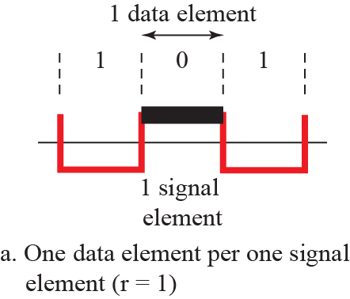
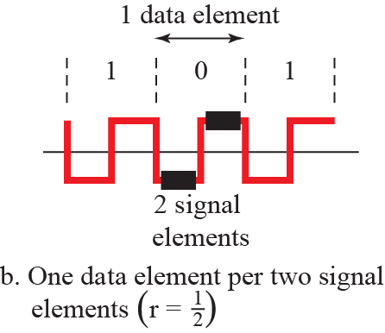
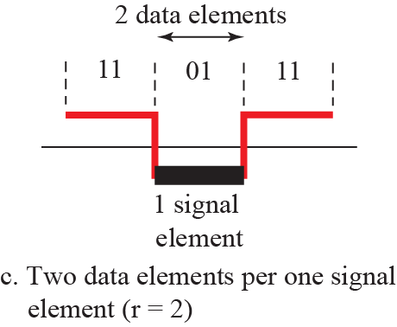
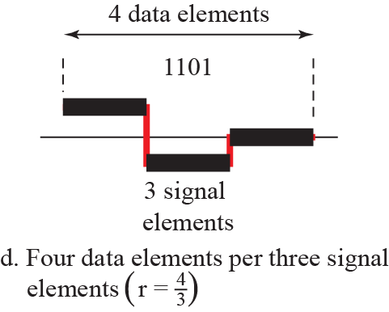
Signal Element versus Data Element

Slide 6
Data Rate versus Signal Rate
Data Rate is number of data elements sent in 1 sec (bps)
Signal Rate is number of signal elements sent in 1 sec (baud)
Data Rate → Bit Rate
Signal Rate → Pulse Rate, Modulation Rate or Baud Rate

Slide 7
Example
A signal has a signal rate of 100 bauds. What is the Data rate if one data element is carried per signal element?

Slide 8
Line Coding
Digital data to Digital signals
Data (Text, Numbers, Pictures, Audio, or Video) is stored in computer memory as sequences of bits
Line coding converts a sequence of Bits to a Digital Signal

Slide 9
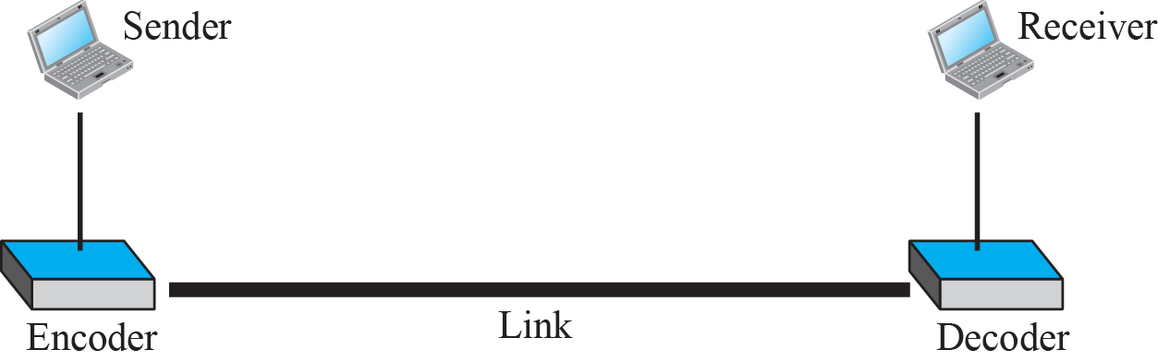
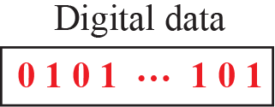
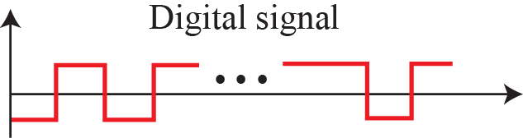
Line Coding and Decoding

Slide 10
Line Coding Schemes
We can roughly divide line coding schemes into five broad categories

Slide 11
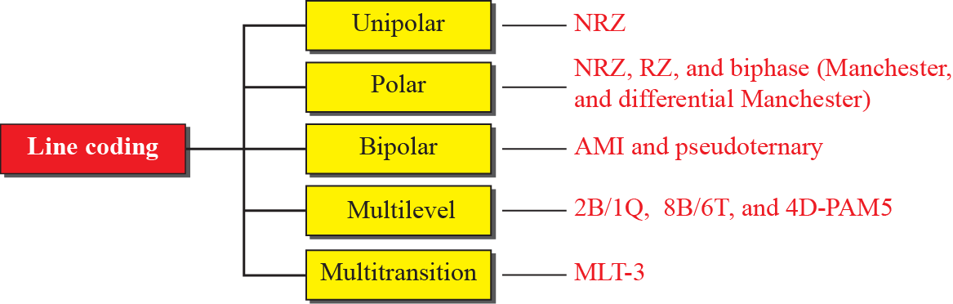
Line Coding Schemes

Slide 12
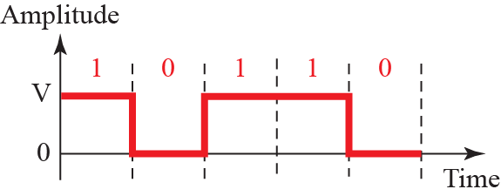
Unipolar NRZ scheme

Slide 13
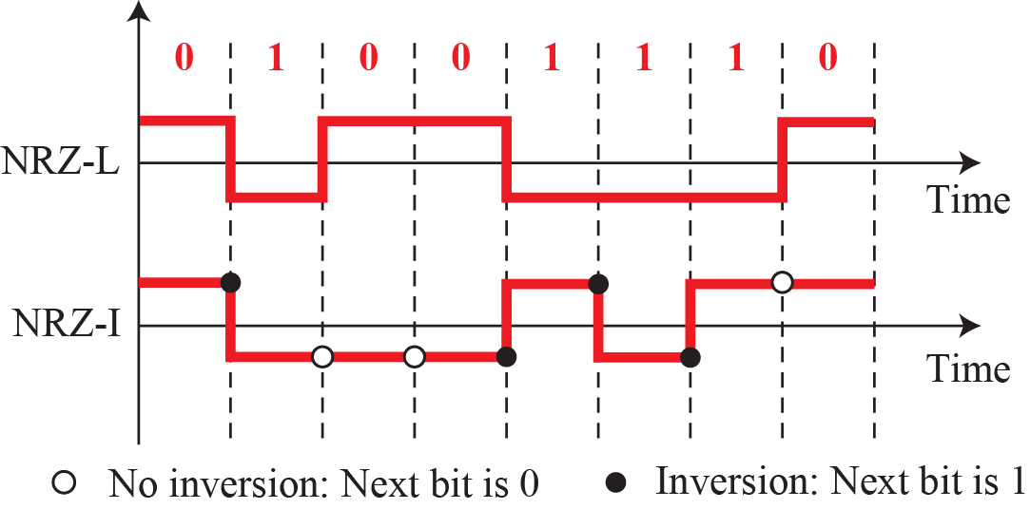
Polar schemes (NRZ)

Slide 14
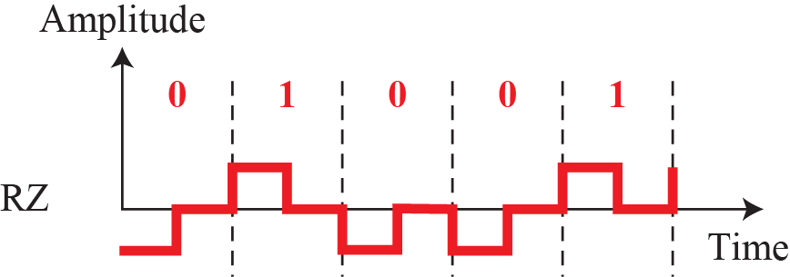
Polar schemes (RZ)

Slide 15
Line Coding Schemes
We can roughly divide line coding schemes into five broad categories

Slide 16
Line Coding Schemes

Slide 17
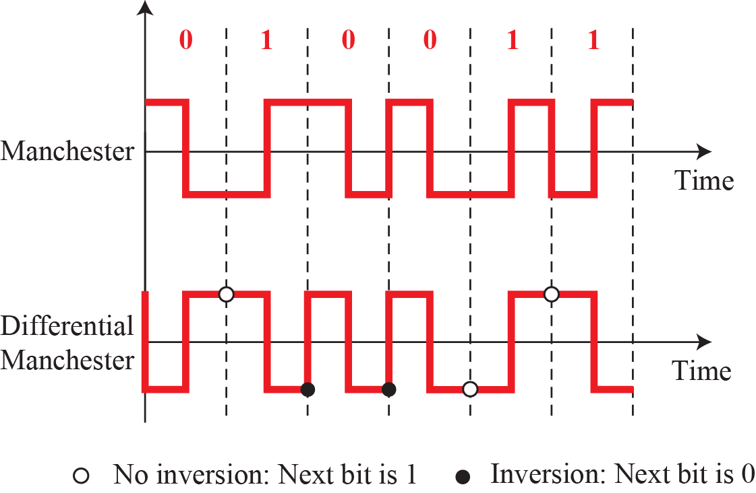
Polar Biphase

Slide 18
Line Coding Schemes
We can roughly divide line coding schemes into five broad categories

Slide 19
Line Coding Schemes

Slide 20
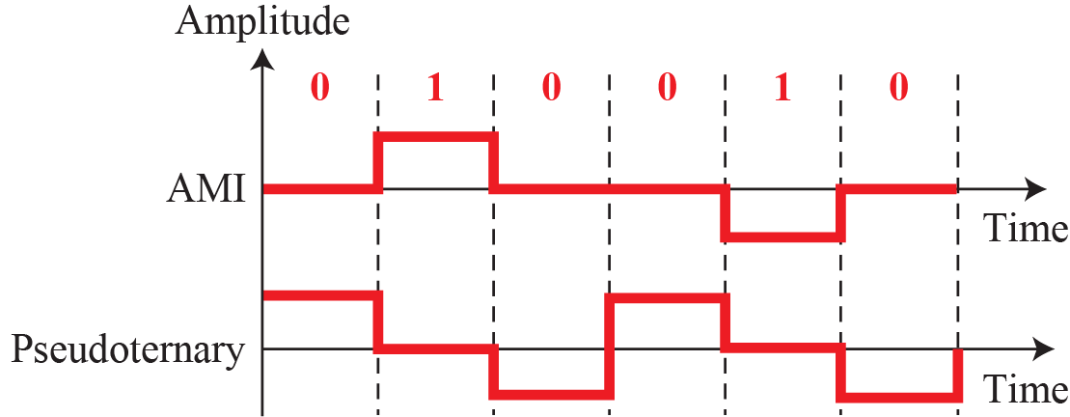
Bipolar schemes: AMI & Pseudoternary

Slide 21
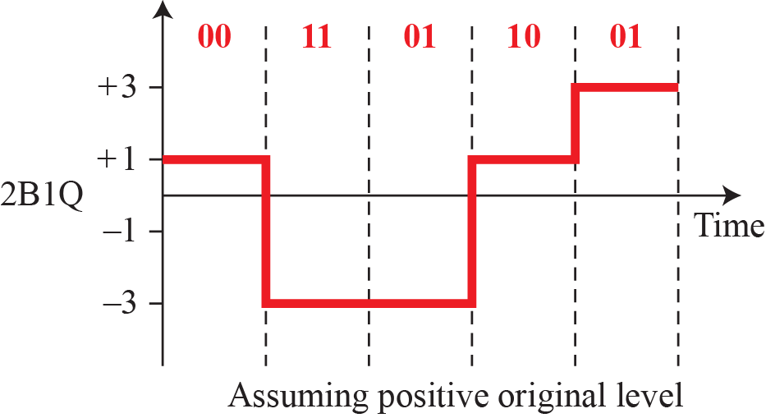
Multilevel: 2B1Q

Slide 22
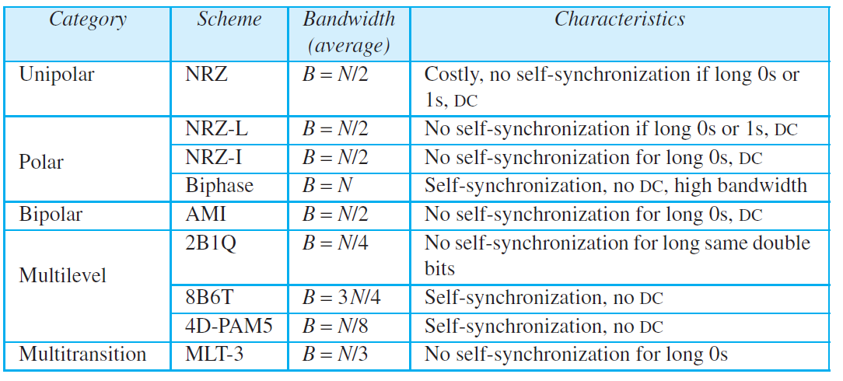
Table 4.1 : Summary of line coding schemes

