Slide 1
Digital-to-Analog Conversion
Process of changing one of the characteristics of analog signal based on the information in digital data
A sine wave is defined by 3 characteristics:
  Amplitude
  Frequency
  Phase
By changing one of these characteristics, we can use it to represent a digital signal

Slide 2
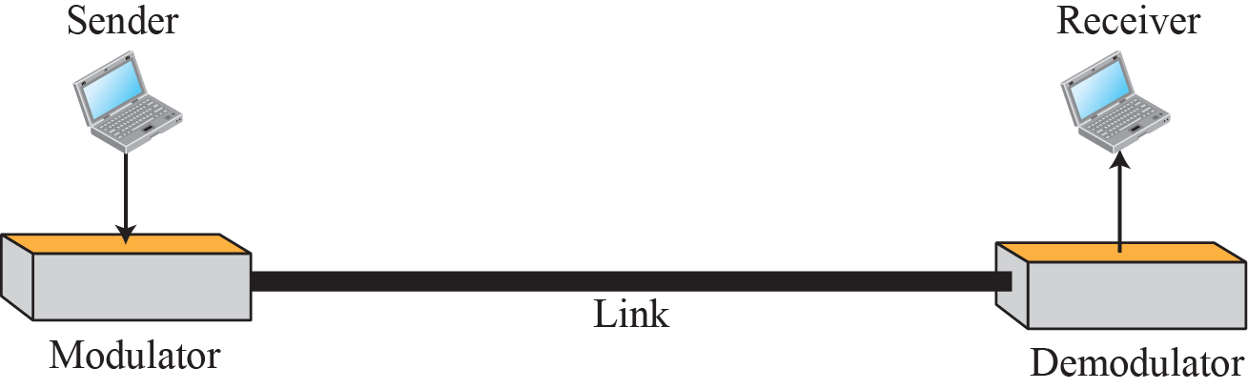
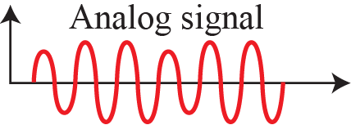
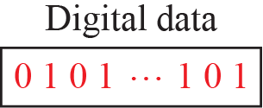
Digital-to-Analog Conversion

Slide 3
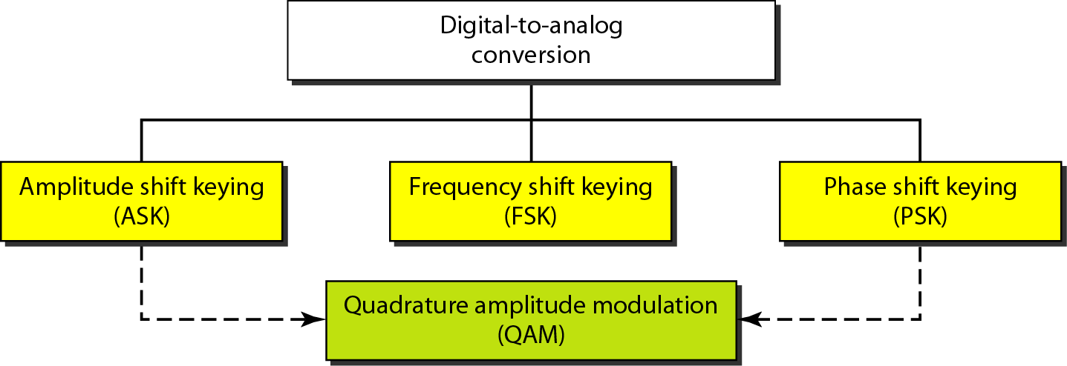
Types of Digital to Analog Conversion

Slide 4
Aspects of Digital to Analog Conversion
Before we discuss specific methods of digital-to-analog modulation, two basic issues must be reviewed:
  Bit and Baud rates and
  The Carrier Signal

Slide 5
Aspects of Digital to Analog Conversion
In Analog Transmission of Digital Data, Baud Rate is less than or equal to the Bit Rate
  Data Element vs. Signal Element
  Data Rate vs. Signal Rate
Bandwidth Required ∝ Signal Rate (except FSK)
Carrier Signal

Slide 6
Aspects of Digital to Analog Conversion
Before we discuss specific methods of digital-to-analog modulation, two basic issues must be reviewed:
  Bit and Baud rates and
  The Carrier Signal

Slide 7
Example
An analog signal carries 4 bits per signal element. If 1000 signal elements are sent per second, find the bit rate?

Slide 8
Example
An analog signal has a bit rate of 8000 bps and a baud rate of 1000 baud. How many data elements are carried by each signal element? How many signal elements do we need?

Slide 9
Amplitude Shift Keying (ASK)
The amplitude of the carrier signal is varied to create signal elements
Both frequency and phase remain constant while the amplitude changes
Binary ASK or On-Off Keying (OOK)

Slide 10
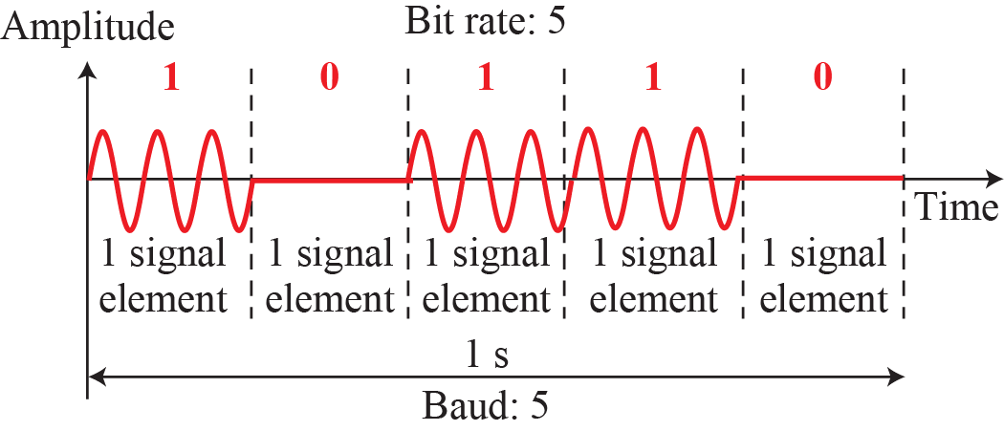
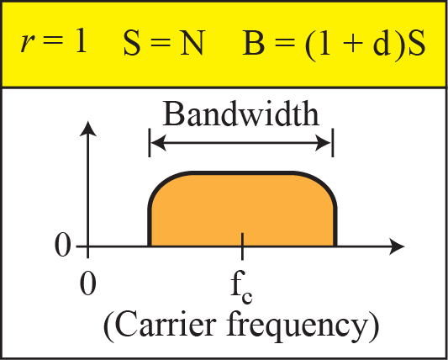
Binary Amplitude Shift Keying (Binary ASK)

Slide 11
Amplitude Shift Keying (ASK)
The amplitude of the carrier signal is varied to create signal elements
Both frequency and phase remain constant while the amplitude changes
Binary ASK or On-Off Keying (OOK)

Slide 12
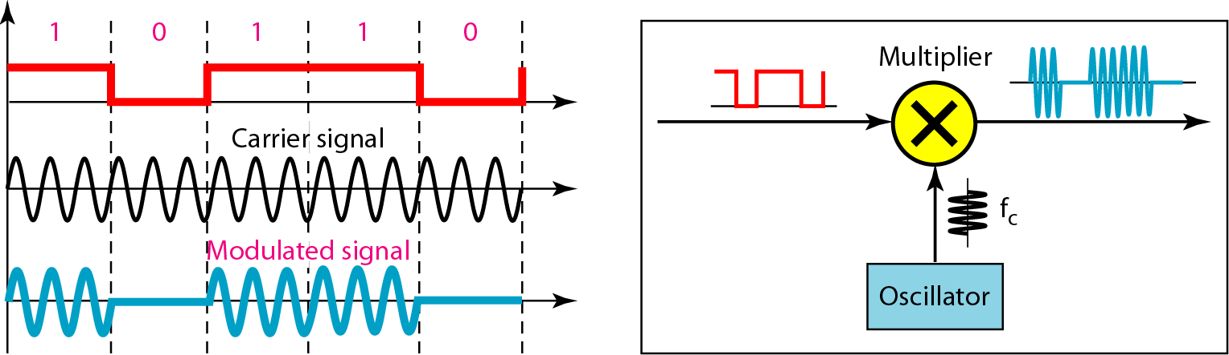
Implementation of Binary ASK

Slide 13
Example
We have an available bandwidth of 100 kHz which spans from 200 to 300 kHz. What are the carrier frequency and the bit rate if we modulated our data by using ASK with d = 1?

Slide 14
Frequency Shift Keying (FSK)
The frequency of the carrier signal is varied to represent data
The frequency of the modulated signal is constant for the duration of one signal element, but changes for the next signal element if the data element changes
Both peak amplitude and phase remain constant

Slide 15
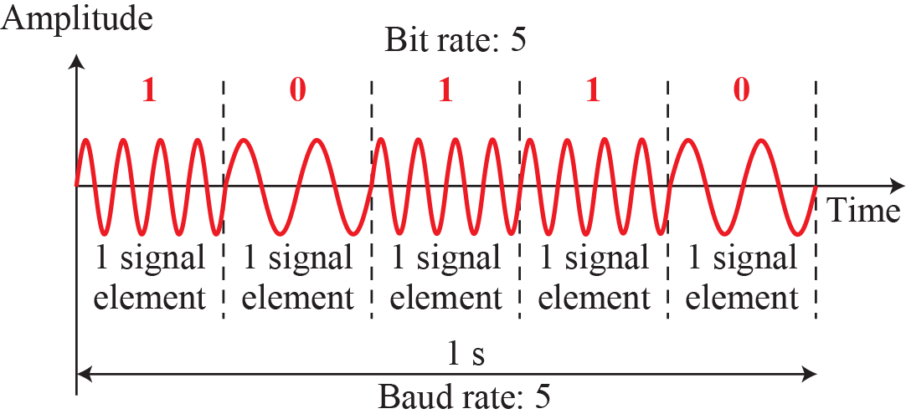
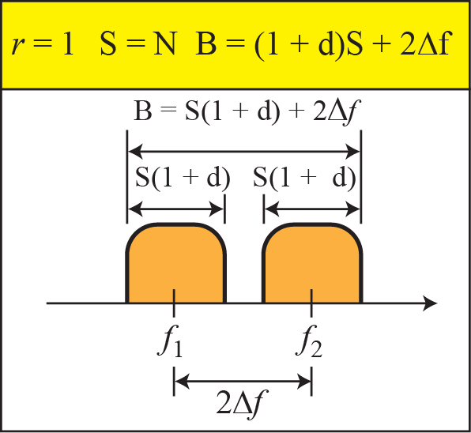
Binary Frequency Shift Keying

Slide 16
Frequency Shift Keying (FSK)
The frequency of the carrier signal is varied to represent data
Both peak amplitude and phase remain constant

Slide 17
Example
We have an available bandwidth of 100 kHz which spans from 200 to 300 kHz. What should be the carrier frequency and the bit rate if we modulated our data by using FSK with d = 1?

Slide 18
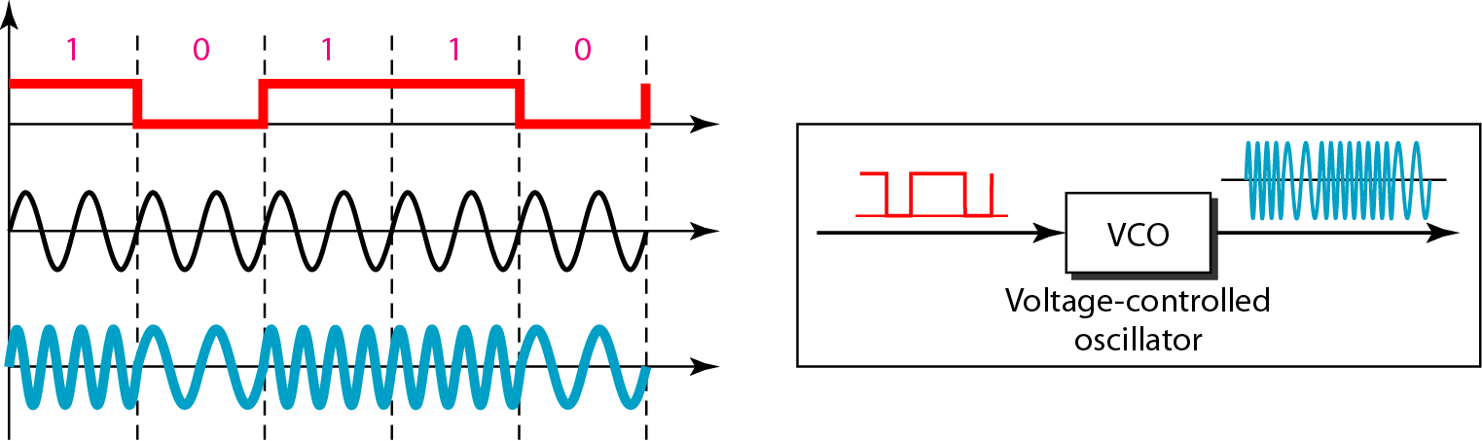
Implementation of BFSK

Slide 19
Phase Shift Keying (PSK)
The phase of the carrier is varied to represent two or more different signal elements
Both peak amplitude and frequency remain constant
PSK is relatively common than ASK or FSK

Slide 20
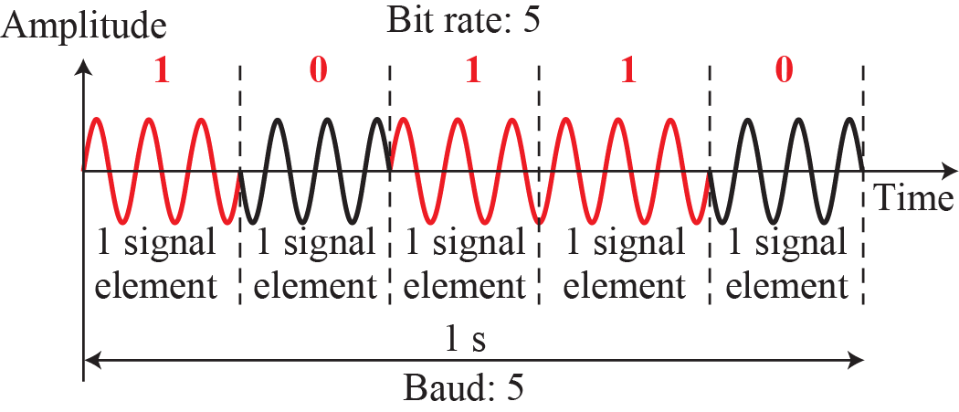
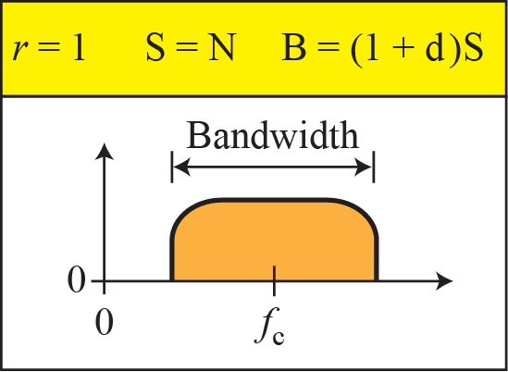
Binary Phase Shift Keying

Slide 21
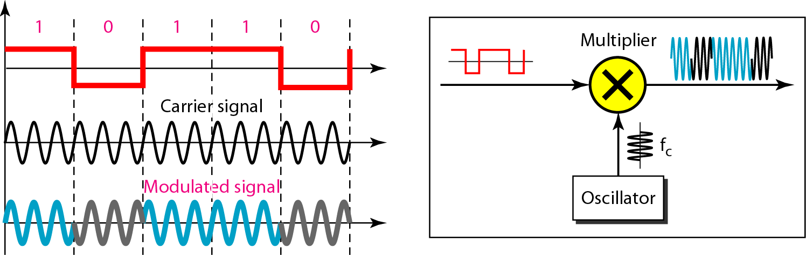
Implementation of BPSK

Slide 22
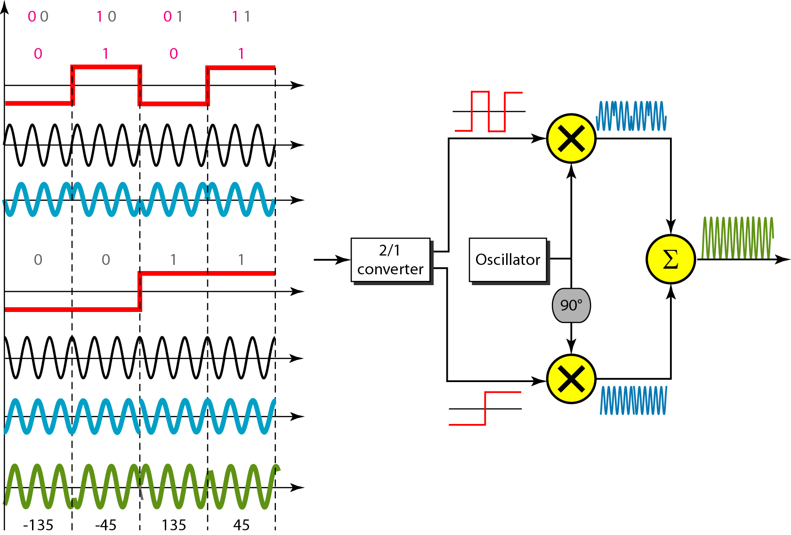
QPSK and its Implementation

Slide 23
Example
Find the bandwidth for a signal transmitting at 12 Mbps for QPSK. The value of d = 0.

Slide 24
Constellation Diagram
Helps us define the phase and amplitude of a signal element when we are using two carriers (one in phase and other in quadrature)
Signal element is represented as a dot

Slide 25
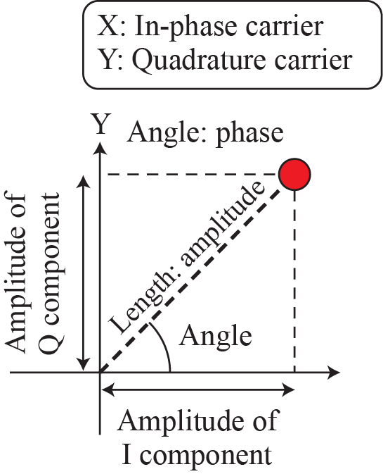
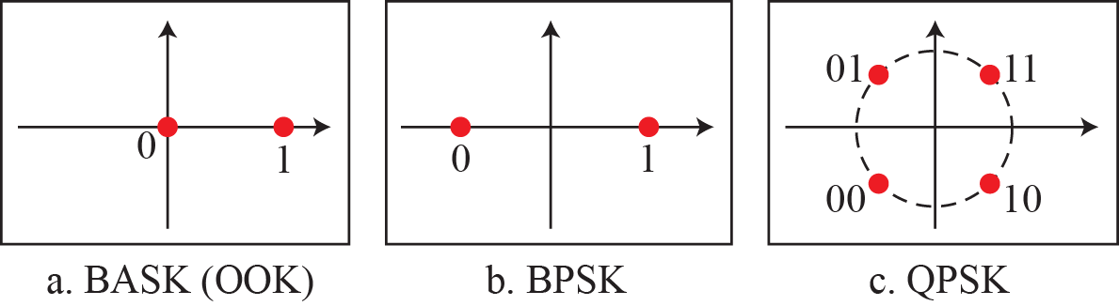
Constellation Diagram

Slide 26
Quadrature Amplitude Modulation (QAM)
PSK is limited by the ability of the equipment to distinguish small differences in phase which limits its potential bit rate
We have been altering only one of the three characteristics of a sine wave at a time; but what if we alter two?
Why not combine ASK and PSK?

Slide 27
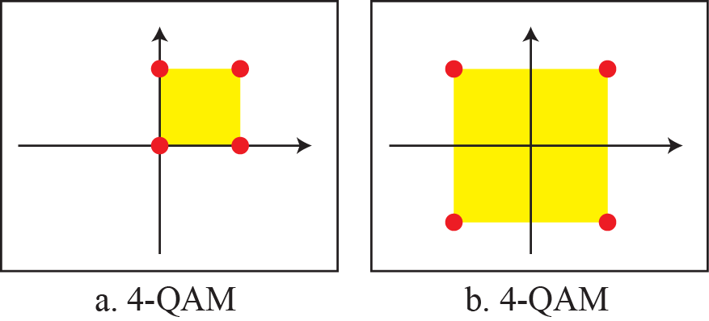
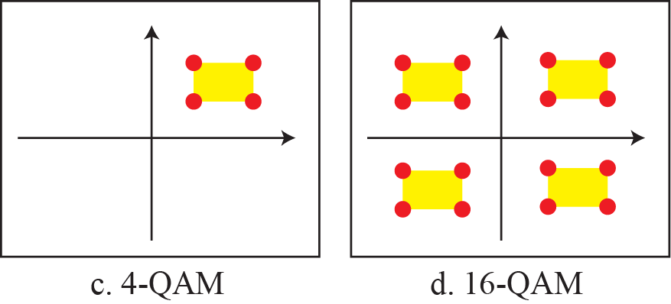
Constellation diagrams for some QAMs

Slide 28
Analog-to-Analog Conversion
Representation of Analog information by an Analog signal
Amplitude Modulation (AM)
Frequency Modulation (FM)
Phase Modulation (PM)

Slide 29
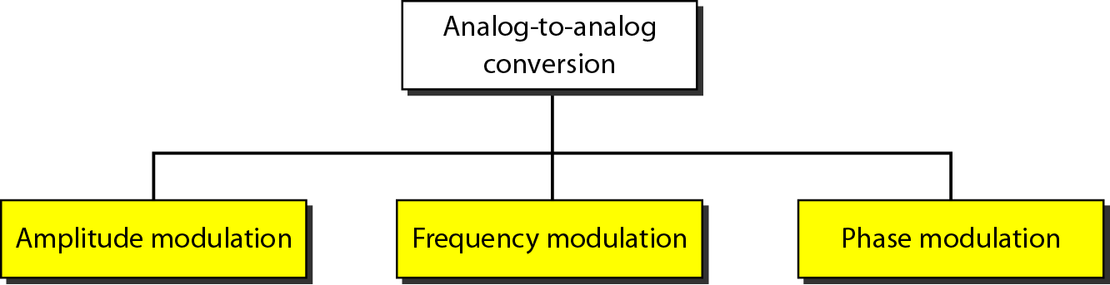
Types of Analog-to-Analog Modulation

Slide 30
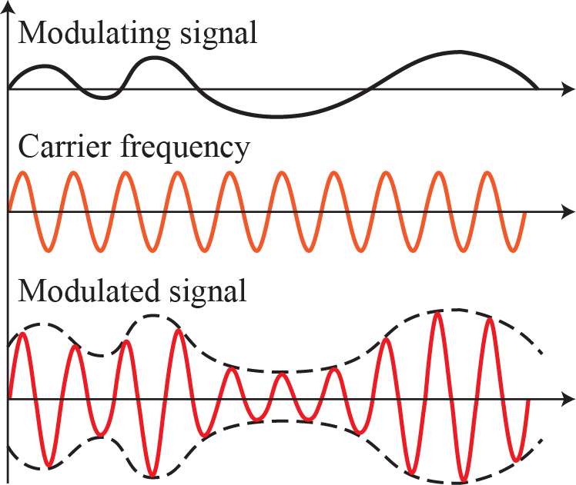
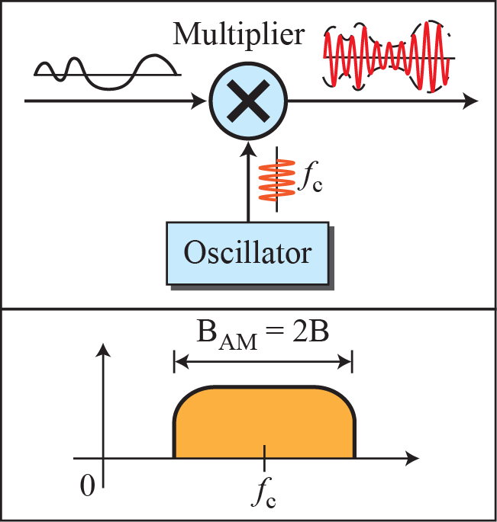
Amplitude modulation

Slide 31
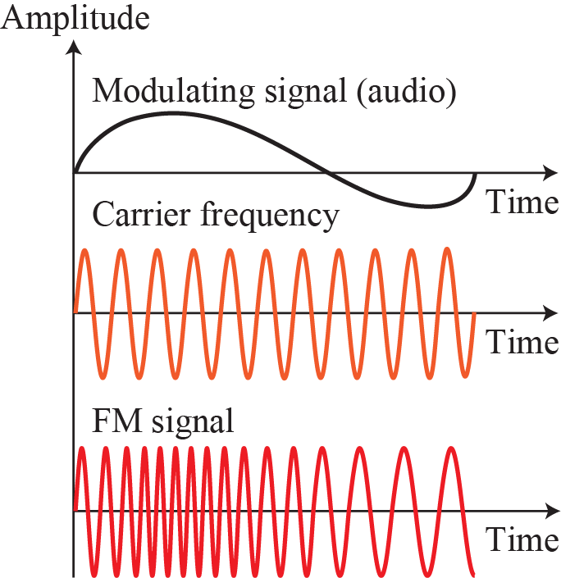
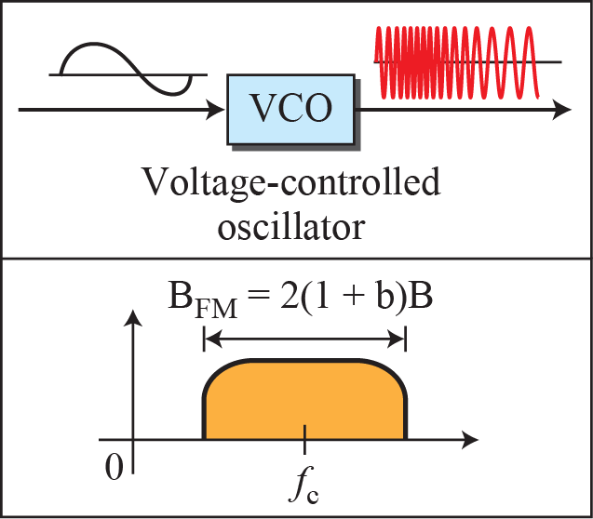
Frequency Modulation

Slide 32
Analog-to-Analog Conversion
Representation of Analog information by an Analog signal
Amplitude Modulation (AM)
Frequency Modulation (FM)
Phase Modulation (PM)

Slide 33
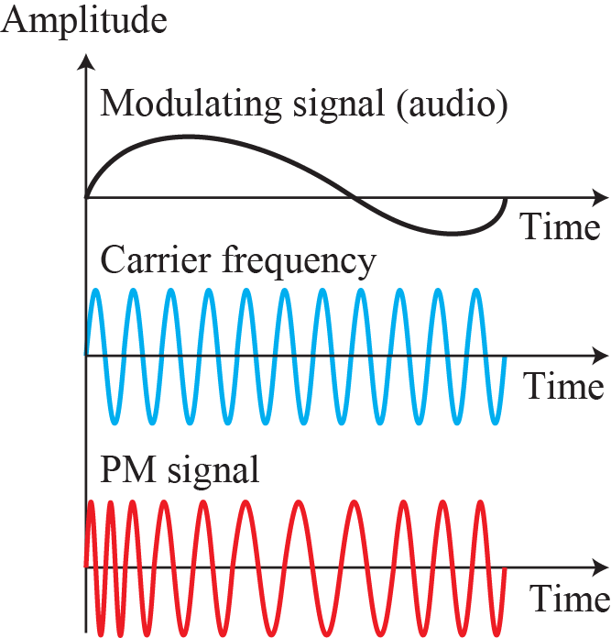
Phase Modulation

