Slide 1
Transmission Media
Located below the physical layer and are directly controlled by the physical layer
Belong to layer zero
Metallic Media i.e. Twisted pair and Coaxial Cable
Optical Fiber Cable
Free Space i.e. Air, Vaccum

Slide 2

Transmission Media & Physical Payer

Slide 3
Transmission Media
Located below the physical layer and are directly controlled by the physical layer
Belong to layer zero
Metallic Media i.e. Twisted pair and Coaxial Cable
Optical Fiber Cable
Free Space i.e. Air, Vaccum

Slide 4
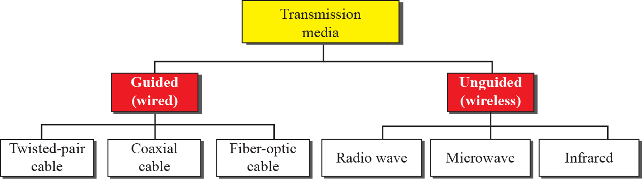
Classes of Transmission Media

Slide 5
Guided Media
Media that provides a conduit from one device to another
Twisted-pair cable, coaxial cable, and fiber-optic cable
Signal traveling along any of these media is directed and contained by the physical limits of the medium

Slide 6
Twisted-Pair Cable
Consists of 2 copper conductors, each with its own plastic insulation, twisted together
One wire carries signals and other is ground reference
Receiver uses difference between the two
Interference (Noise) & Crosstalk

Slide 7

Twisted-Pair Cable

Slide 8
Twisted-Pair Cable
UTP
STP

Slide 9
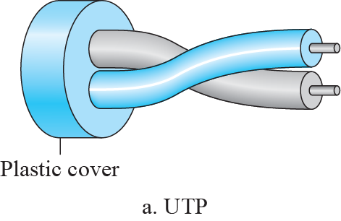
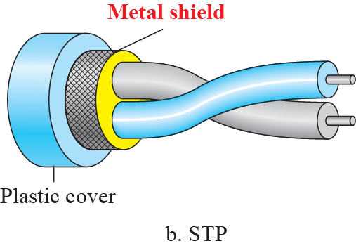
Unshielded vs. Shielded Twisted Pair Cable

Slide 10
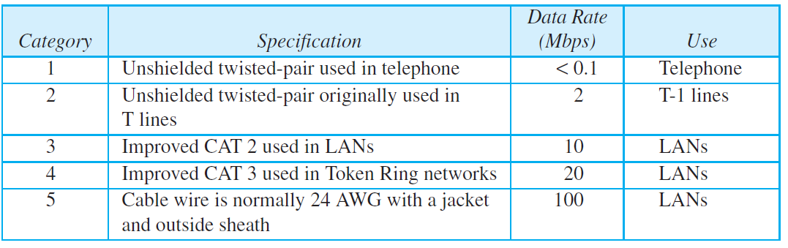
Categories of Unshielded Twisted-Pair Cables

Slide 11
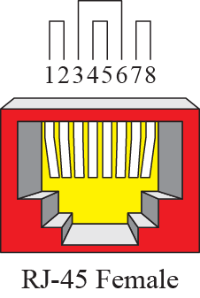
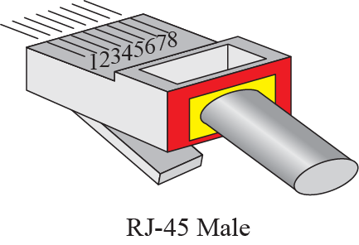
UTP Connectors

Slide 12
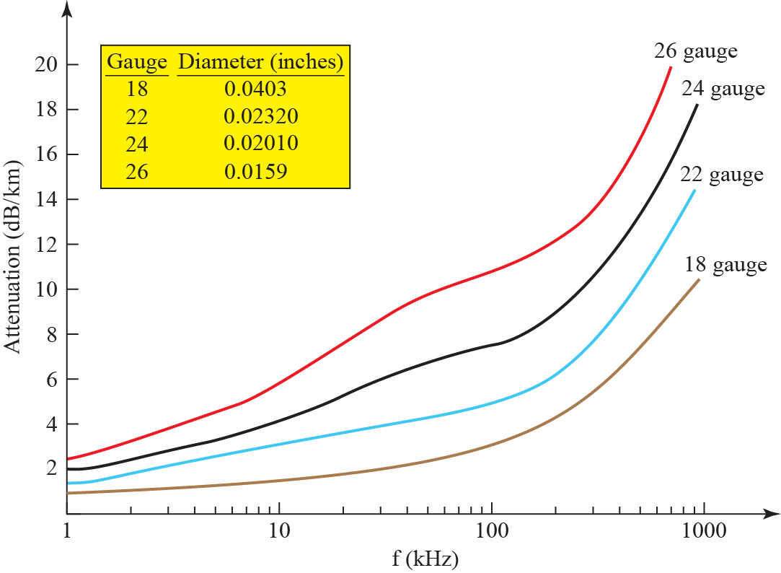
UTP Performance

Slide 13
Coaxial Cable
Carries signals of higher frequency ranges than those in twisted pair cable

Slide 14
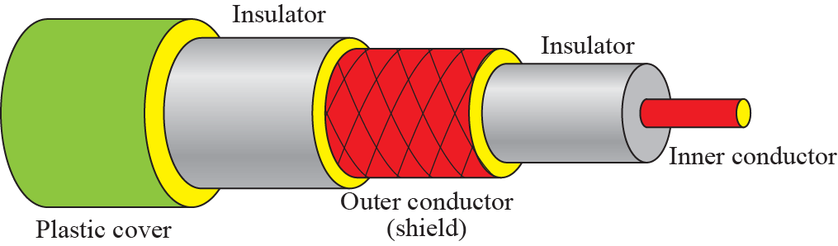
Coaxial Cable

Slide 15
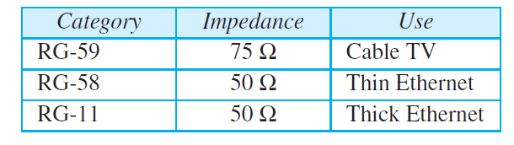
Categories of Coaxial Cables

Slide 16
Coaxial Cable
Carries signals of higher frequency ranges than those in twisted pair cable

Slide 17
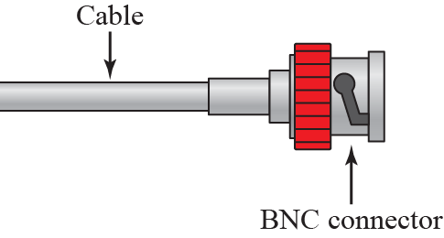
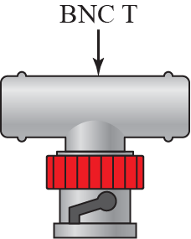
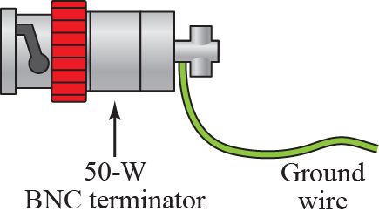
BNC Connectors

Slide 18
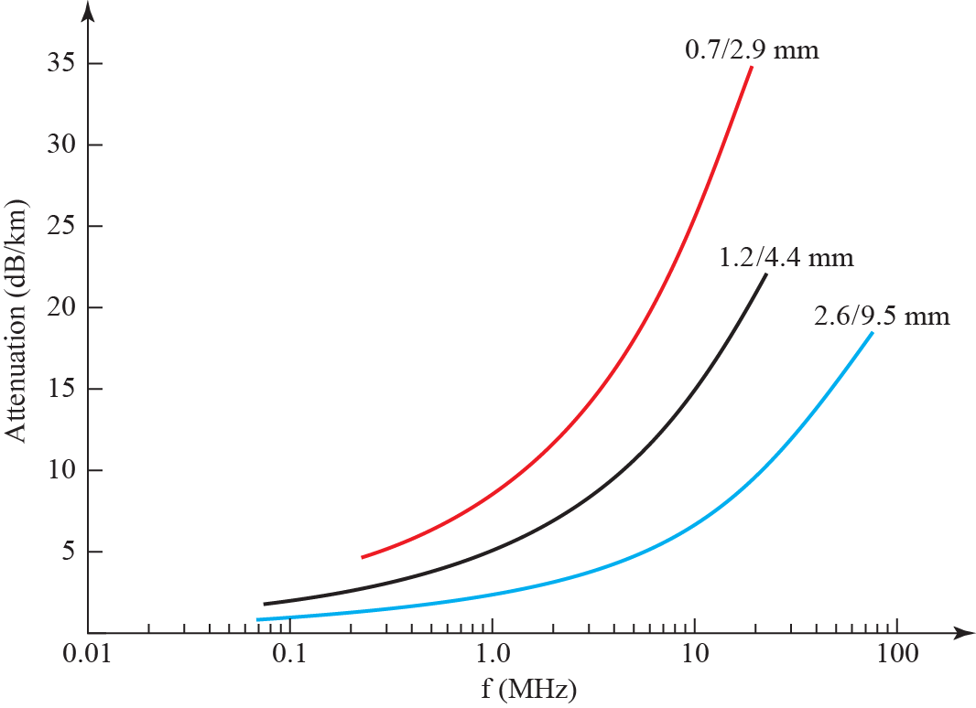
Coaxial Cable Performance

Slide 19
Fiber-Optic Cable
Made of glass or plastic and transmits signals in the form of light
Light travels in a straight line as long as it is moving through a single uniform substance
If a ray of light traveling through one substance suddenly enters another substance (of a different density), the ray changes direction

Slide 20
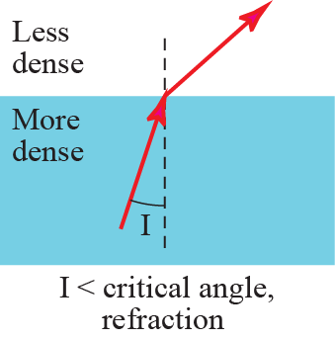
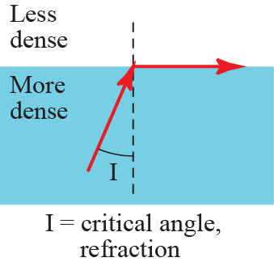
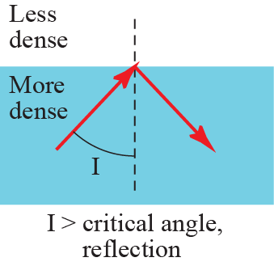
Bending of Light Ray

Slide 21
Fiber-Optic Cable
Made of glass or plastic and transmits signals in the form of light

Slide 22
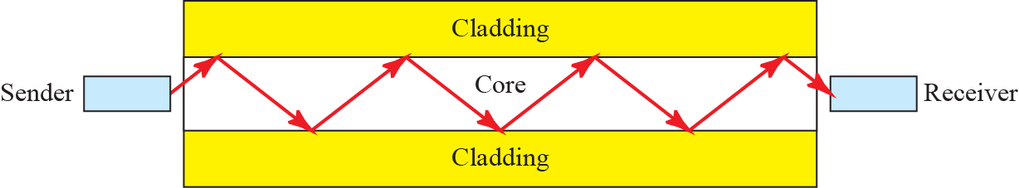
Optical Fiber

Slide 23
Fiber-Optic Cable
Made of glass or plastic and transmits signals in the form of light

Slide 24
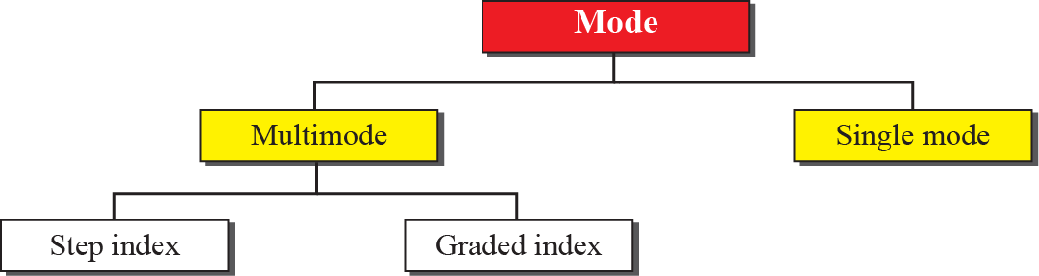
Propagation Modes

Slide 25

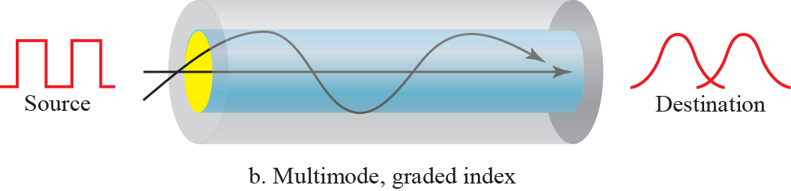

Modes

Slide 26
Fiber-Optic Cable
Made of glass or plastic and transmits signals in the form of light

Slide 27
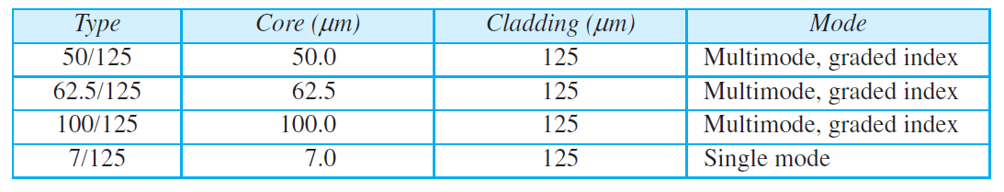
Fiber Types

Slide 28
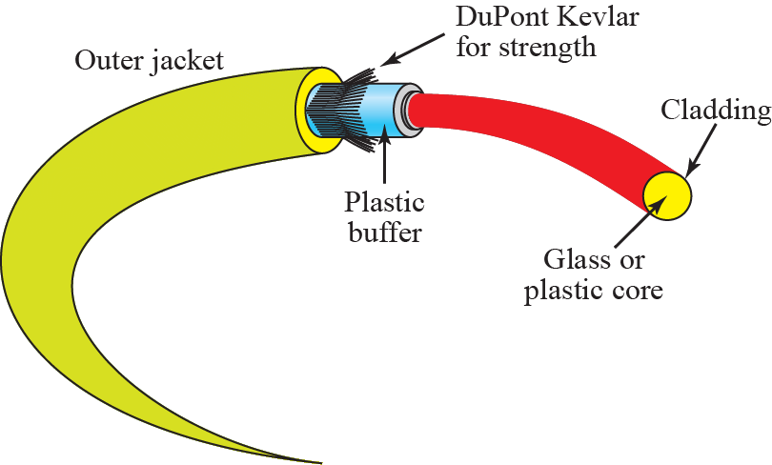
Fiber Composition

Slide 29
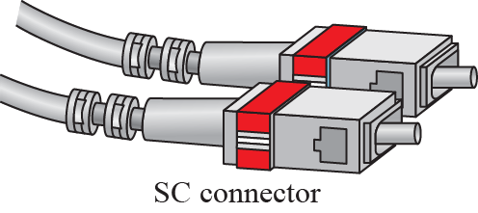
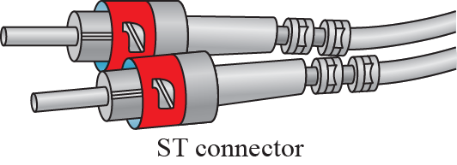
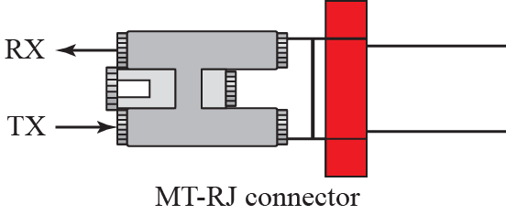
Fiber-Optic Cable Connector

Slide 30
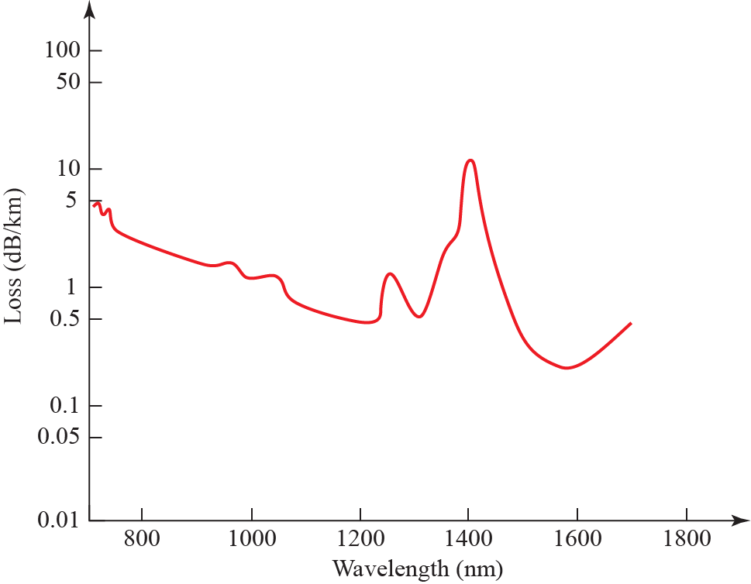
Optical Fiber Performance

Slide 31
Advantages & Disadvantages
Higher Bandwidth
Less Attenuation
Less EM Interference
Light Weight
Less corrosive than copper
Installation/Maintenance
Unidirectional
Cost

Slide 32
Unguided Media
Unguided medium transport waves without using a physical conductor
Often referred to wireless communication
Signals are normally broadcast through free space and thus are available to anyone who has a device capable of receiving them

Slide 33
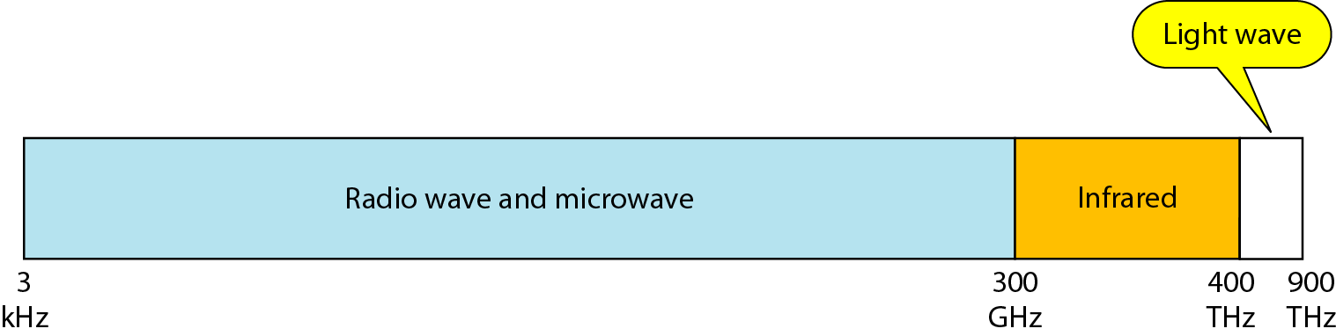
Electromagnetic Spectrum

Slide 34
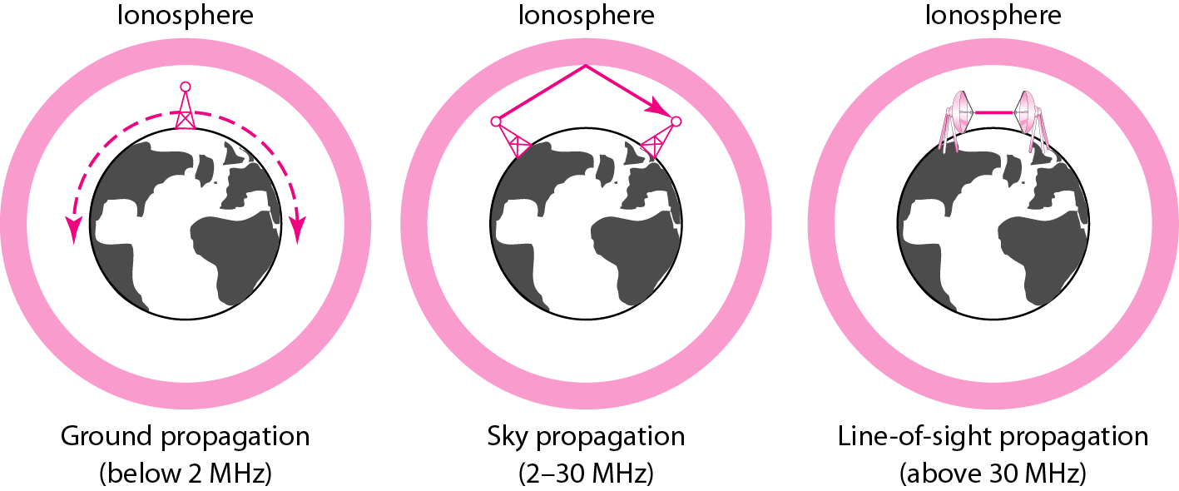
Propagation Methods

Slide 35
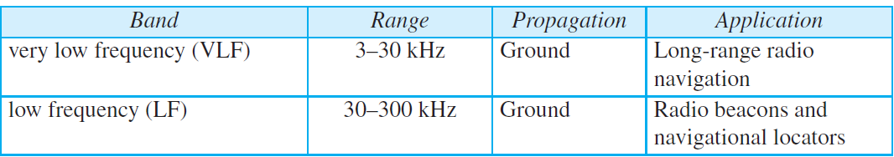
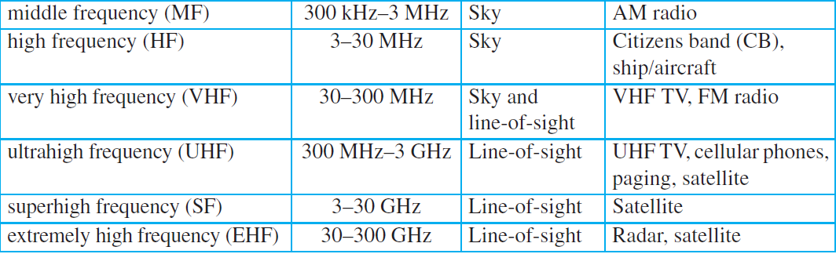
Bands

Slide 36
Radio Waves
Electromagnetic waves ranging in frequencies between 3 kHz and 1 GHz are normally called radio waves
Electromagnetic waves ranging in frequencies between 1 and 300 GHz are called microwaves

Slide 37
Electromagnetic Spectrum

Slide 38

Omnidirectional Antenna

Slide 39
Microwaves
Electromagnetic waves having frequencies between 1 and 300 GHz are called microwaves
Microwaves are unidirectional
When an antenna transmits microwaves, they can be narrowly focused

Slide 40
Electromagnetic Spectrum

Slide 41
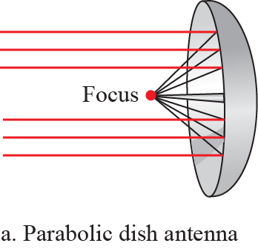
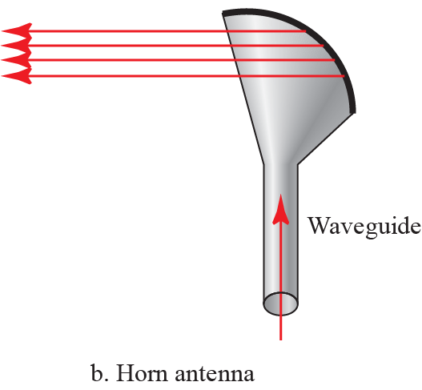
Unidirectional Antennas

Slide 42
Infrared
Infrared waves, with frequencies from 300 GHz to 400 THz (wavelengths from 1 mm to 770 nm), can be used for short-range communication
Infrared waves, having high frequencies, cannot penetrate walls
Prevents interference between one system and another

