Slide 1
Switching
A network is a set of connected devices
Problem of how to connect multiple devices to make one-to-one communication possible
The solution is Switching
Switched network consists of a series of switches

Slide 2
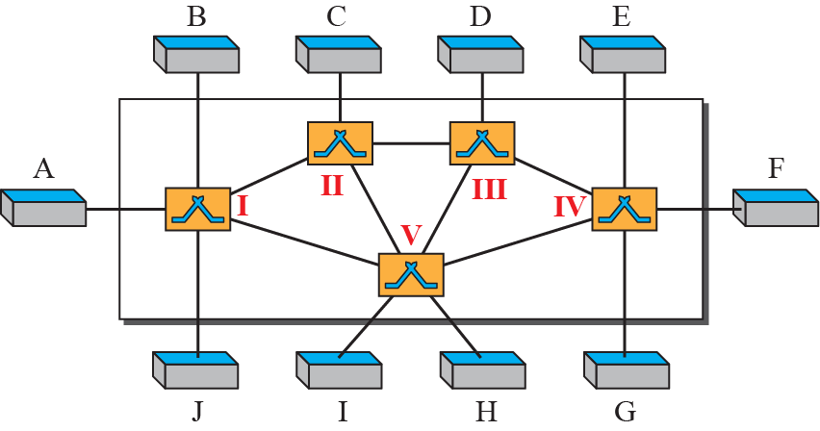
Switched Network

Slide 3
Three Methods of Switching
Three Methods:
  Circuit Switching
  Packet Switching
  Message switching
The first two are commonly used today
The third has been phased out in general communications

Slide 4
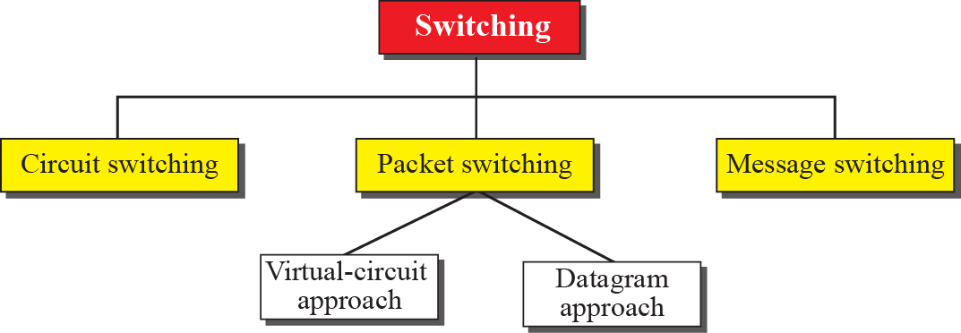
Taxonomy of Switched Networks

Slide 5
Circuit-switched Networks
A set of switches connected by physical links
A connection between two stations is a dedicated path made of one or more links
Each connection uses only one dedicated channel on each link
Each link is normally divided into n channels by using FDM or TDM

Slide 6
Circuit-switched Networks
A set of switches connected by physical links

Slide 7
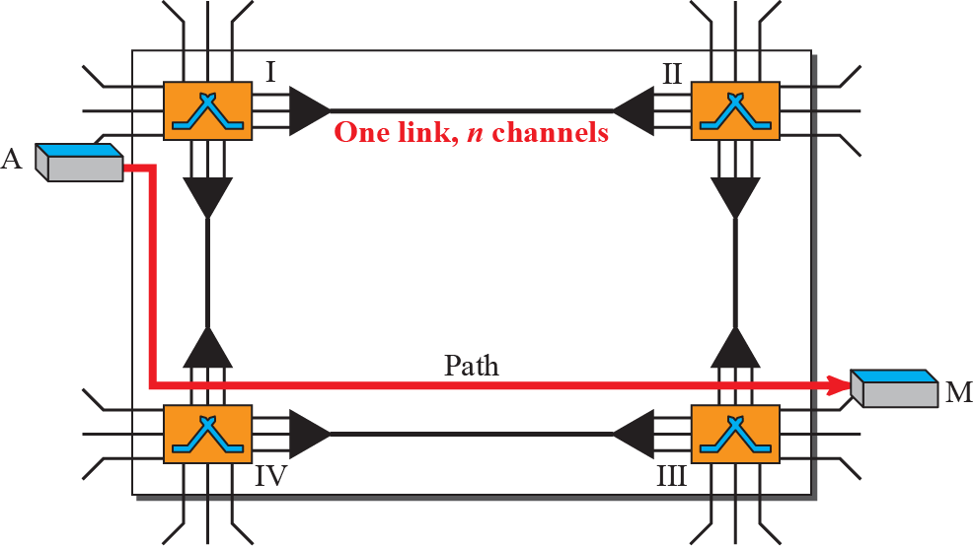
A Circuit-Switched Network

Slide 8
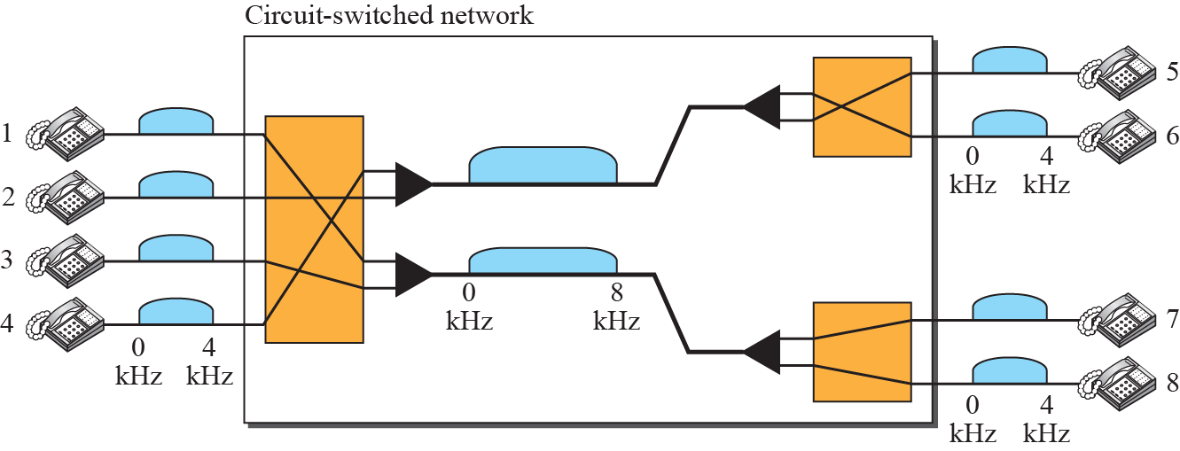
Example
As a trivial example, let us use a circuit-switched network to connect eight telephones in a small area. Communication is through 4-kHz voice channels. We assume that each link uses FDM to connect a maximum of two voice channels. The bandwidth of each link is then 8 kHz.

Slide 9
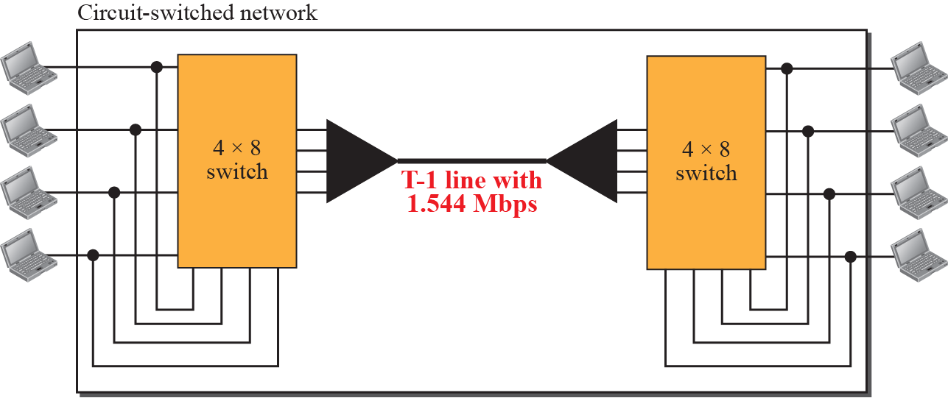
Example
As another example, consider a circuit-switched network that connects computers in two remote offices of a private company. The offices are connected using a T-1 line leased from a communication service provider. There are two 4 × 8 (4 inputs and 8 outputs) switches in this network.

Slide 10
Three Phases in a Circuit Switched Network
The actual communication in a circuit-switched network requires 3 phases:
  Connection Setup
  Data Transfer
  Connection Teardown

Slide 11
Three Phases in a Circuit Switched Network

Slide 12
Efficiency of a Circuit-Switched Network
Not as efficient as packet switching because resources are allocated during the entire duration of the connection and these resources are unavailable to other connections

Slide 13
Efficiency of a Circuit-Switched Network
In a telephone network, people normally terminate the communication when they have finished their conversation
Data Network is an issue

Slide 14
Delay in a Circuit-Switched Network
Circuit switched networks have low efficiency but minimal delay
Data is not delayed at each switch; the resources are allocated for the duration of the connection

Slide 15
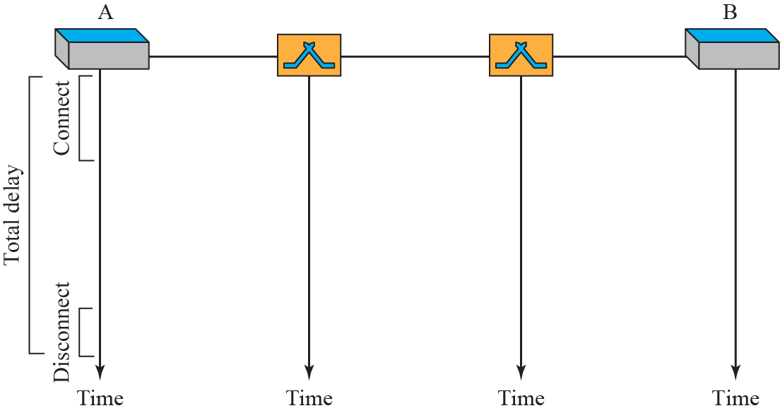
Delay in a Circuit-Switched Network

Slide 16
Packet Switching
If the message is going to pass through a packet-switched network, it needs to be divided into packets of fixed or variable size
The size of the packet is determined by the network and the governing protocol

Slide 17
Datagram Networks
Each packet is treated independently of all others.
Even if a packet is part of a multi-packet transmission, the network treats it as though it existed alone
Packets are referred to as datagrams

Slide 18
Virtual-Circuit Networks
A virtual-circuit network is a cross between a circuit-switched network and a datagram network

Slide 19
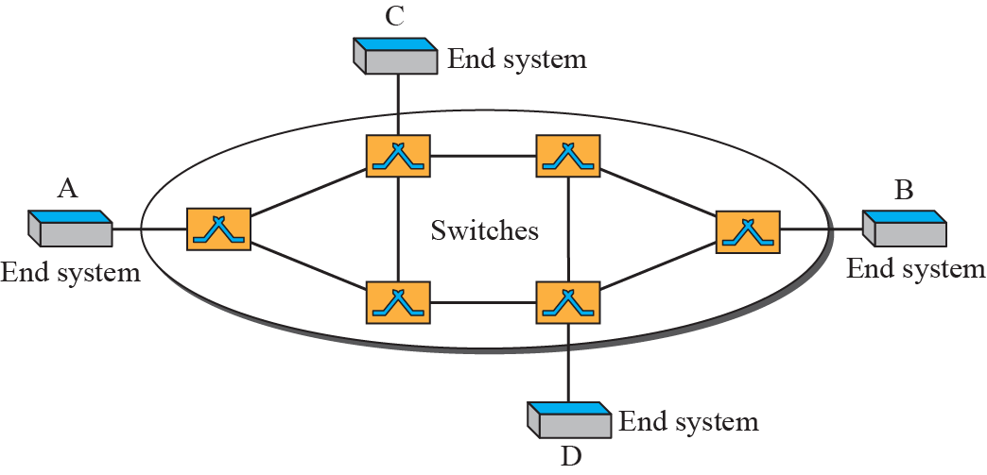
Virtual-circuit network

Slide 20
Virtual-Circuit Networks
A virtual-circuit network is a cross between a circuit-switched network and a datagram network

Slide 21
Virtual-Circuit Networks

Slide 22
Virtual-Circuit Networks
A virtual-circuit network is a cross between a circuit-switched network and a datagram network

Slide 23
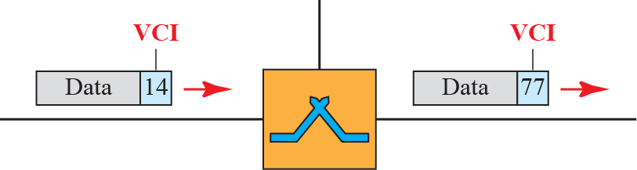
Virtual-Circuit Identifier

Slide 24
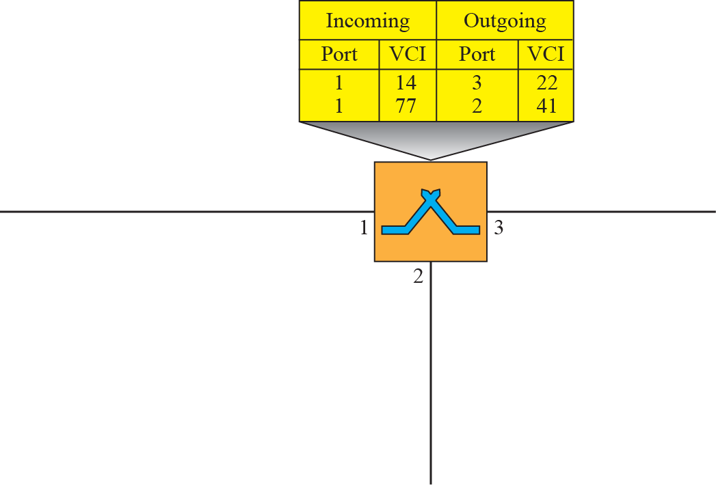



Switch & table for a virtual-circuit network

Slide 25
Structure Of A Circuit Switch
Circuit switching today can use either of two technologies:
  The Space-Division switch
  The Time-Division switch

Slide 26
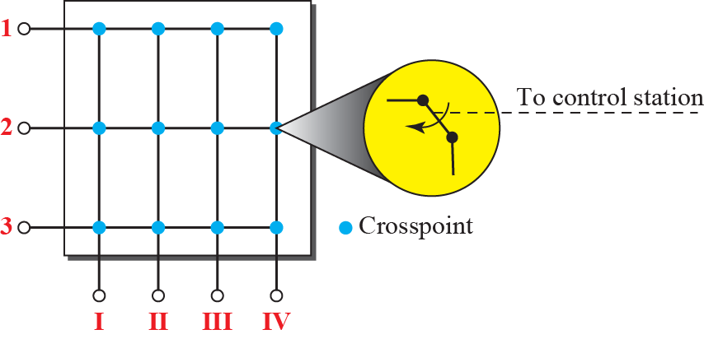
Crossbar switch with 3 inputs & 4 outputs

Slide 27
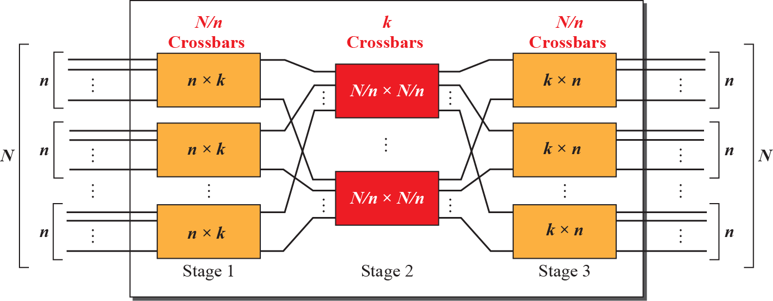
Multistage Switch

Slide 28
Time-Division Switch
Uses TDM inside a switch
Most popular technology is Time-Slot Interchange (TSI)

Slide 29
Time-Division Switch

