Slide 1
Types of Errors
Data transmission suffers unpredictable changes because of interference
The interference can change the shape of the signal
  Single-bit error means that only 1 bit of a given data unit (such as a byte, character, or packet) is changed from 1 to 0 or from 0 to 1

Slide 2
Types of Errors
  Burst Error means that 2 or more bits in the data unit have changed from 1 to 0 or from 0 to 1

Slide 3
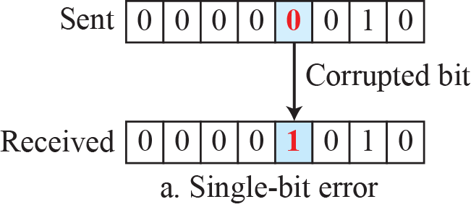
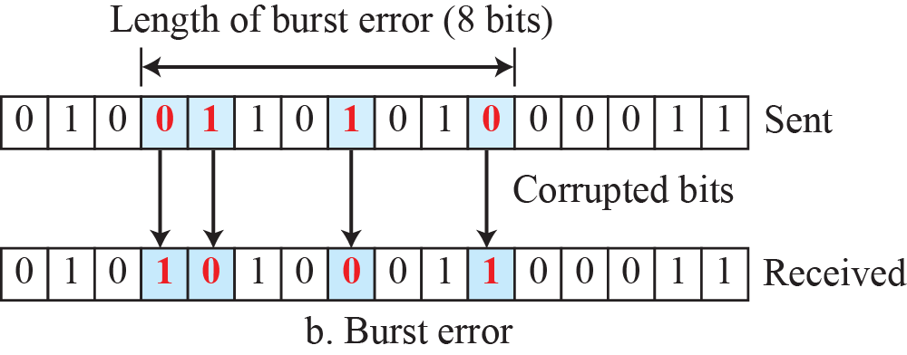
Single-Bit and Burst Error

Slide 4
Redundancy
Central concept in detecting or correcting errors is Redundancy
To be able to detect or correct errors, we send some extra bits with our data
The presence of these redundant bits allows the receiver to detect or correct corrupted bits

Slide 5
Detection versus Correction
Correction is more difficult than the detection
In error detection, we are only looking to see if any error has occurred (Yes or No)
We are not interested in the number of corrupted bits in Detection
Single-bit error is same as a Burst error

Slide 6
Detection versus Correction
In Error Correction, we need to know:
  The exact number of bits that are corrupted and,
  Their location in the message

Slide 7
Coding
Redundancy is achieved through various coding schemes
Sender adds redundant bits through a process that creates a relationship between redundant bits and the actual data bits
The receiver checks the relationships between the two sets of bits to detect errors

Slide 8
Coding
The ratio of redundant bits to data bits and the robustness of the process are important factors in any coding scheme

Slide 9
Types of Coding Schemes
Coding schemes can be divided into 2 broad categories:
  Block Coding
  Convolution Coding

Slide 10
Block Coding
We divide our message into blocks, each of ‘k’ bits, called datawords
We add ‘r’ redundant bits to each block to make the length ‘n = k + r’
The resulting ‘n-bit’ blocks are called codewords

Slide 11
BLOCK CODING in Error Detection
If the following two conditions are met, the receiver can detect a change in the original codeword:
  The receiver has (or can find) a list of valid codewords
  The original codeword has changed to an invalid one

Slide 12
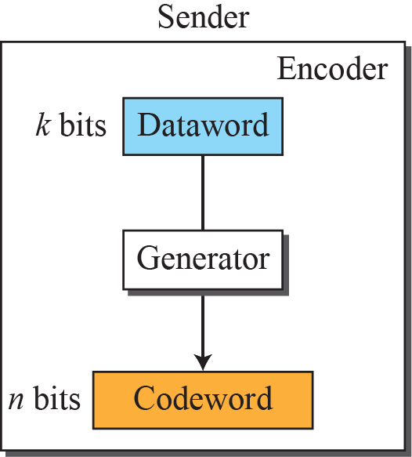
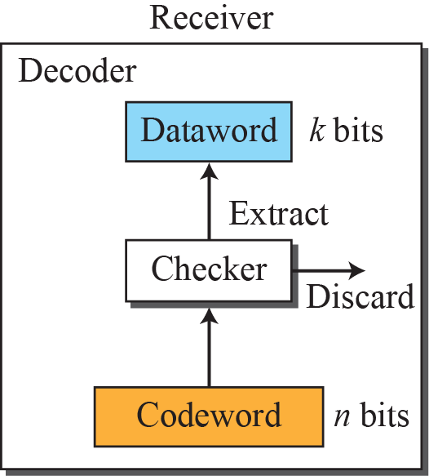

Process of Error Detection in Block Coding

Slide 13
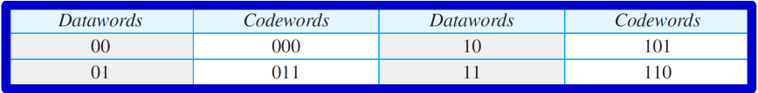
Example
Let us assume that k = 2 and n = 3. Table below shows the list of datawords and codewords. Later, we will see how to derive a cod word from a dataword.

Slide 14
Hamming Distance
Hamming Distance between two words of the same size is the number of differences between the corresponding bits
Hamming Distance between two words x and y is d(x,y)
Hamming distance between received codeword and sent codeword is number of bits corrupted

Slide 15
Example
Let us find the Hamming distance between two pairs of words.
d(000, 011)
d(10101, 11110)

Slide 16
Minimum Hamming Distance
Minimum Hamming Distance is smallest hamming distance between all possible pairs of codewords
dmin= s+1
where,
  s →no. of detectable errors
  dmin→ minimum hamming distance

Slide 17
Example
A code scheme has a Hamming distance dmin = 4. This code guarantees the detection of up to how many errors?

Slide 18
Linear Block Codes
Subset of Block Codes in which the exclusive OR of two valid codewords creates another valid codeword

Slide 19
Example
The code below is a linear block code because the result of XORing any codeword with any other codeword is a valid codeword. For example, the XORing of the second and third codewords creates the fourth one.
The numbers of 1s in the nonzero codewords are 2, 2, and 2. So the minimum Hamming distance is dmin = 2.

Slide 20
Parity-Check Code
Most common error-detecting code
Linear block code (n=k+1)
The extra parity bit is selected to make total number of 1s in codeword even

Slide 21
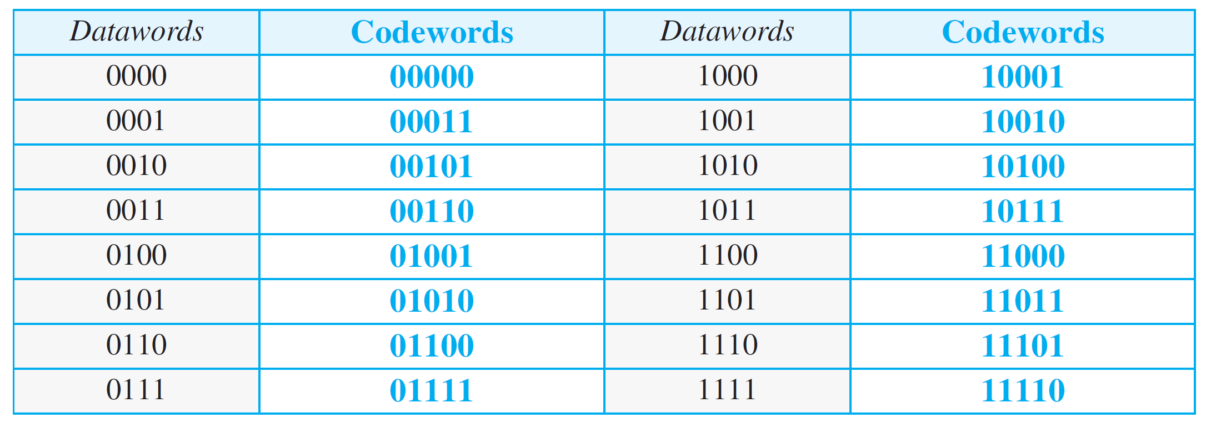
Simple parity-check code C(5, 4)

Slide 22
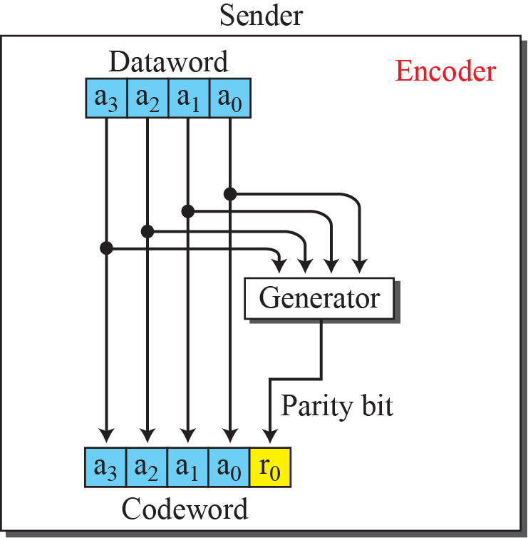
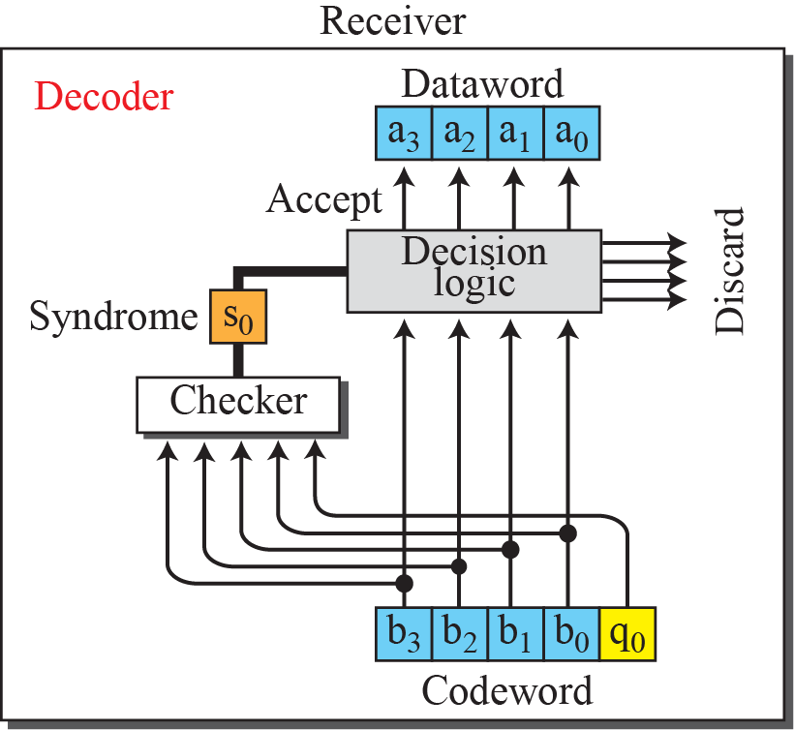
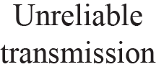
Encoder & decoder for simple parity-check code

Slide 23
CYCLIC CODES
Special linear block codes with one extra property
If a codeword is cyclically shifted (rotated), the result is another codeword
If 1011000 is a codeword and we cyclically left-shift, then 0110001 is also a codeword

Slide 24
Cyclic Redundancy Check (CRC)
Subset of Cyclic Codes
Cyclic redundancy check (CRC) is used in networks such as LANs and WANs

Slide 25
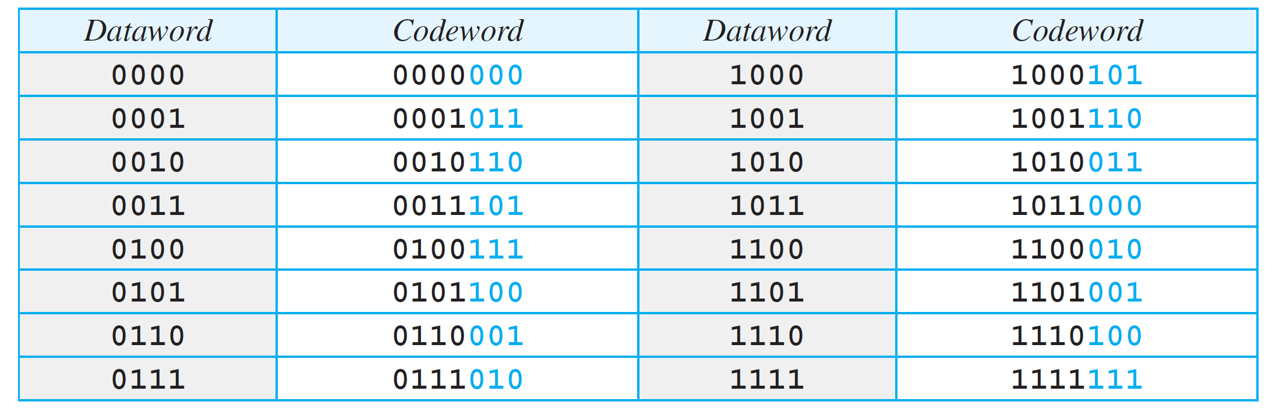
A CRC code with C(7, 4)

Slide 26
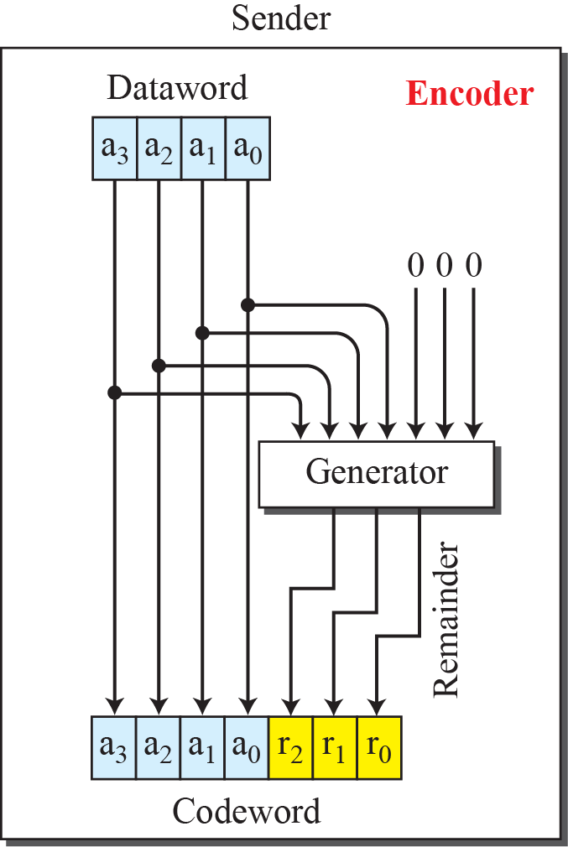
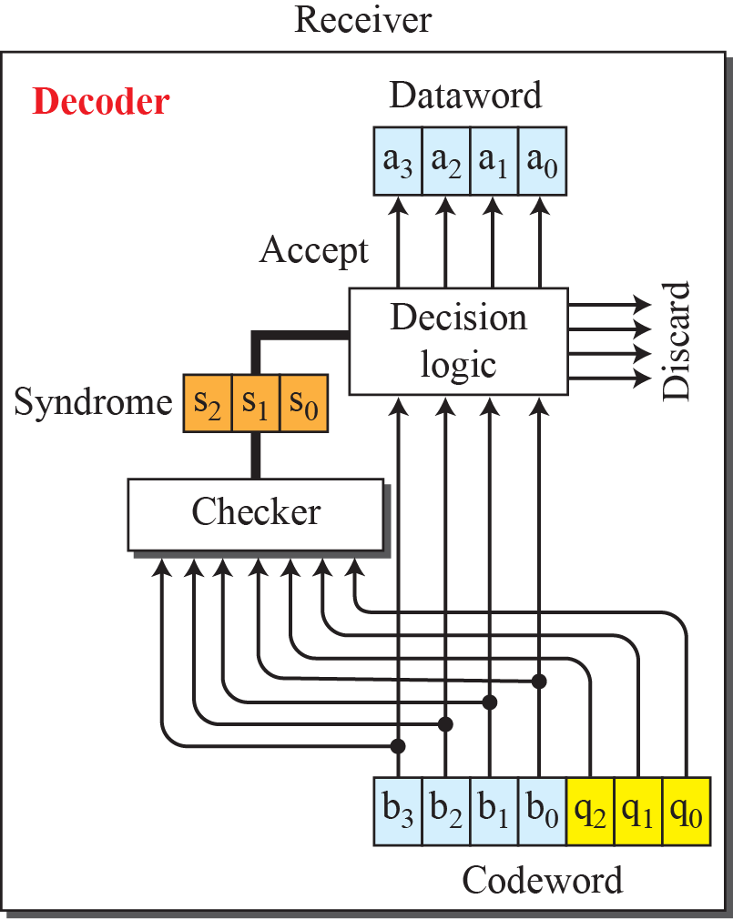
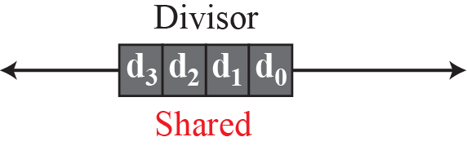
CRC Encoder and Decoder

Slide 27
Cyclic Code Analysis using Polynomials

Slide 28
Advantages of Cyclic Codes
Good performance in detection:
  Single-bit errors
  Double errors
  Odd number of errors
  Burst errors
Easy Implementation
Fast Implementation

Slide 29
CHECKSUM
Error-detection technique that can be applied to a message of any length
Checksum mostly used at the network and transport layer rather than the data-link layer

Slide 30
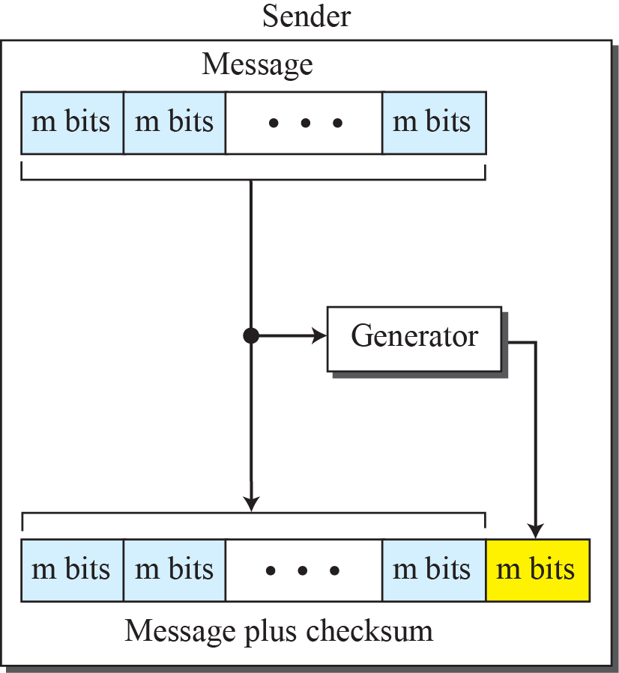
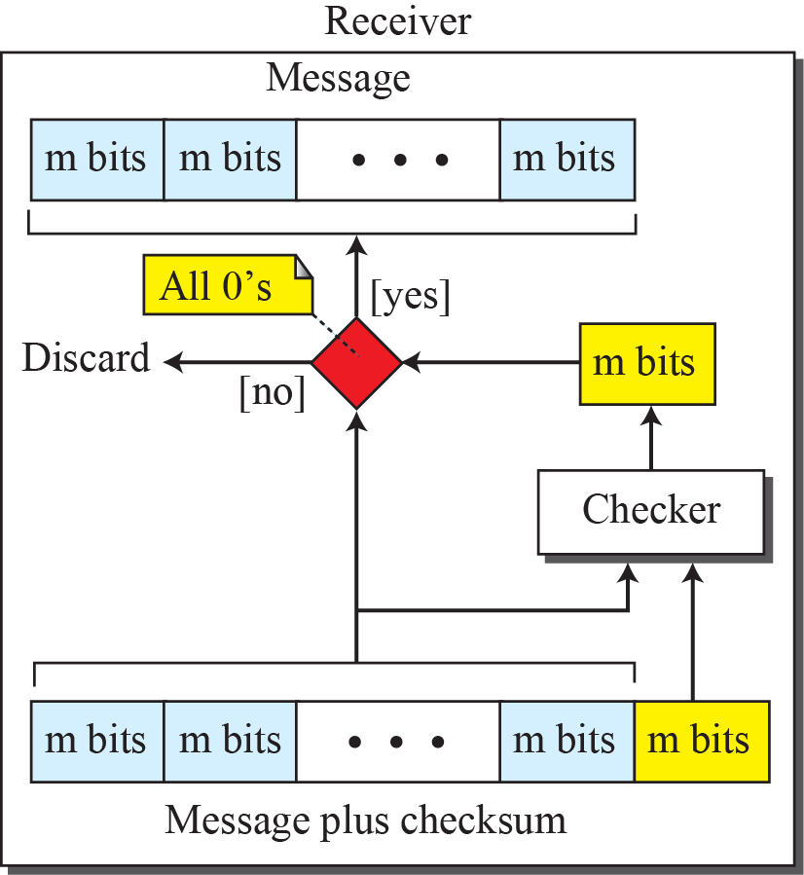
Checksum

Slide 31
Concept behind Checksum
The idea of the traditional checksum is simple. We show this using a simple example

Slide 32
Example
Suppose the message is a list of five 4-bit numbers that we want to send to a destination. In addition to sending these numbers, we send the sum of the numbers.
Set of numbers is (7, 11, 12, 0, 6)

Slide 33
Example
In the previous example, the decimal number 36 in binary is (100100)2. To change it to a 4-bit number we add the extra leftmost bit to the right four bits as shown below
(10)₂ + (0100) ₂ = (0110) ₂
(6) ₁₀

Slide 34
Forward Error Correction
Retransmission of corrupted and lost packets is not useful for real-time multimedia transmission
We need to correct the error or reproduce the packet immediately
Several techniques developed and are commonly called Forward Error Correction techniques

Slide 35
Using Hamming Distance
For error detection, we definitely need more distance
It can be shown that to correct ‘t’ errors, we need to have:
d_{min} = 2t + 1
If we want to correct 10 bits in a packet, we need to make the minimum hamming distance 21 bits
A lot of redundant bits need to be sent with the data

Slide 36
Using Hamming Distance
If we want to correct 10 bits in a packet, we need to make the minimum hamming distance 21 bits

Slide 37
Using XOR
Another recommendation is to use the property of the exclusive OR operation as shown below.
R = P₁ + P₂ +…+ P_{i} + … + P_{N}
This means:
P_{i} = P₁ + P₂ +…+ R +. . .+ P_{N}

Slide 38
Using XOR
Another recommendation is to use the property of the exclusive OR operation as shown below.
R = P₁ + P₂ +…+ P_{i} + … + P_{N}

Slide 39
Chunk Interleaving
Another way to achieve FEC in multimedia is to allow some small chunks to be missing at the receiver
We cannot afford to let all the chunks belonging to the same packet be missing; however, we can afford to let one chunk be missing in each packet

Slide 40
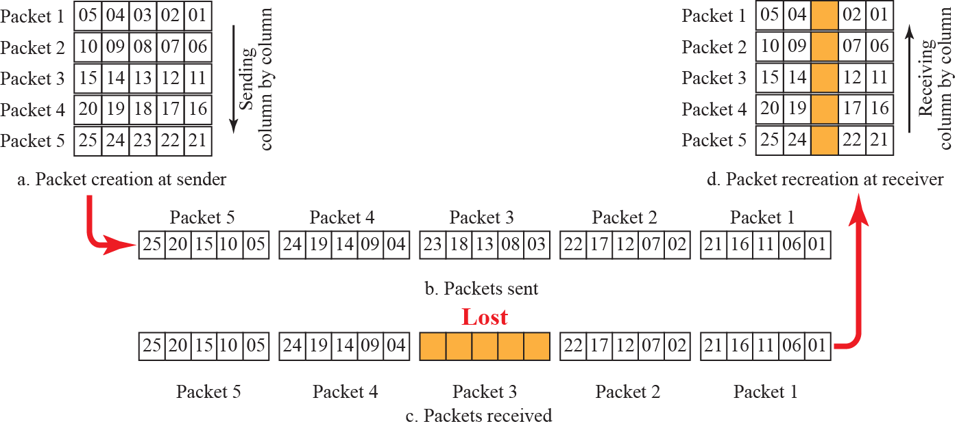
Interleaving

Slide 41
Combining Hamming Distance & Interleaving
Hamming distance and interleaving can be combined
We can first create n-bit packets that can correct t-bit errors
Then we interleave m rows and send the bits column by column
Possible to correct burst errors up to m × t bits of errors

Slide 42
Compounding High & Low Resolution Packets
Creation of a duplicate of each packet with a low-resolution redundancy and combine the redundant version with the next packet
For example, we can create four low-resolution packets out of five high-resolution packets and send them

Slide 43
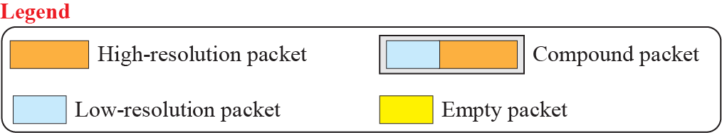
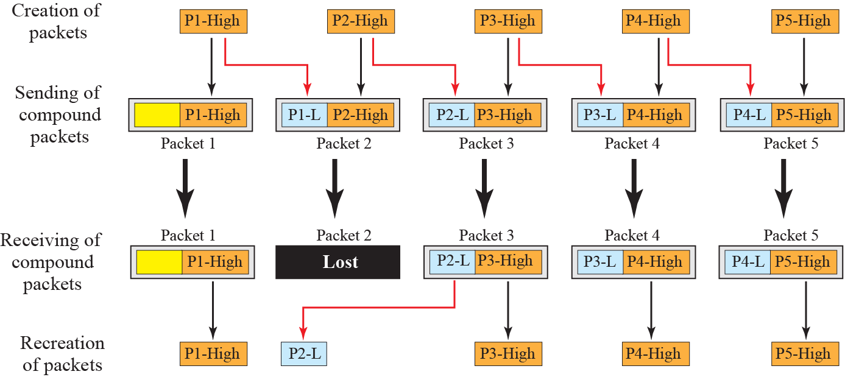
Compounding High-and-Low resolution Packets

