Slide 1
Data Link Control (DLC) Services
The data link control (DLC) deals with procedures for communication between two adjacent nodes no matter whether the link is dedicated or broadcast
Data link control functions include framing, flow control and error control

Slide 2
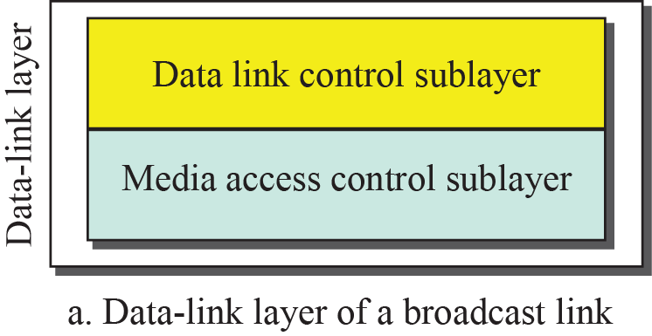
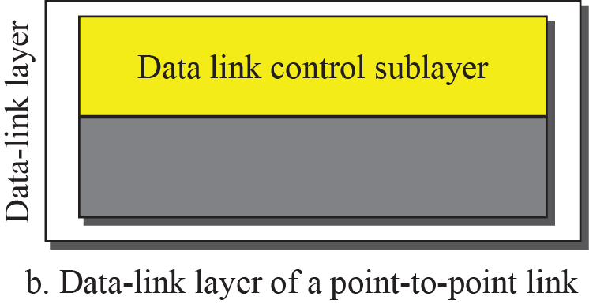
DLC Services
DLC Services
Framing
Flow Control
Error Control

Slide 3
Framing
Data-Link layer needs to pack bits into frames, so that each frame is distinguishable from another
Our postal system practices a type of framing
Framing separates a message by adding a sender address and a destination address

Slide 4
Framing
The destination address defines where the packet is to go; the sender address helps the recipient acknowledge the receipt

Slide 5
Frame Size
Why not one BIG Frame?
Frames can be of:
  Fixed Size
    Size acts as a boundary/delimiter
  Variable Size
    How to define Beginning and End of a Frame?

Slide 6
Variable Framing Techniques
Variable Framing Techniques
Character Oriented Framing
Bit Oriented Framing

Slide 7
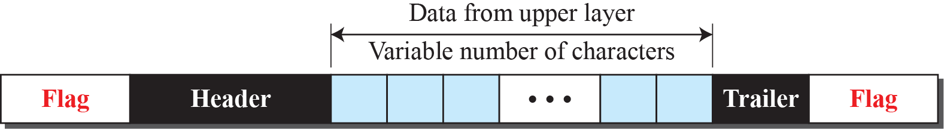
A Frame in a Character-Oriented Protocol

Slide 8
Connection Oriented Framing
Data to be carried are 8-bit characters

Slide 9
Byte Stuffing in Connection-Oriented Framing
Connection-oriented Framing used text characters as flags
Nowadays any character used for flag can also be a part of the data
In order to avoid confusing the receiver, we use Byte Stuffing

Slide 10
Byte Stuffing in Connection-Oriented Framing
Several Issues:
  One or more escape characters followed by a byte with same pattern as a flag?
  Unicode (16/32 bit) vs. 8-bit characters
Data is stuffed with a pre-defined Escape Character (byte) when there is a character with same pattern as a flag

Slide 11
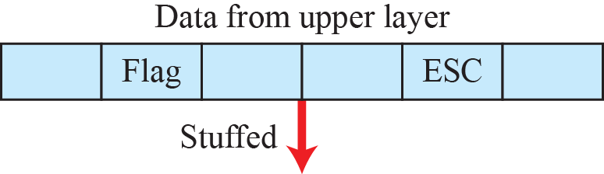
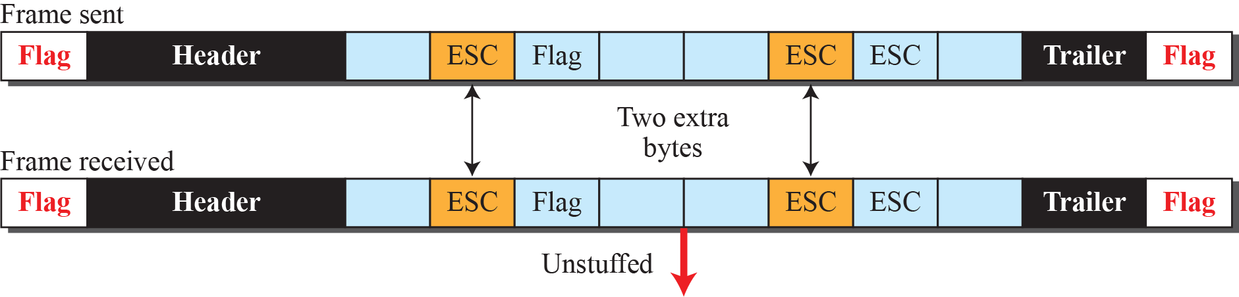
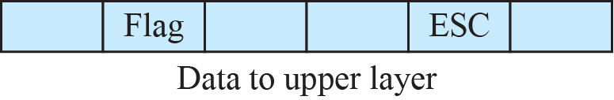
Byte Stuffing and Unstuffing

Slide 12
Bit-Oriented Framing
Data section of frame is a sequence of bits
We need a delimiter to separate one frame from the other
A special 8-bit pattern (01111110) to define beginning and end of a frame
Same issue as Connection-oriented Framing

Slide 13
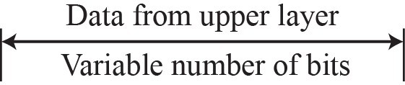
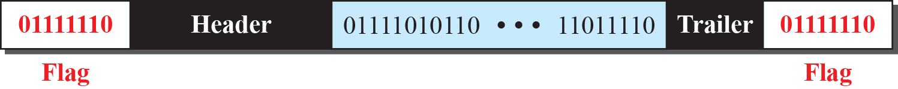
A Frame in a Bit-Oriented Protocol

Slide 14
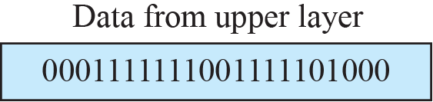
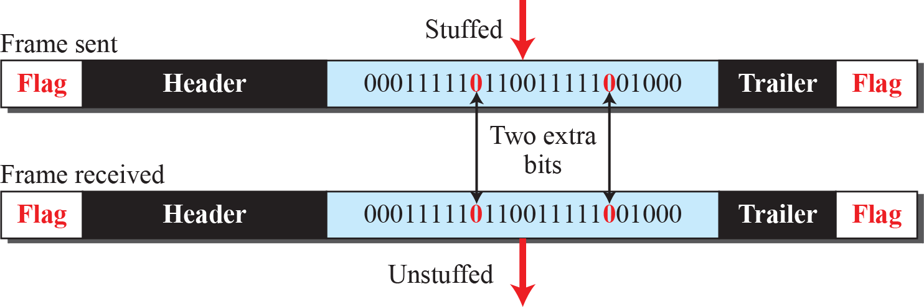
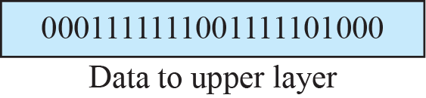
Bit Stuffing and Unstuffing

Slide 15
Flow and Error Control
One of the responsibilities of the data-link control sublayer is flow and error control at the data-link layer

Slide 16
Flow Control
Balance between production and consumption rates
If frames are produced faster than they are consumed at the receiving data link layer, the frames will be discarded
Use of buffers; one at sending end and other at receiving end

Slide 17
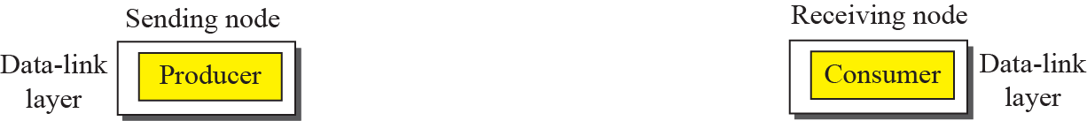

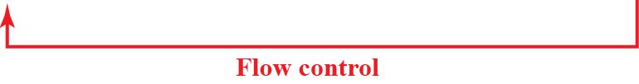
Flow Control at the Data Link Layer

Slide 18
Example
Consumers need to communicate with the producers on two occasions:
  When the buffer is full; &
  When there are vacancies
If the two parties use a buffer with only one slot, the communication can be easier

Slide 19
Error Control
Error Control at Data Link layer uses CRC in one of the two ways:
  If a frame is corrupted, it is silently discarded and if it is good, it is delivered to network layer
  If frame is corrupted, it is silently discarded and if it is good, an acknowledgement is sent to sender

Slide 20
Connectionless and Connection-Oriented
A DLC protocol can be either connectionless or connection-oriented
Connectionless: No relationship between the frames
Connection-Oriented: Frames are numbered and sent in order

Slide 21
Finite State Machine (FSM)
A machine with a finite number of states
Machines stays in one of the states until an event occurs
Each event is associated with 2 reactions:
  List of actions to be performed
  Determining the next state

Slide 22
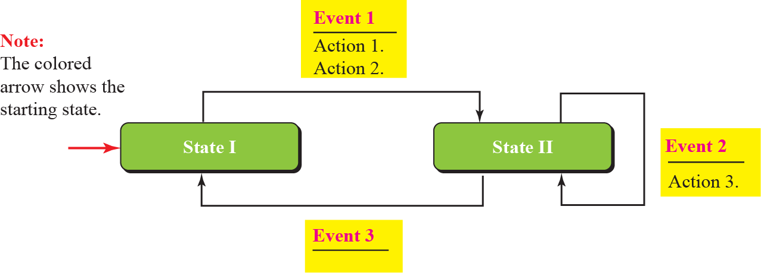
Finite State Machine (FSM)

Slide 23
DATA-LINK LAYER PROTOCOLS
Traditionally four protocols have been defined for the data-link layer to deal with flow and error control:
  Simple Protocol
  Stop-and-Wait Protocol
  Go-Back-N Protocol
  Selective-Repeat Protocol

Slide 24
Simple Protocol
Simple protocol has neither flow nor error control
Assumption: The receiver can immediately handle any frame it receives
The receiver can never be overwhelmed with incoming frames

Slide 25
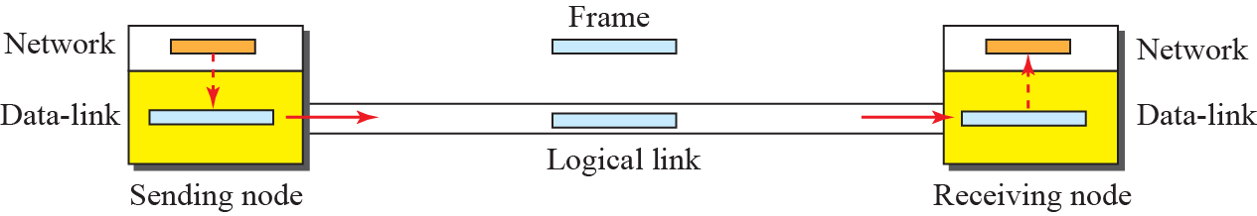
Simple Protocol

Slide 26
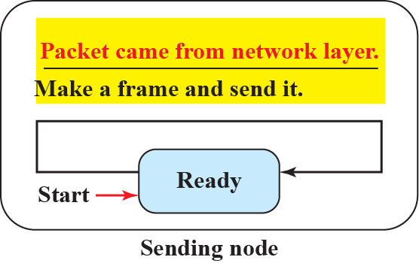
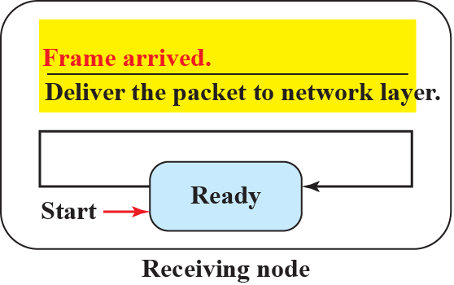
FSM for Simple Protocol

Slide 27
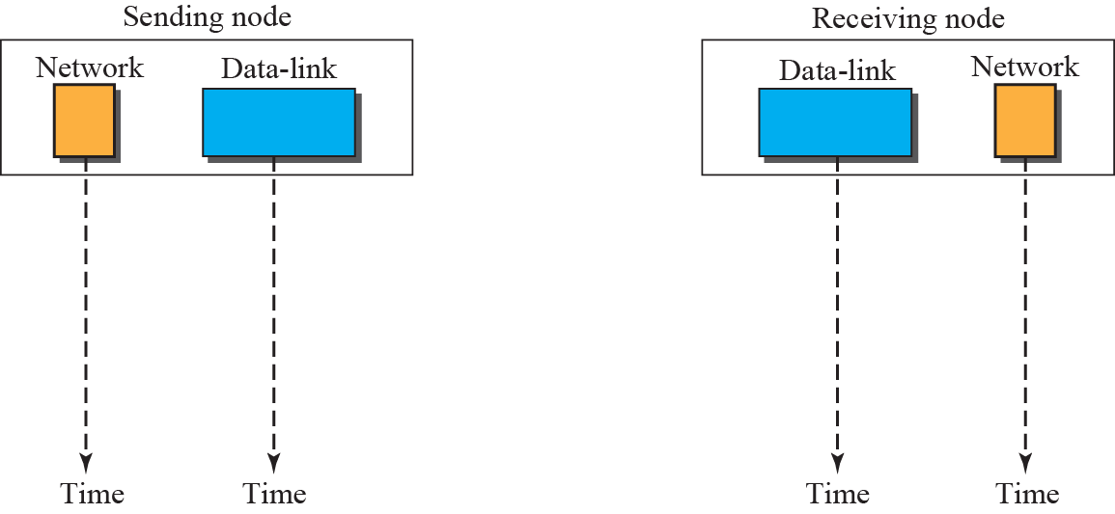


Example
Here is an example of communication using this protocol. It is very simple. The sender sends frames one after another without even thinking about the receiver.

Slide 28
Stop-and-Wait Protocol
Stop-and-Wait protocol uses both flow and error control
The sender sends one frame at a time and waits for an acknowledgment before sending the next one
To detect corrupted frames, we add a CRC code

Slide 29
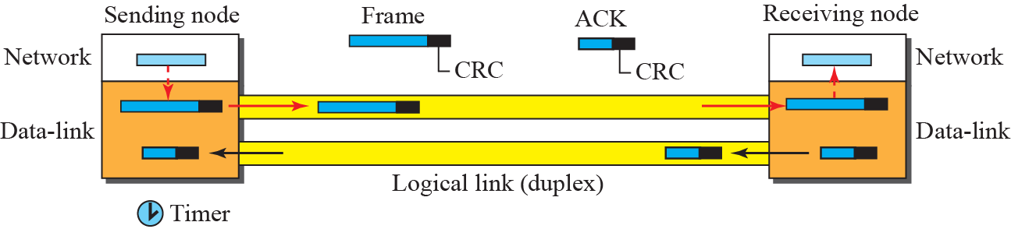
Stop-and-Wait Protocol

Slide 30
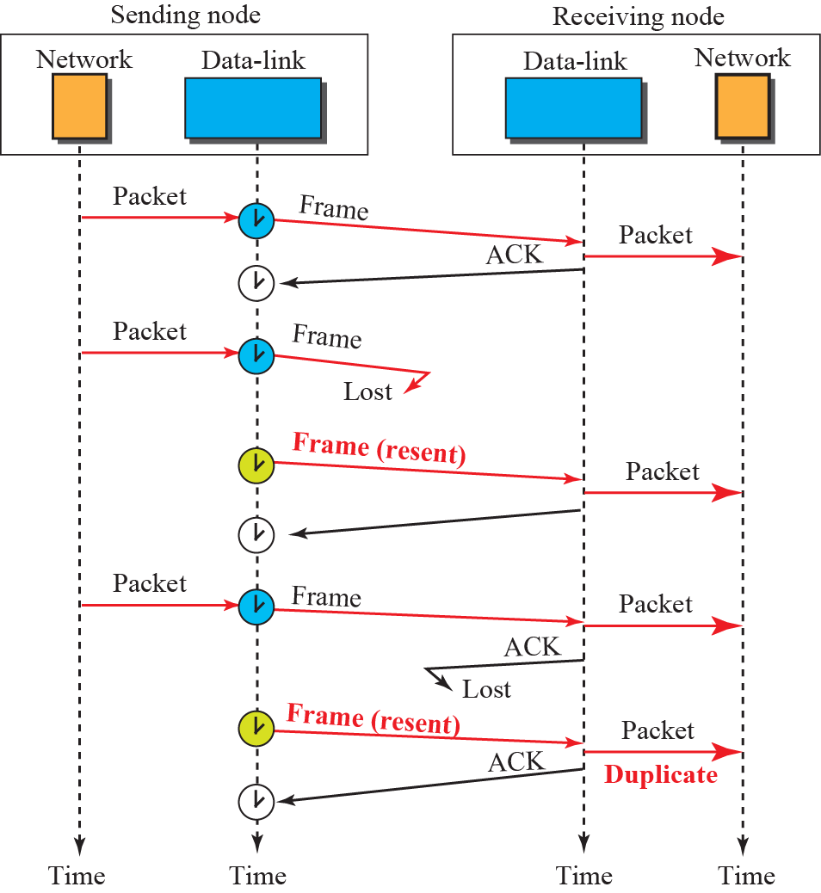
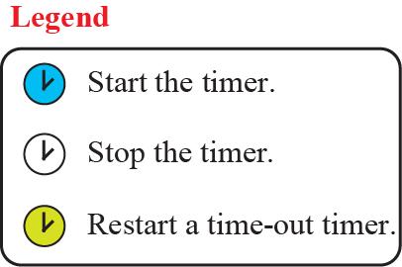
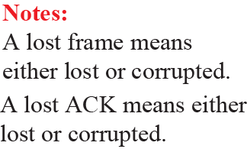
Example

Slide 31
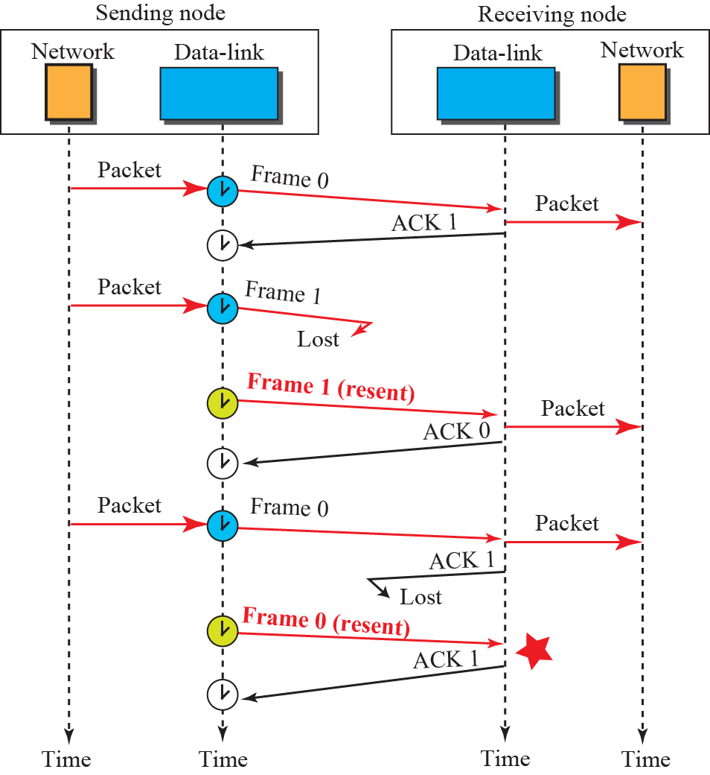

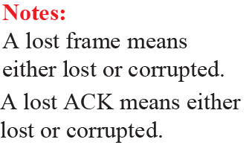
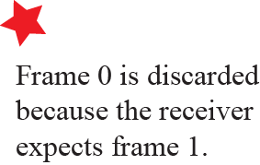
Example

Slide 32
Piggybacking
Both Simple and Stop-and-wait protocols are designed for unidirectional communication
Data flows in one direction and ACK travels in the other
To make the system efficient, the data in one direction is piggybacked with the acknowledgment in the other direction

Slide 33
High-level Data Link Control (HDLC)
Bit -oriented protocol for communication over point-to-point and multipoint links
It implements Stop-and-Wait protocol
Most of the concepts defined in this protocol is the basis for other protocols such as PPP, Ethernet, or wireless LANs

Slide 34
Configurations & Transfer Modes in HDLC
HDLC provides two common transfer modes that can be used in different configurations:
  Normal Response Mode (NRM) &
  Asynchronous Balanced Mode (ABM)

Slide 35
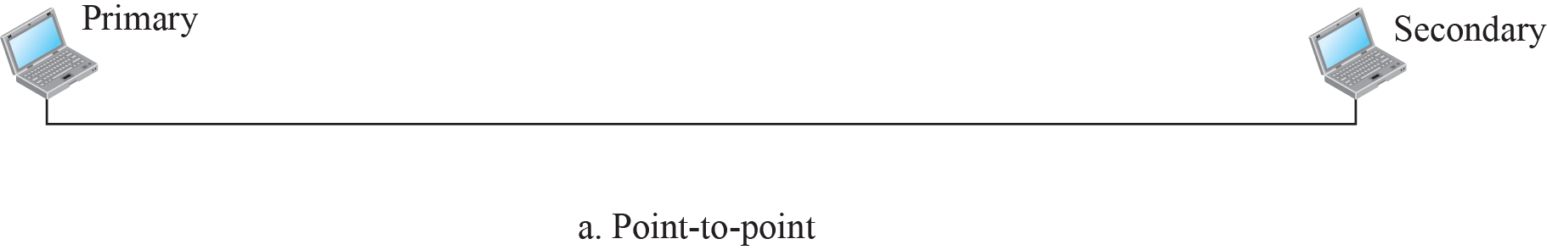


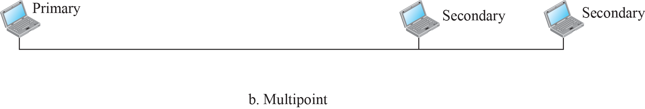
Normal Response Mode

Slide 36
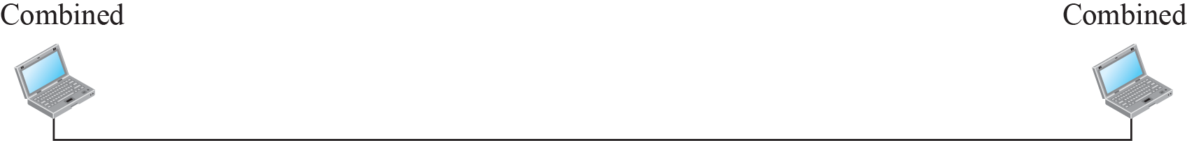


Asynchronous Balanced Mode

Slide 37
Framing
HDLC defines three types of frames:
  information frames (I-frames)
  Supervisory frames (S-frames)
  Unnumbered frames (U-frames)

Slide 38
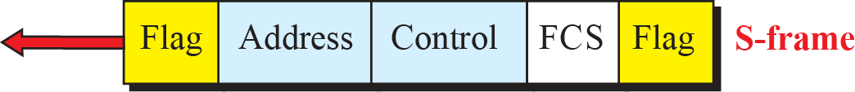
HDLC Frames

Slide 39
Point-to-Point Protocol (PPP)
Most common protocol for point-to-point access
Millions of Internet users who need to connect their home computers to the server of an Internet service provider use PPP
To control and manage the transfer of data, there is a need for a PPP at the data-link layer

Slide 40
Services provided by PPP
The designers of PPP have included several services to make it suitable for a point-to-point protocol, but have ignored some traditional services to make it simple
Services Included | Services Not Included
Framing | Flow Control
Link Establishment and Data Exchange | Error Correction (PPP has CRC detection only)
Authentication | No Sequence Numbering
Multilink PPP Address configuration | Absence of sophisticated Addressing Mechanism
Network Address configuration

Slide 41
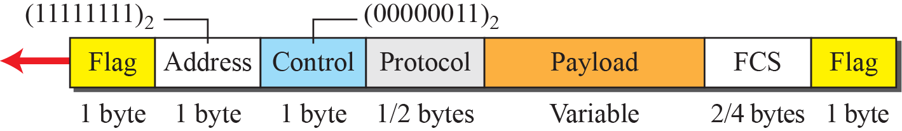
PPP Frame Format
PPP uses a character-oriented (or byte-oriented) frame

Slide 42
Multiplexing in PPP
Although PPP is a link-layer protocol, it uses another set of protocols to establish the link, authenticate and carry the network-layer data
Three sets of protocols are:
  Link Control Protocol (LCP)
  Two Authentication Protocols (APs)
  Several Network Control Protocols (NCPs)

Slide 43
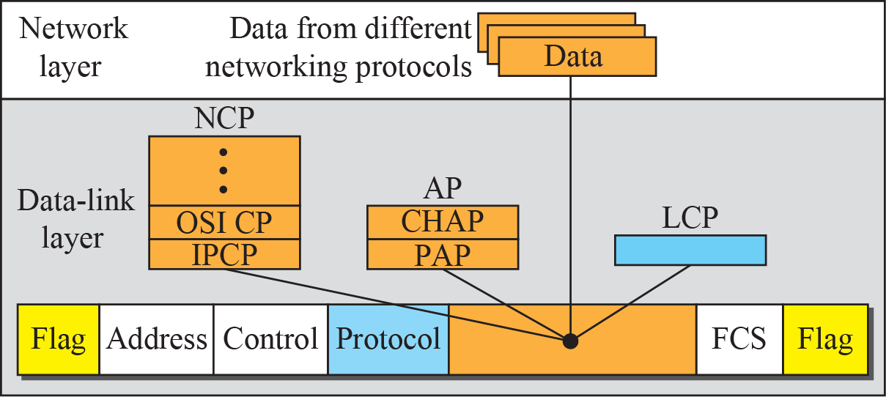
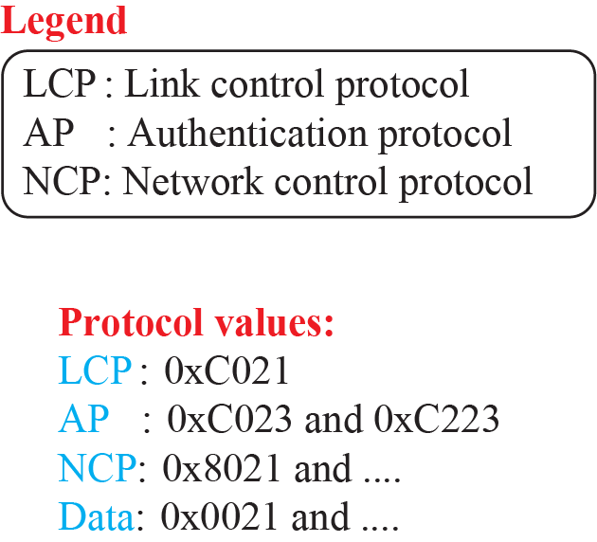
Multiplexing in PPP

Slide 44
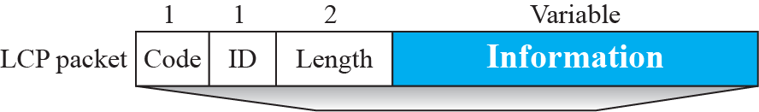

LCP Packet encapsulated in a Frame

Slide 45
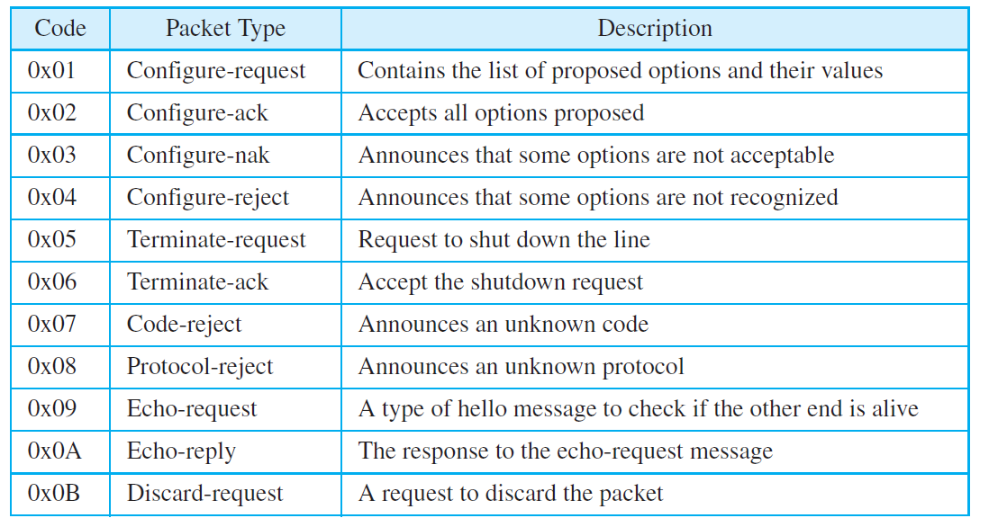
LCP Packets

Slide 46
Authentication Protocols in PPP
PPP Authentication
Password Authentication Protocol
(PAP)
Challenge Handshake Authentication Protocol
(CHAP)

Slide 47
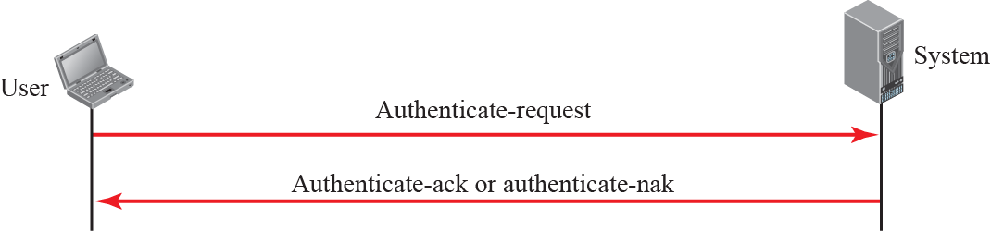
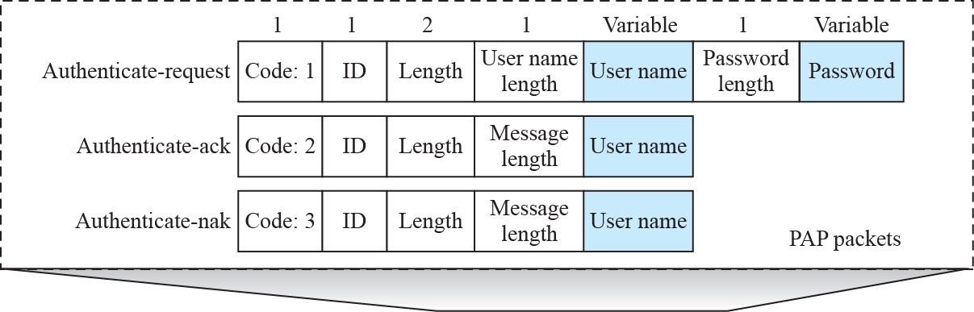
PAP packets encapsulated in a PPP frame

Slide 48
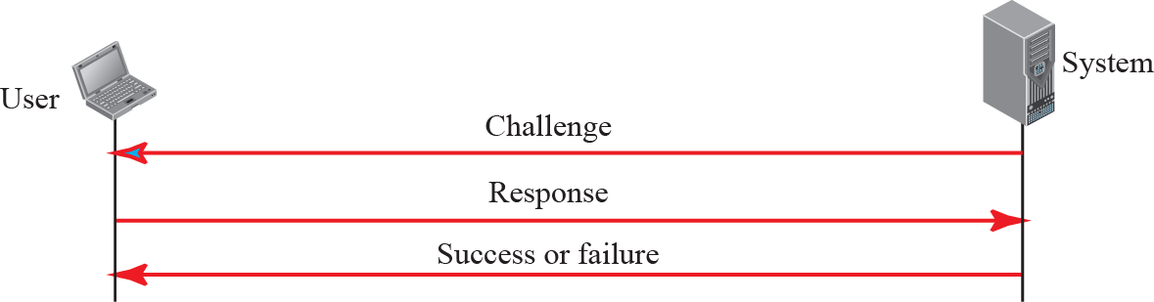
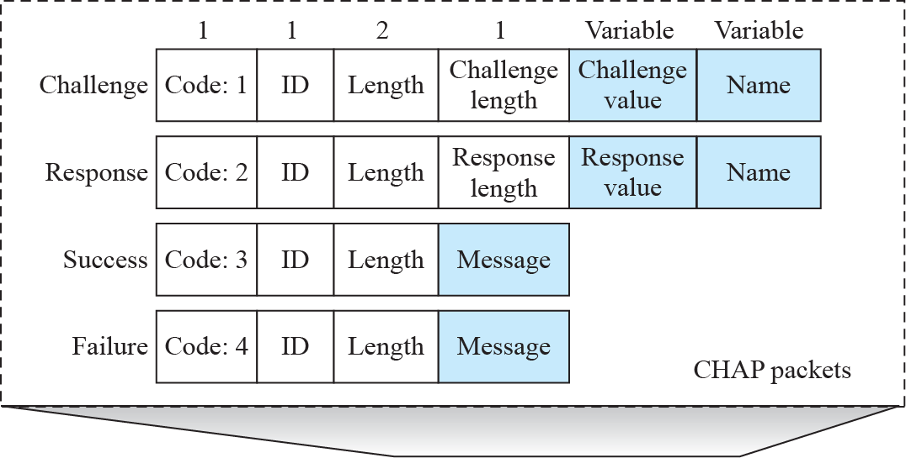
CHAP Packets encapsulated in a PPP frame

Slide 49
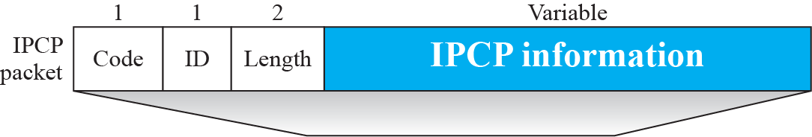
Internet Protocol Control Protocol (IPCP)

Slide 50
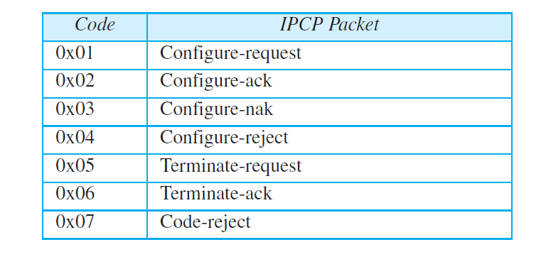
Code values for IPCP Packets

Slide 51
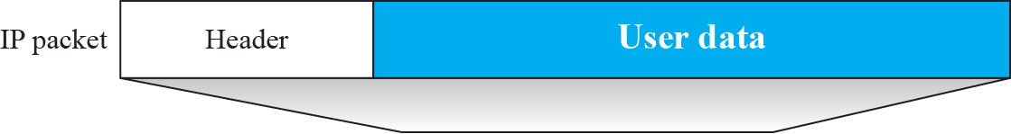
IP datagram encapsulated in a PPP frame

