Slide 1
Media Access Control (MAC) Sub-Layer
When nodes use a multipoint or broadcast link, we need a multiple-access protocol to coordinate access to the link
Many protocols have been devised to handle access to a shared link
All of these protocols belong to Media Access Control (MAC) sub-layer

Slide 2
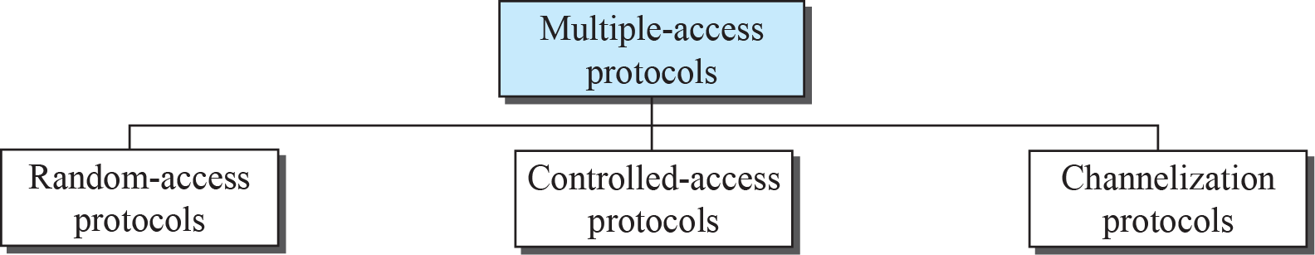
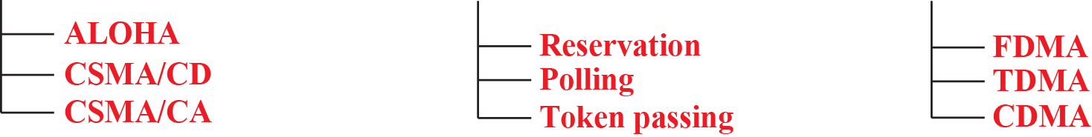
Taxonomy of Multiple-Access Protocols

Slide 3
Random Access
In random-access or contention no station is superior to the other and none is assigned control over the other
Station that has data to send uses a procedure defined by the protocol to make a decision on whether or not to send
This decision depends on the state of the medium (idle or busy)

Slide 4
ALOHA
ALOHA, the earliest random access method, was developed in early 1970s
Designed for a radio (wireless) LAN, but it can be used on any shared medium
Potential collisions in this arrangement as the medium is shared between the stations

Slide 5
ALOHA
When a station sends data, another station may attempt to do so at the same time
The data from the two stations collide and become garbled

Slide 6
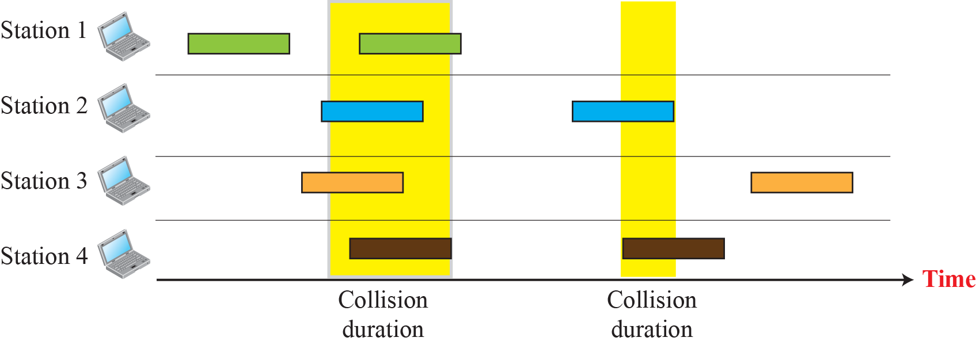
Frames in a pure ALOHA network

Slide 7
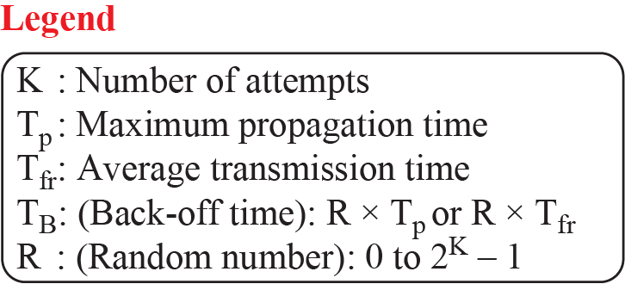
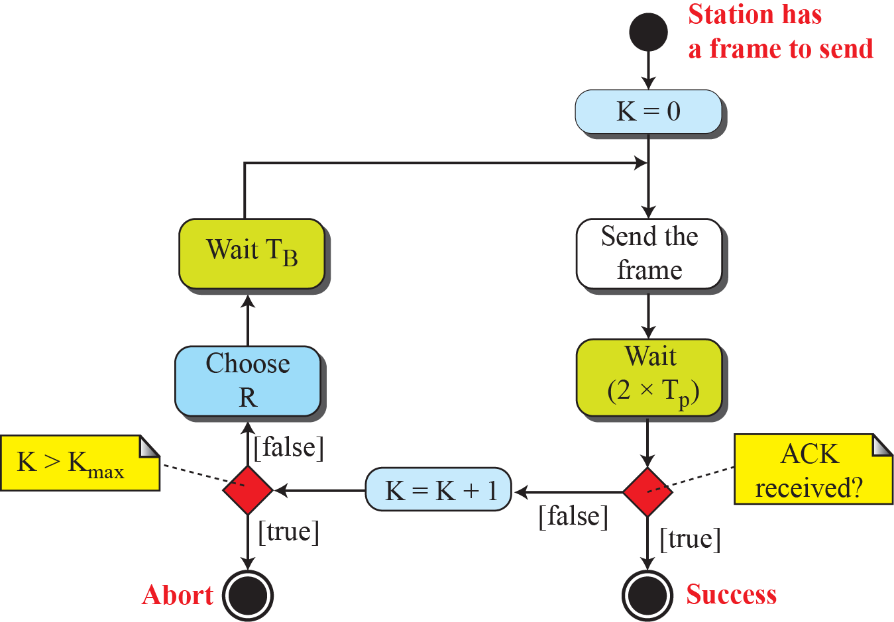
Procedure for pure ALOHA protocol

Slide 8
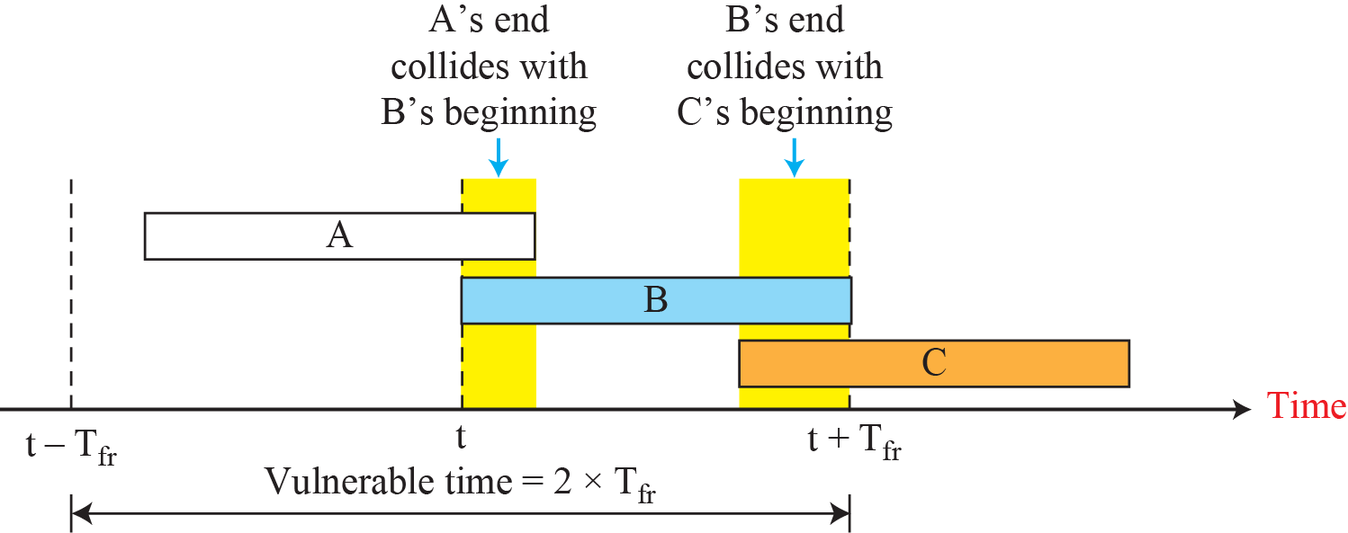
Vulnerable Time for pure ALOHA protocol

Slide 9
Slotted ALOHA
We divide time into slots of Tfr sec and force the station to send only at the beginning of the slot
Invented to improve the efficiency of pure ALOHA
If a station misses the time slot, it must wait until beginning of next time slot reducing vulnerable time to Tfr (vs. 2 x Tfr for pure ALOHA)

Slide 10
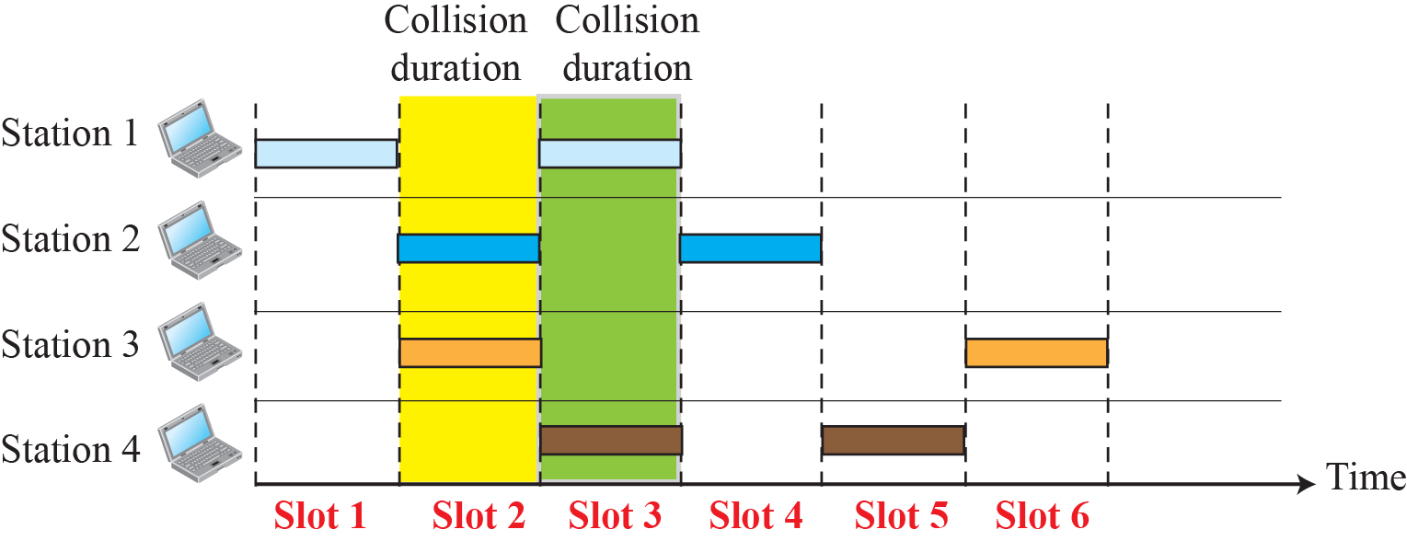
Frames in a Slotted ALOHA Network

Slide 11
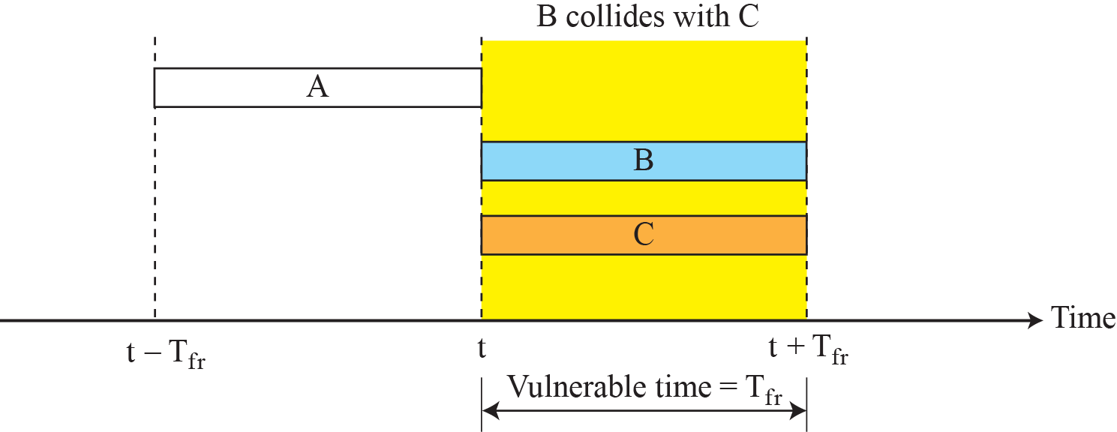
Vulnerable Time for Slotted ALOHA

Slide 12
Carrier Sense Multiple Access (CSMA)
To minimize the chance of collision and, therefore, increase the performance, CSMA was developed
The chance of collision is reduced as the station is required to sense/listen to the medium before sending data
‘sense before transmit’ or ‘listen before talk’

Slide 13
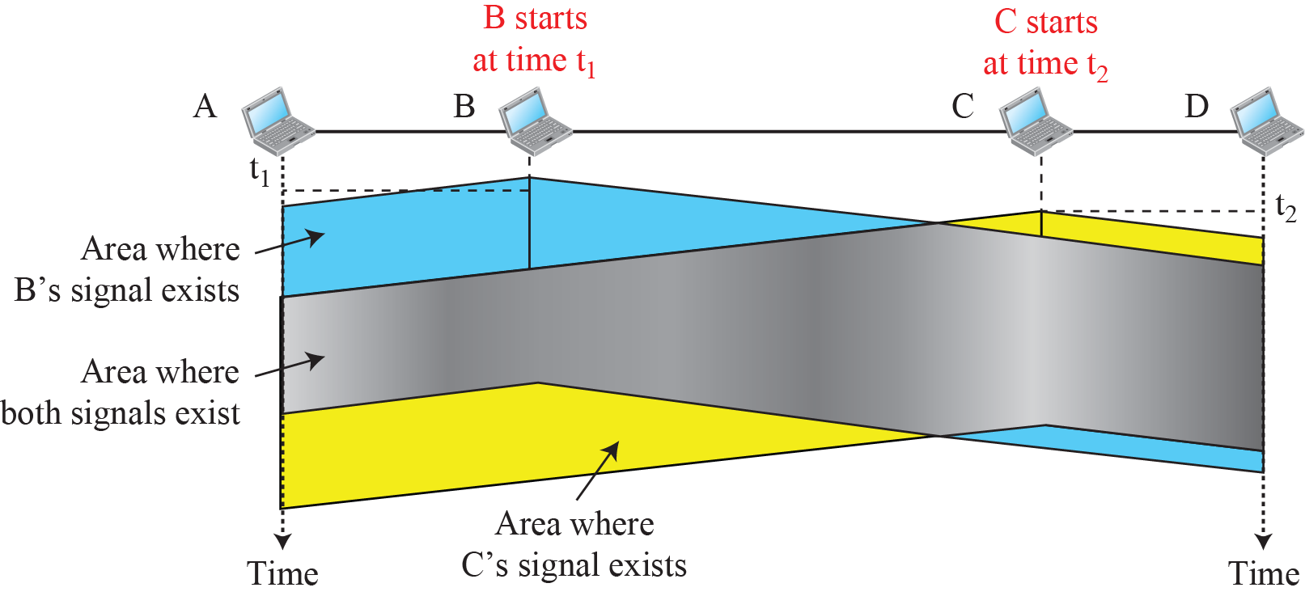
Space/Time Model of a Collision in CSMA

Slide 14
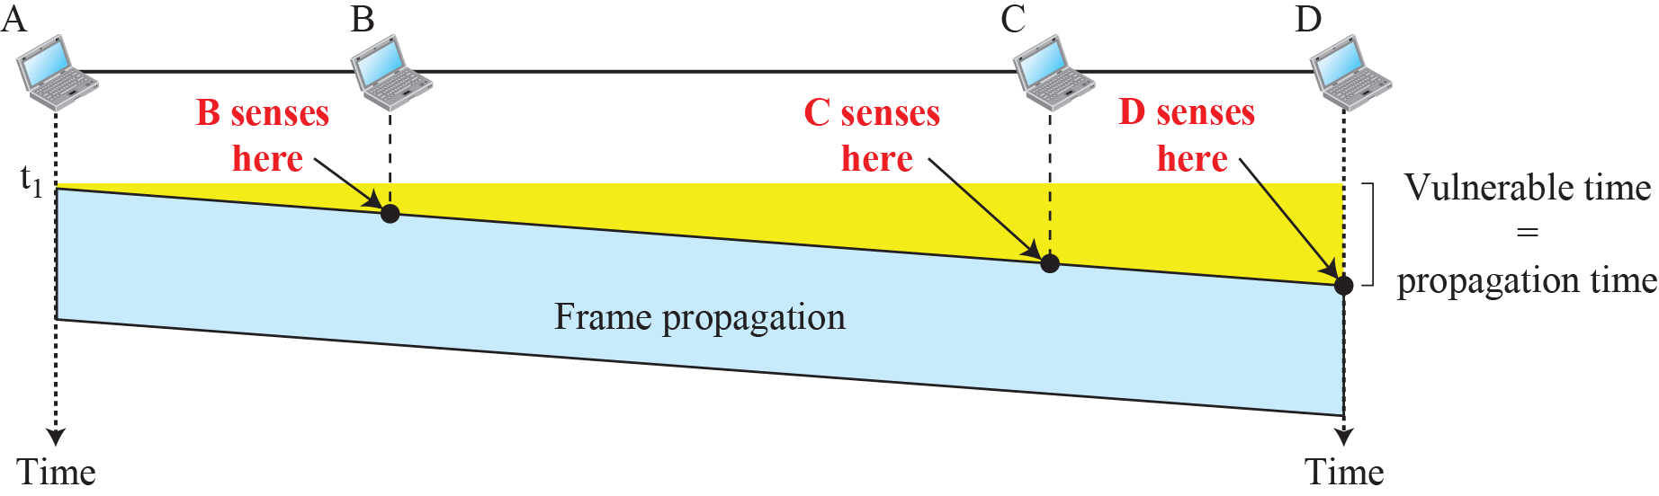
Vulnerable Time in CSMA

Slide 15
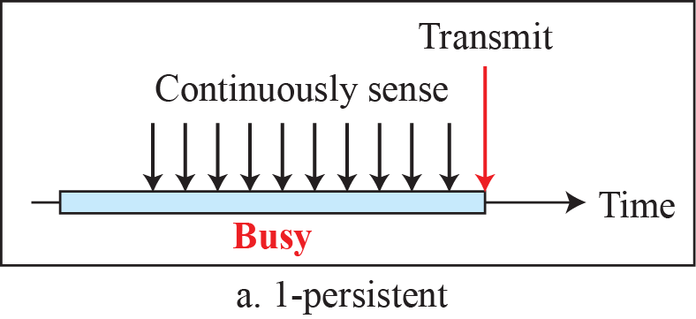
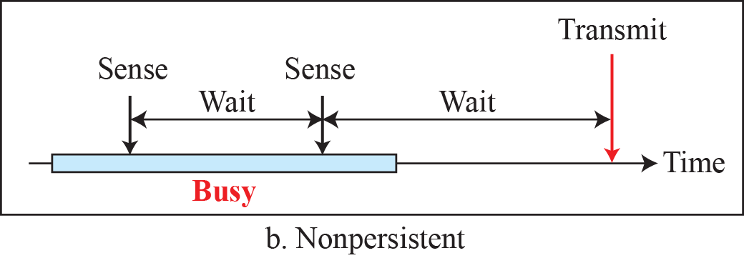
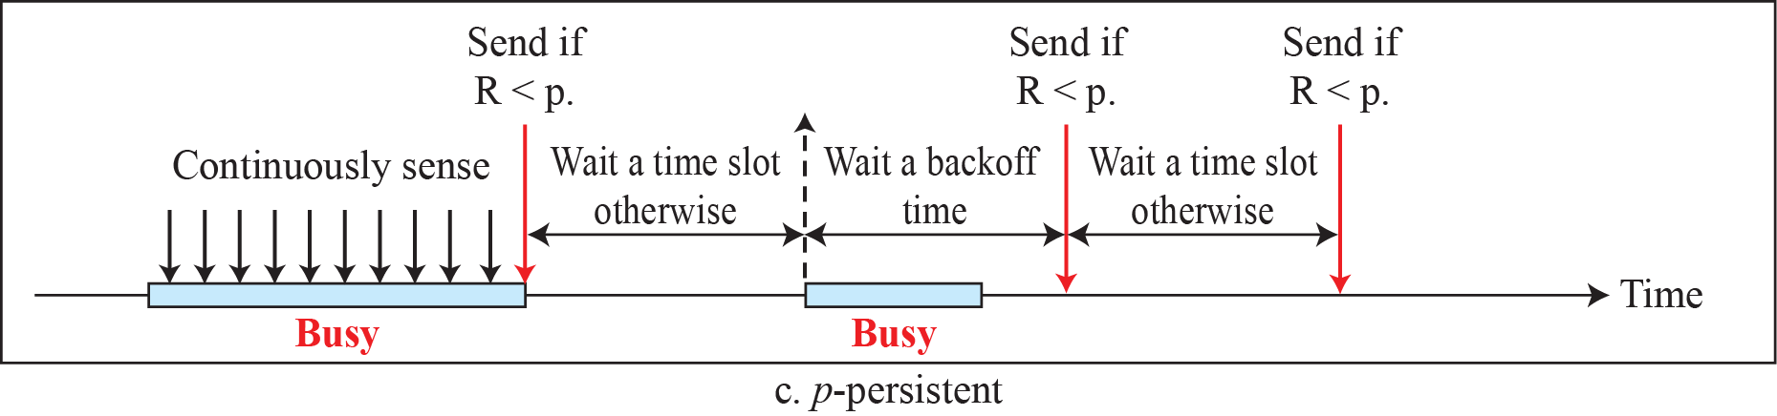
Behavior of Three Persistence Methods

Slide 16
Carrier Sense Multiple Access/Collision Detection
CSMA method does not specify the procedure following a collision
CSMA/CD augments the algorithm to handle the collision
The station monitors the medium after it sends a frame to see if the transmission was successful. If there is a collision, the frame is sent again

Slide 17
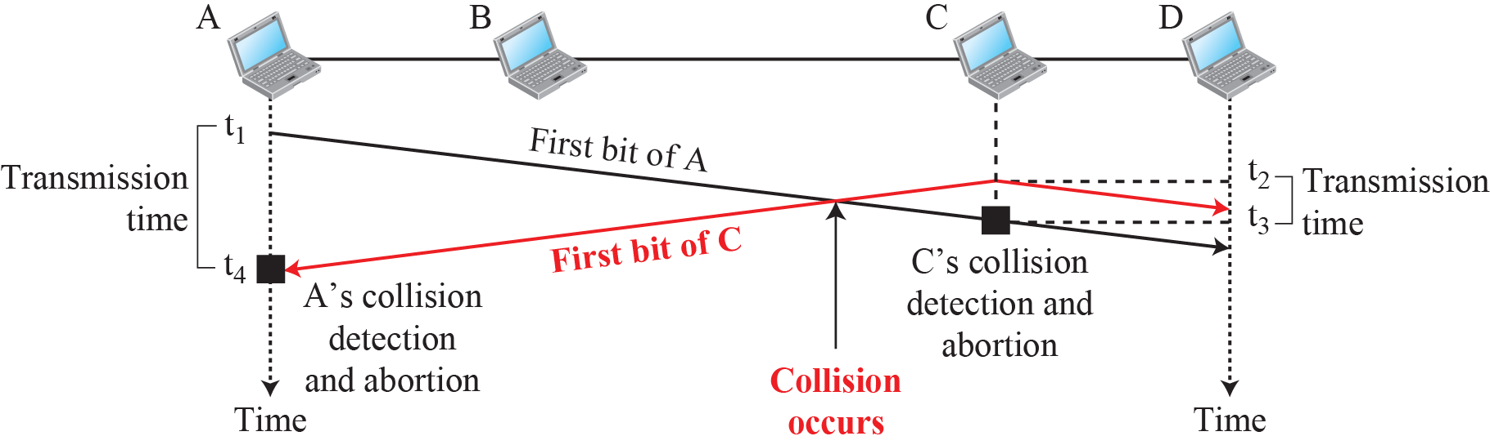
Collision of the First Bits in CSMA/CD

Slide 18
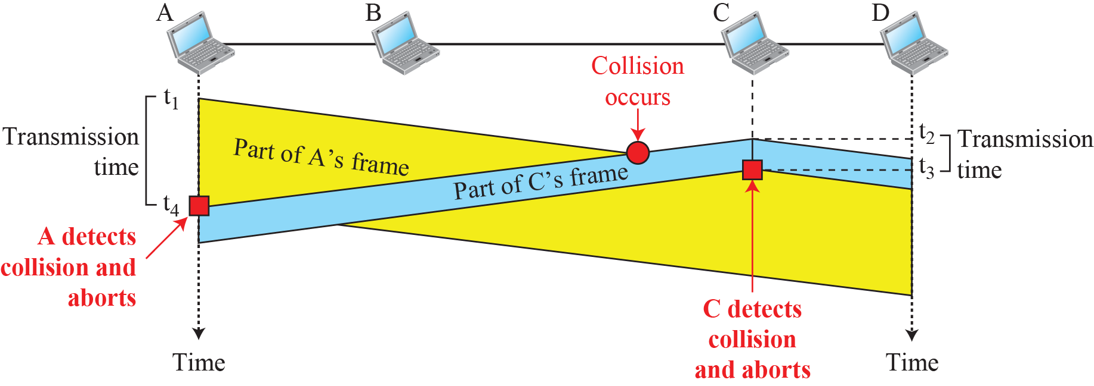
Collision and Abortion in CSMA/CD

Slide 19
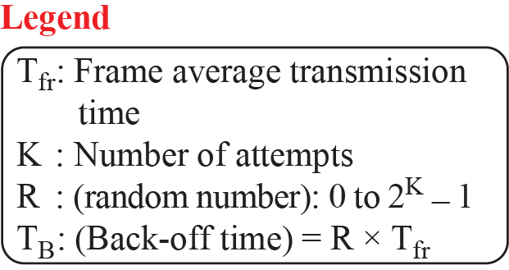
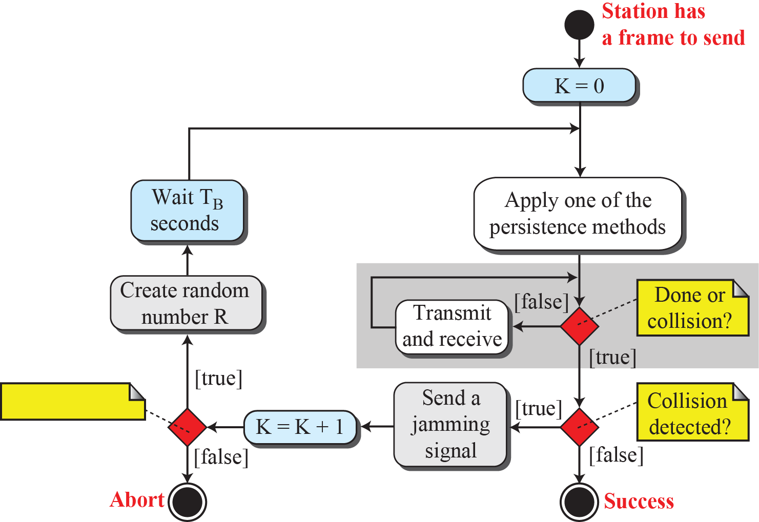
Flow Diagram for the CSMA/CD

Slide 20
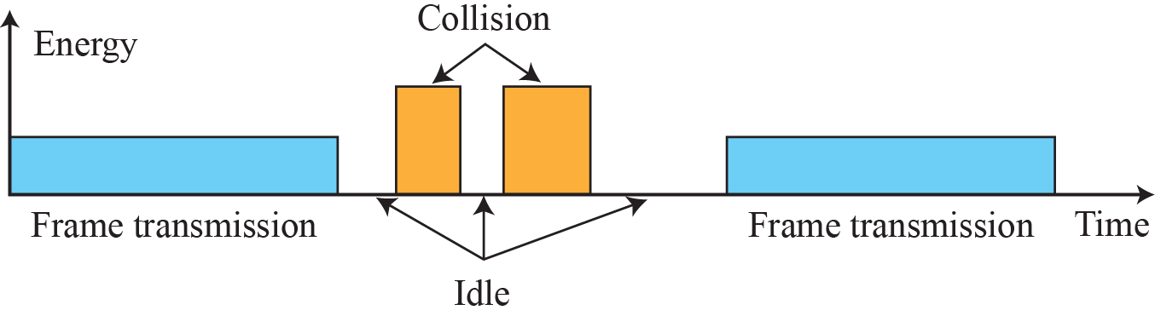
Energy Level During Transmission, Idleness and Collision

Slide 21
Carrier Sense Multiple Access/Collision Avoidance
CSMA/CA was invented for Wireless Networks
Collisions are avoided through the use of three strategies:
  The Interfame Space
  The Contention Window
  Acknowledgements

Slide 22
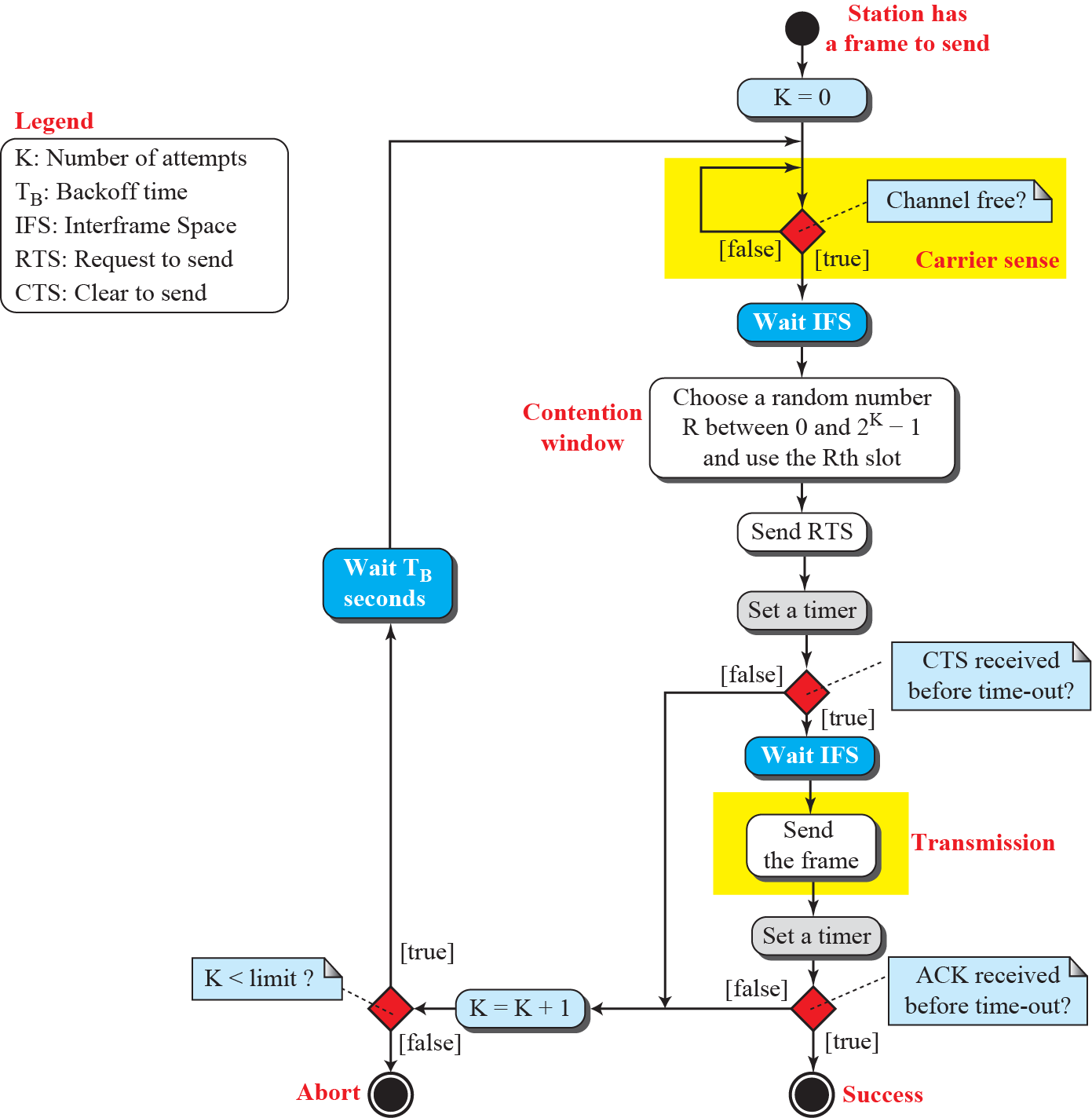
Flow Diagram for CSMA/CA

Slide 23
CSMA/CA
Interframe Space (IFS): Collisions are avoided by deferring transmission even if the channel is idle
Contention Window: Amount of time divided into slots. Station chooses a random number of slots as its wait time (one slot first time and double each time system cannot detect an idle channel)

Slide 24
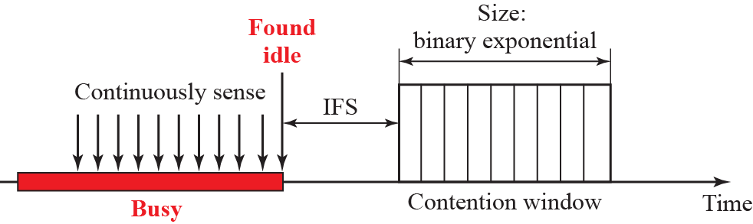
Contention Window

Slide 25
CSMA/CA
Acknowledgement: Positive acknowledgement and time-out timer can help guarantee that the receiver has received the frame

Slide 26
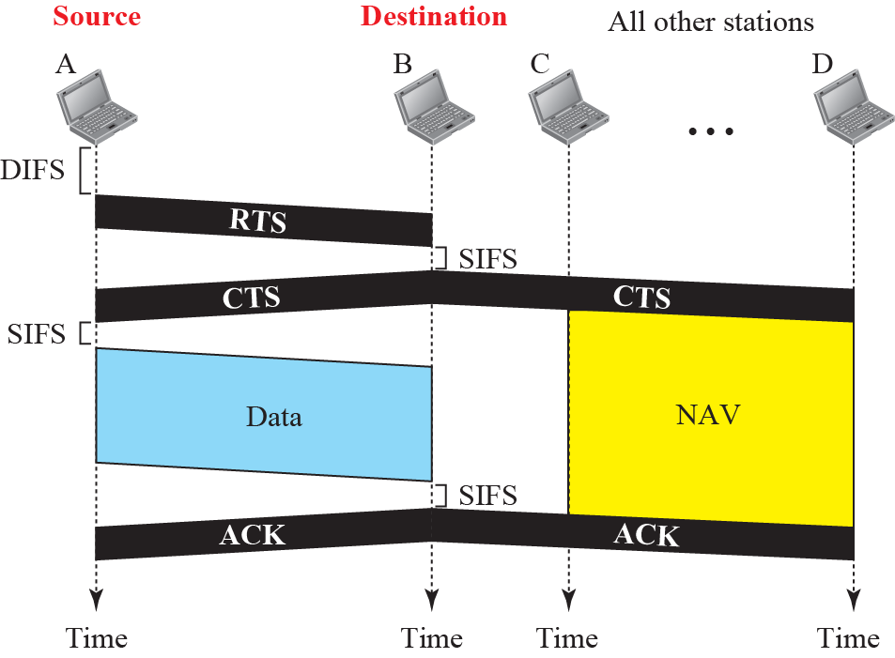
CSMA/CA and Network Allocation Vector (NAV)

Slide 27
CONTROLLED ACCESS
The stations consult one another to find which station has the right to send
A station cannot send unless authorized by other stations
We discuss three controlled-access methods:
  Reservation
  Polling
  Token Passing

Slide 28
Reservation
In the reservation method, a station needs to make a reservation before sending data
Time is divided into intervals
In each interval, a reservation frame precedes the data frames sent in that interval

Slide 29
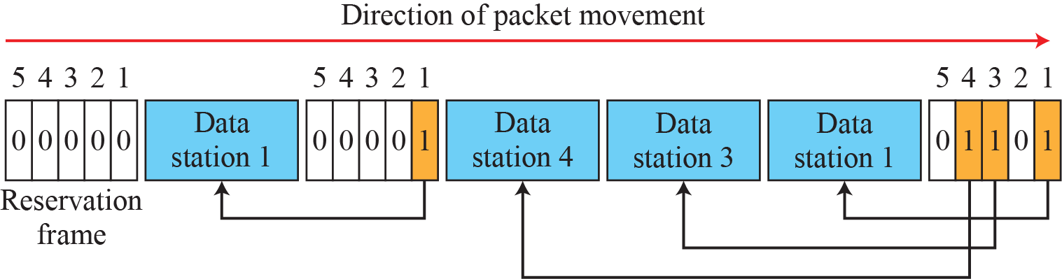
Reservation Access Method

Slide 30
Polling
Polling works with topologies in which one device is designated as a primary station and the other devices are secondary stations
All data exchanges must be made through primary device even when the ultimate destination is a secondary device

Slide 31
Polling
The primary device controls the link; the secondary devices follow its instructions

Slide 32


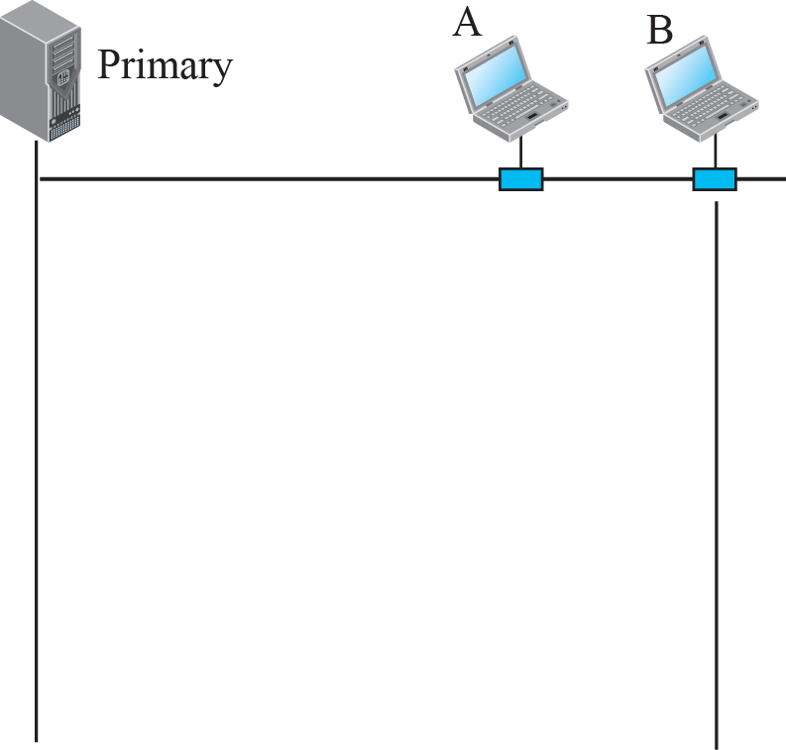
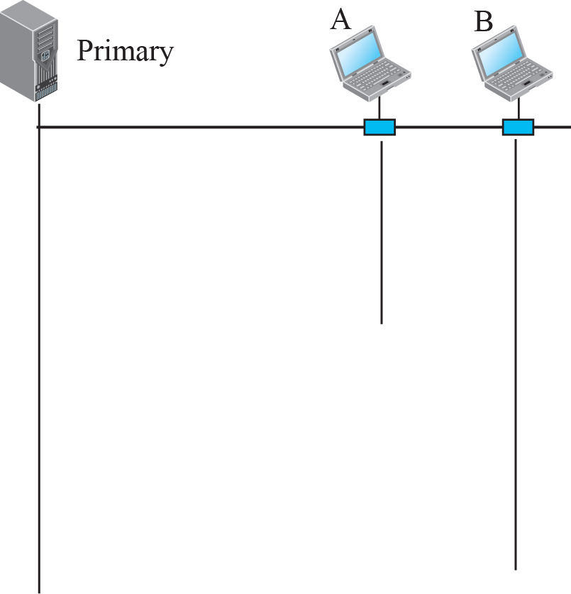





Select and Poll Functions in Polling-Access Method

Slide 33
Token Passing
In the token-passing method, the stations in a network are organized in a logical ring
For each station, there is a predecessor and a successor
The predecessor is the station which is logically before the station in the ring; the successor is the station which is after the station in the ring

Slide 34
Token Passing
Special packet called TOKEN circulates through the ring
Possession of TOKEN gives the station the right to send the data
TOKEN Management is required to manage possession time, Token monitoring, priority assignment etc.

Slide 35
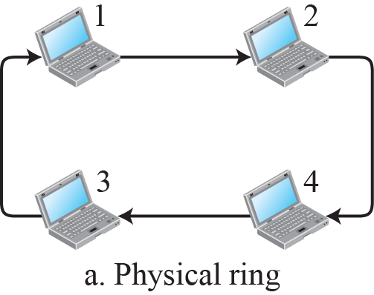
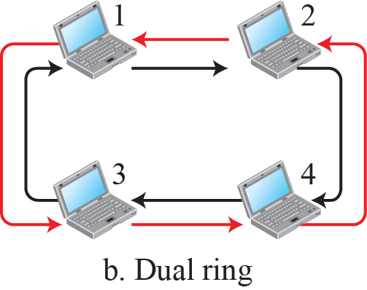
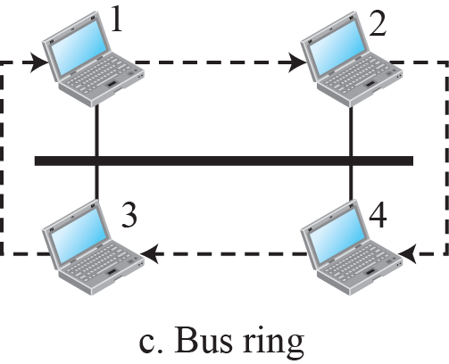
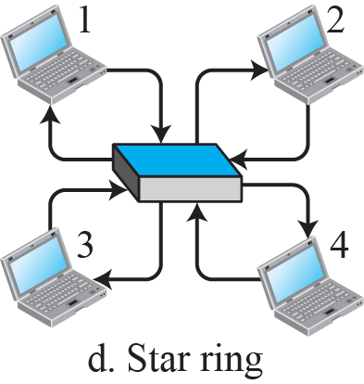
Logical Ring & Physical Topology in Token-Passing Method

Slide 36
CHANNELIZATION (Channel Partition)
The available bandwidth of a link is shared in time, frequency, or through code, among different stations
We discuss three protocols:
  Frequency Division Multiple Access (FDMA)
  Time Division multiple Access (TDMA)
  Code Division Multiple Access (CDMA)

Slide 37
Frequency-Division Multiple Access (FDMA)
In FDMA, the available bandwidth is divided into frequency bands
Each station is allocated a band to send its data i.e. each band is reserved for a specific station, and it belongs to the station all the time
Each station also uses a bandpass filter to confine the transmitter frequencies

Slide 38
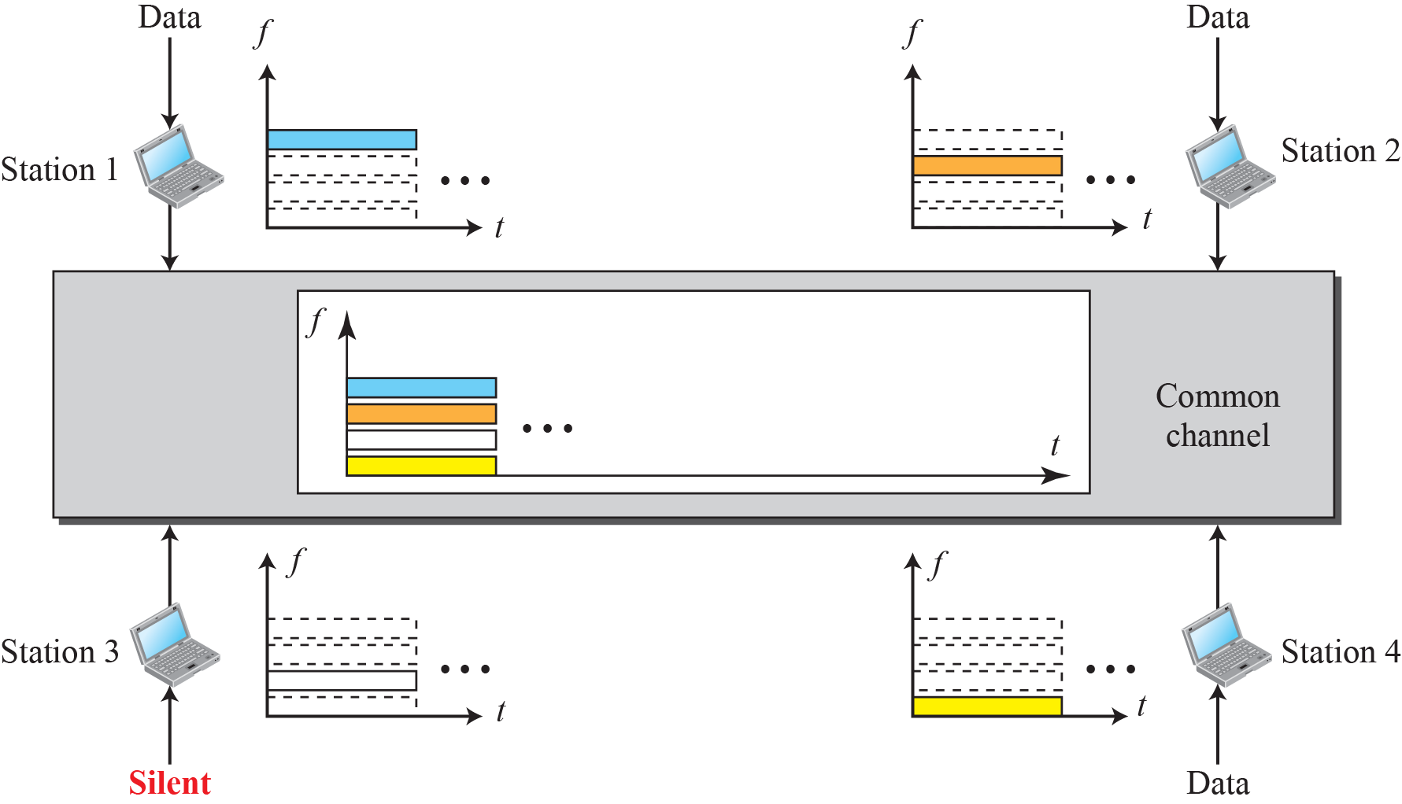
Frequency-Division Multiple Access (FDMA)

Slide 39
TDMA
Stations share the bandwidth of the channel in time
Each station is allocated a time slot during which it can send data
Each station transmits its data in its assigned time slot

Slide 40
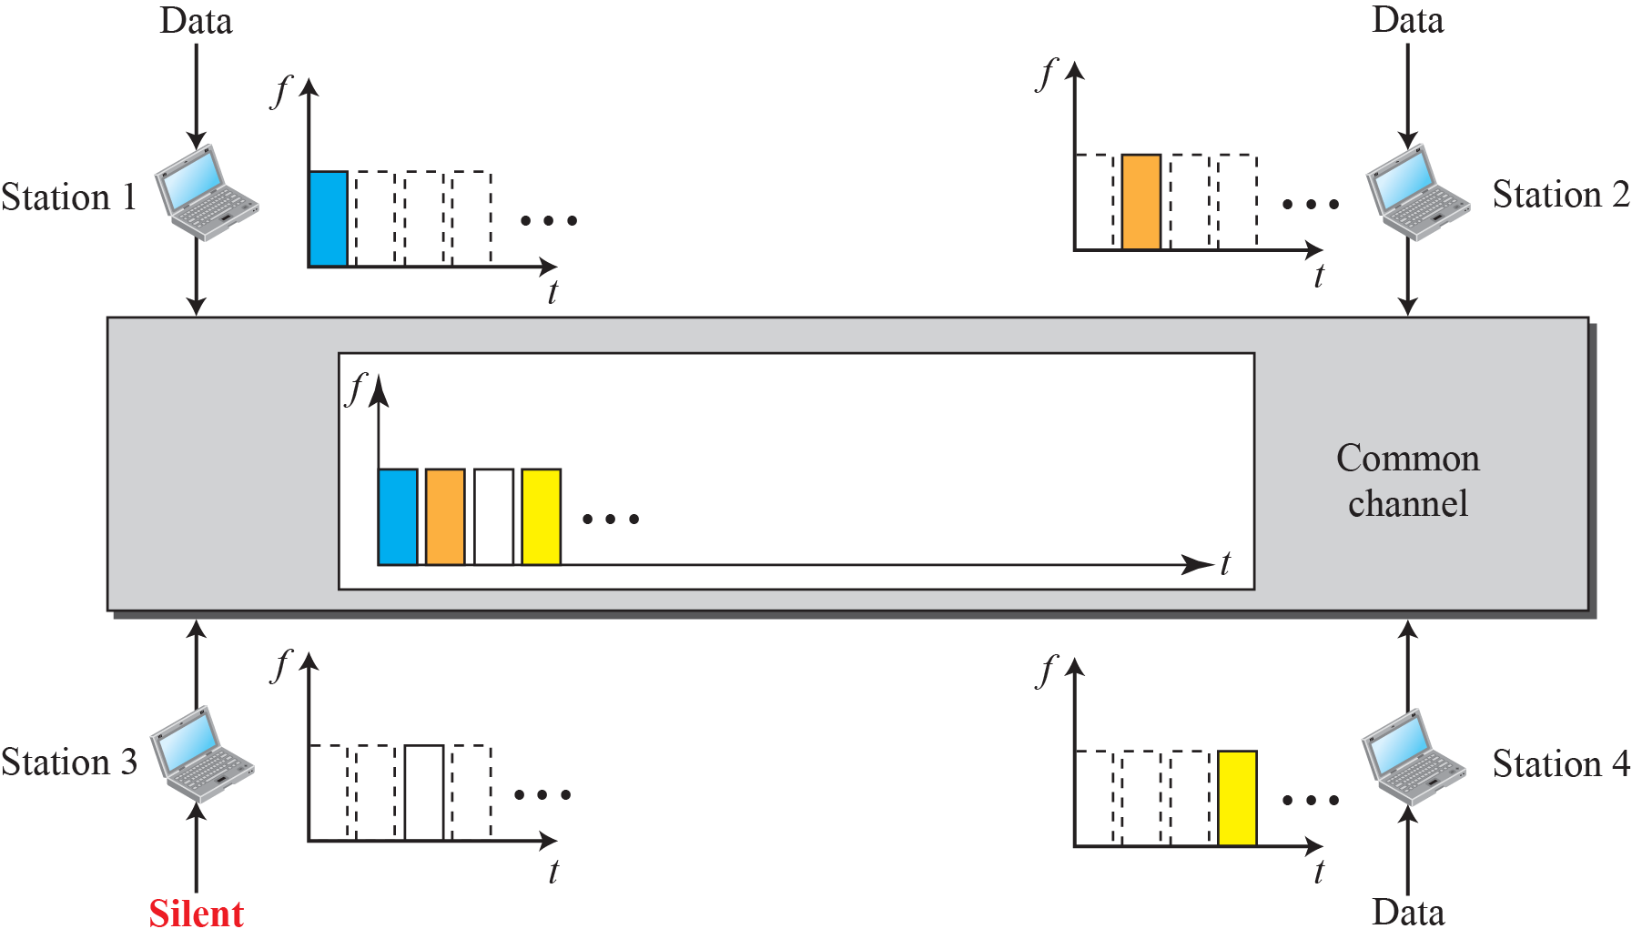
Time-Division Multiple Access (TDMA)

Slide 41
Code Division Multiple Access (CDMA)
CDMA differs from FDMA in that only one channel occupies the entire bandwidth of the link
CDMA differs from TDMA in that all stations can send data simultaneously; there is no timesharing

Slide 42
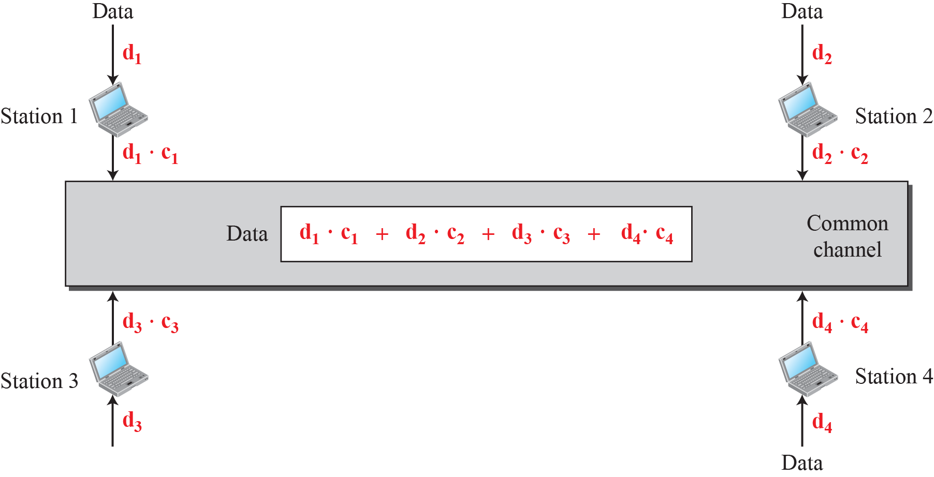
Simple idea of Communication with Code

Slide 43
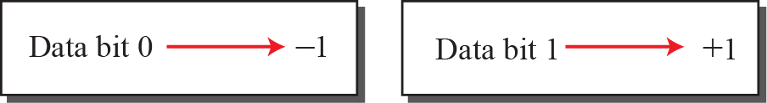
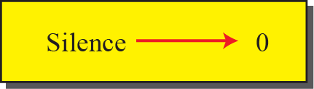
Data Representation in CDMA

