Slide 1
Ethernet Protocol
Data-link layer and the physical layer are the territory of the local and wide area networks
We can have wired or wireless networks

Slide 2
IEEE Project 802
In 1985, the Computer Society of the IEEE started a project, called Project 802, to set standards to enable inter-communication among equipment from a variety of manufacturers
Project 802 did not seek to replace any part of the OSI model or TCP/IP protocol suite

Slide 3
IEEE Project 802
A way of specifying functions of the physical layer and the data-link layer of major LAN protocols

Slide 4
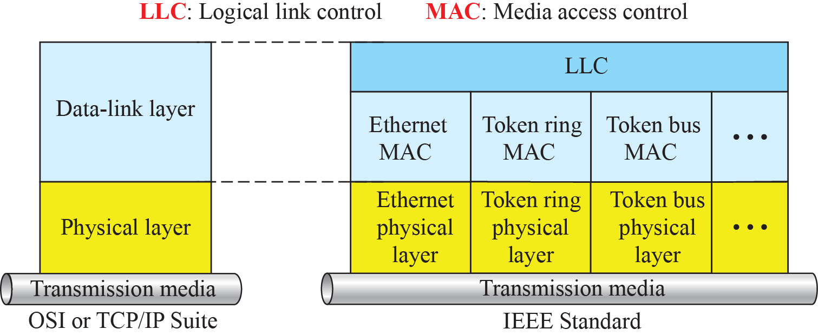
IEEE Standard for LANs

Slide 5
Ethernet Evolution
The Ethernet LAN was developed in the 1970s
Since then, it has gone through four generations:
  Standard Ethernet (10 Mbps)
  Fast Ethernet (100 Mbps)
  Gigabit Ethernet (1 Gbps)
  10 Gigabit Ethernet (10 Gbps)

Slide 6
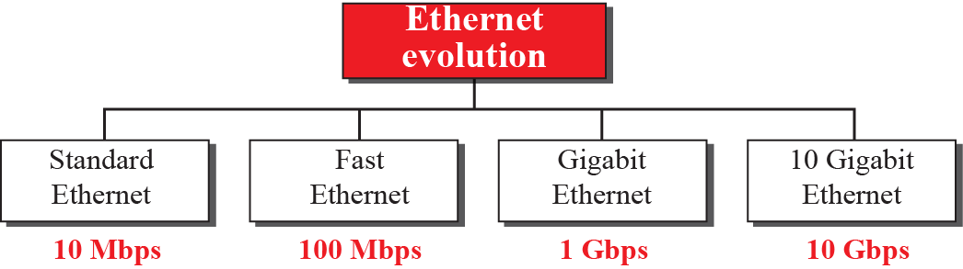
Ethernet Evolution

Slide 7
Standard Ethernet
The original Ethernet technology with the data rate of 10 Mbps is called Standard Ethernet
Most implementations have moved to later evolutions
Still some features of the Standard Ethernet that have not changed during the evolution

Slide 8
Connectionless & Unreliable Service
Each frame is independent of other
No connection establishment or tear down process
The sender may overwhelm receiver with frames and frames are dropped
If frame drops, sender will not know about it unless we are using TCP (Transport)

Slide 9
Connectionless & Unreliable Service
Ethernet is unreliable like IP and UDP
If a frame is corrupted, receiver silently drops it
Left to high level protocols to find out abut it

Slide 10
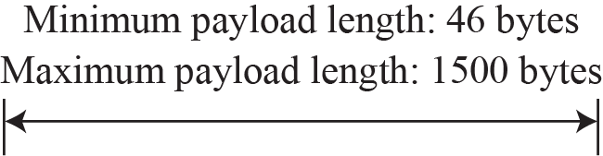
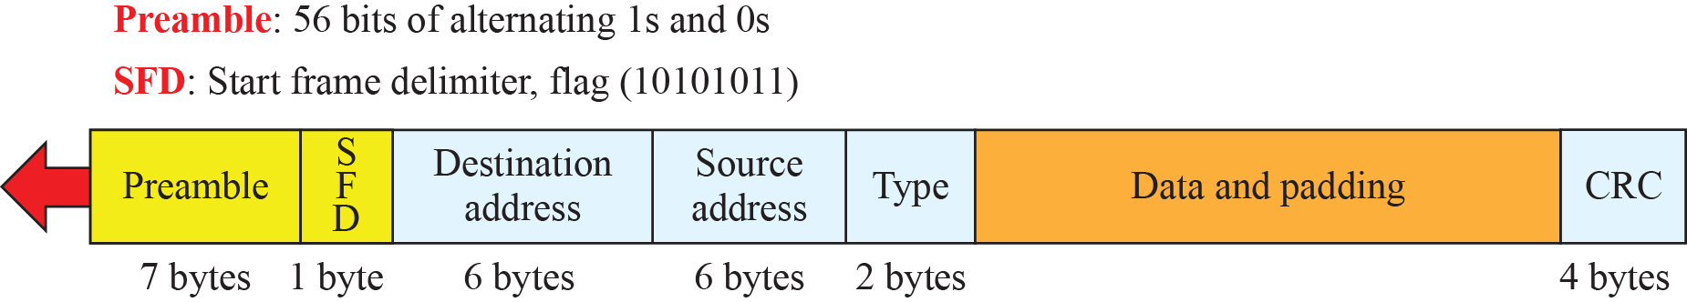
Ethernet Frame Format

Slide 11
Addressing in Standard Ethernet
Each station on Ethernet has its own network interface card (NIC)
The NIC fits inside the station and provides the station with a link-layer/physical address
The Ethernet address is 6 bytes (48 bits), normally written in hexadecimal notation, with a colon between the bytes

Slide 12
Addressing
For example, the following shows an Ethernet MAC address:
4A:30:10:21:10:1A

Slide 13
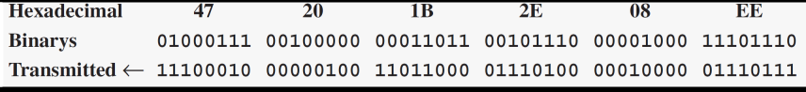
Transmission of Address Bits
How the address 47:20:1B:2E:08:EE is sent out online.
The address is sent left to right, byte by byte; for each byte, it is sent right to left, bit by bit, as shown below:

Slide 14

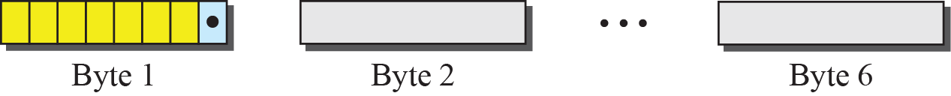
Unicast and Multicast Addresses

Slide 15
Example 13.2
Define the type of the following destination addresses:
4A:30:10:21:10:1A
47:20:1B:2E:08:EE
FF:FF:FF:FF:FF:FF
To find the type of the address, we need to look at the second hexadecimal digit from the left. If it is even, the address is unicast. If it is odd, the address is multicast. If all digits are Fs, the address is broadcast. Therefore, we have the following:
This is a unicast address because A in binary is 1010 (even).
This is a multicast address because 7 in binary is 0111 (odd).
This is a broadcast address because all digits are Fs in hexadecimal.

Slide 16
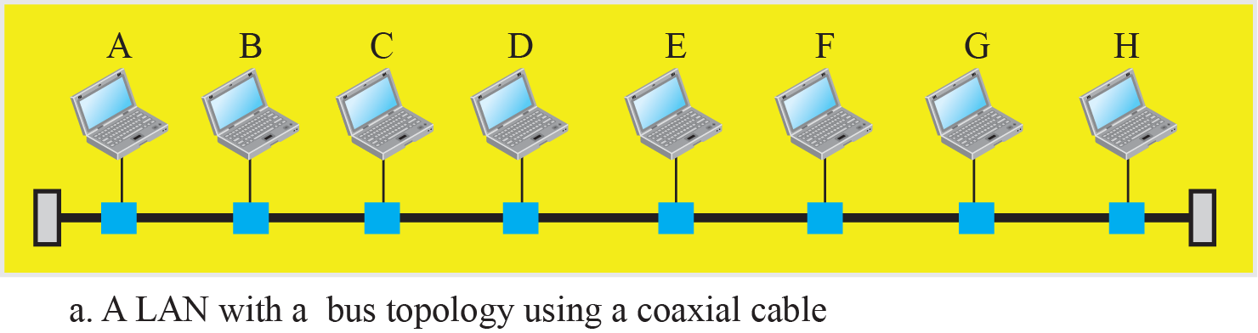
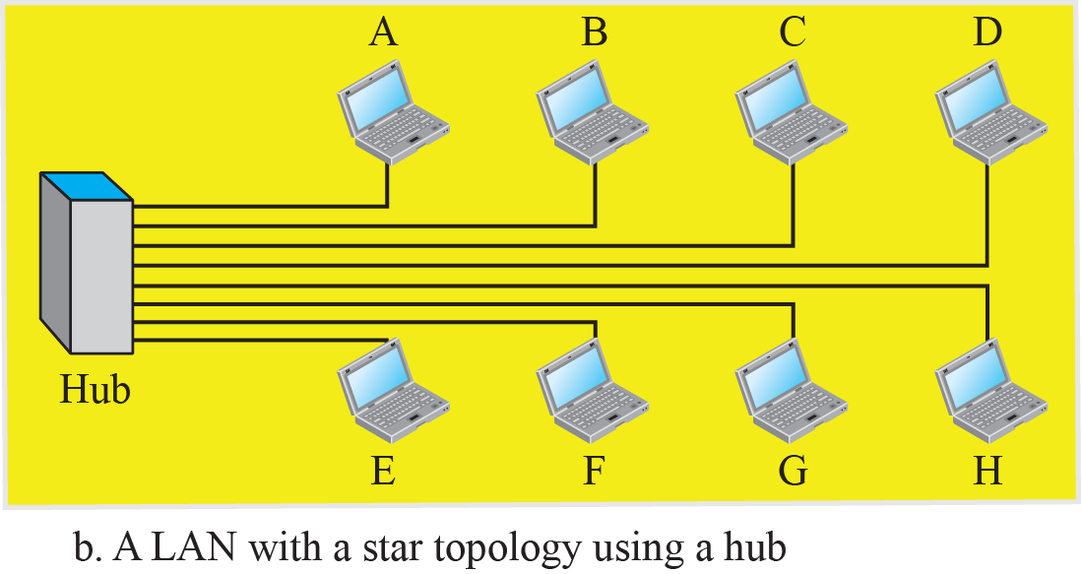
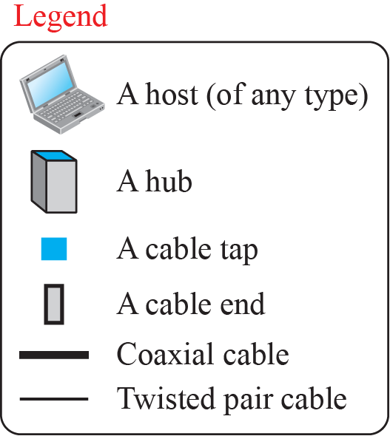
Implementation of Standard Ethernet

Slide 17
Access Method in Standard Ethernet
Since the network that uses the standard Ethernet protocol is a broadcast network, we need to use an access method to control access to the sharing medium
The standard Ethernet chose CSMA/CD with 1-Persistent Method

Slide 18
Access Method in Standard Ethernet

Slide 19
Efficiency of Standard Ethernet
The ratio of the time used by a station to send data to the time the medium is occupied by this station
The practical efficiency of standard Ethernet has been measured to be:
Efficiency = 1/(1+ 6.4 x a)
  where a = number of frames that can fit on a medium

Slide 20
Example
In the Standard Ethernet with the transmission rate of 10 Mbps, we assume that the length of the medium is 2500 m and the size of the frame is 512 bits. The propagation speed of a signal in a cable is normally 2 × 10^{8 m/s.}

Slide 21
Implementation of Standard Ethernet
The Standard Ethernet defined several implementations, but only four of them became popular during the 1980s

Slide 22
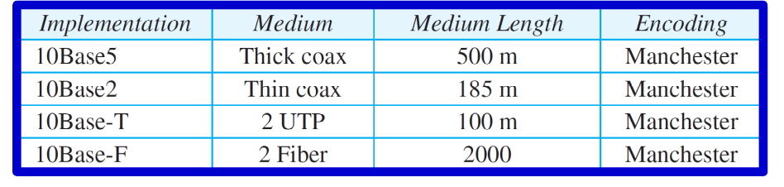
Summary of Standard Ethernet implementations

Slide 23
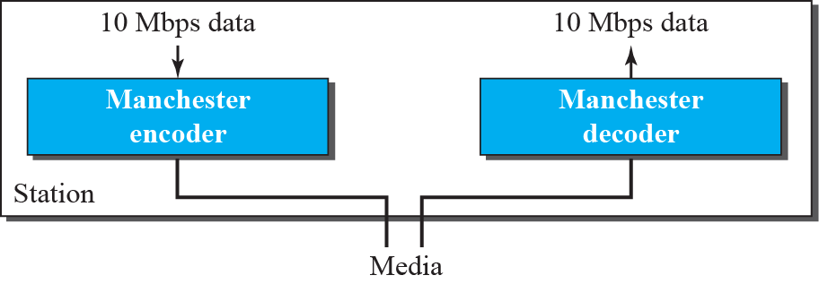
Encoding in Standard Ethernet

Slide 24
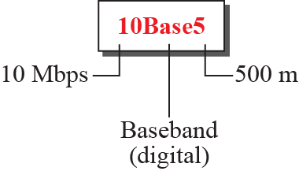
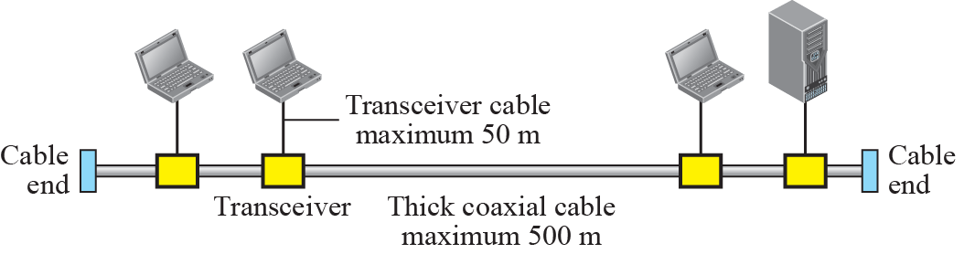
10Base5 implementation

Slide 25
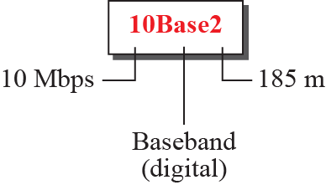
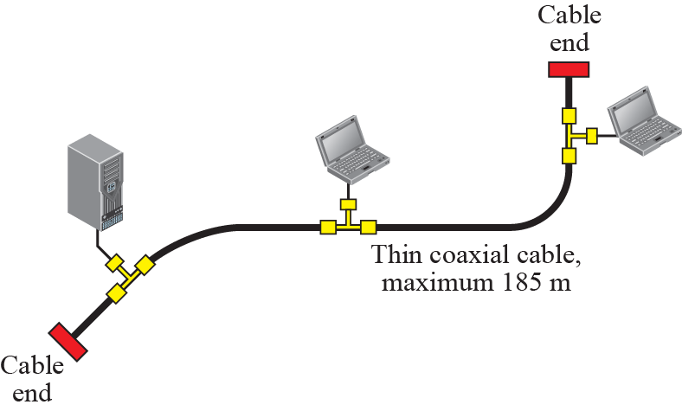
10Base2 implementation

Slide 26
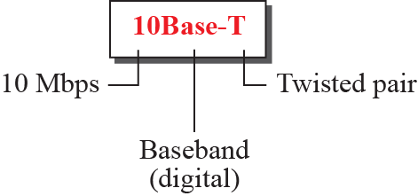
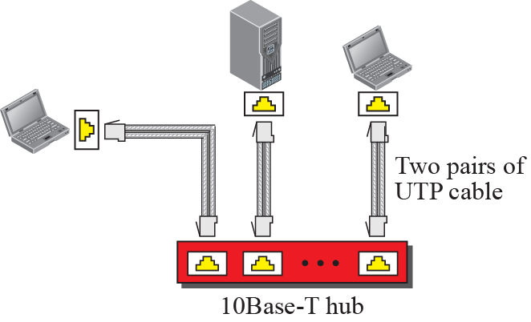
10Base-T implementation

Slide 27
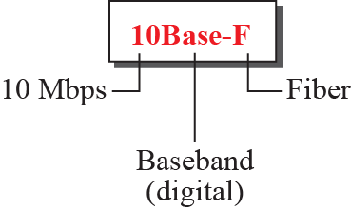
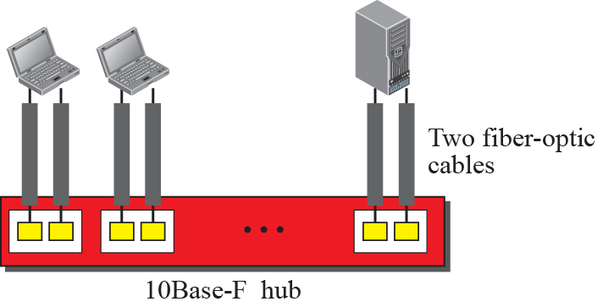
10Base-F implementation

Slide 28
Changes in the Standard
The changes that occurred to the 10-Mbps Standard Ethernet opened the road to the evolution of the Ethernet to become compatible with other high-data-rate LANs
  Bridged Ethernet
  Switched Ethernet
  Full-Duplex Ethernet

Slide 29
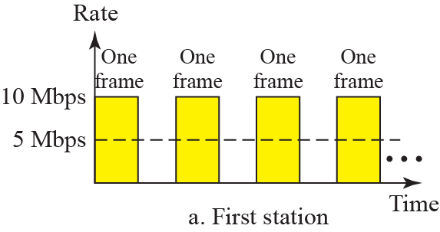
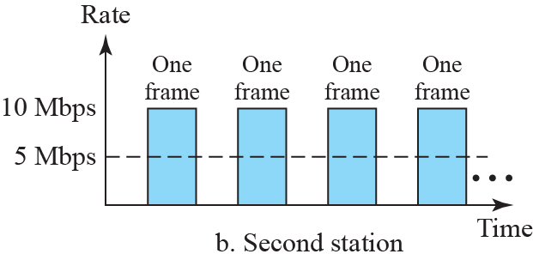
Bridged Ethernet- Sharing Bandwidth

Slide 30
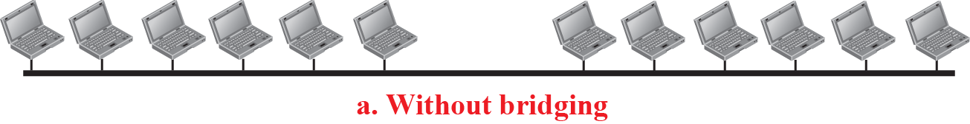
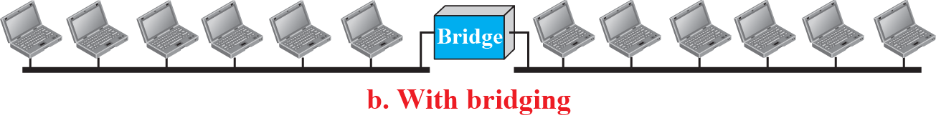
A Network with and without Bridging

Slide 31
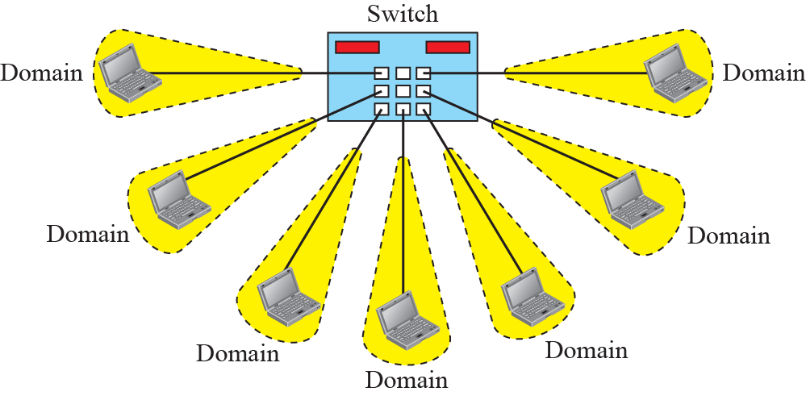
Switched Ethernet

Slide 32
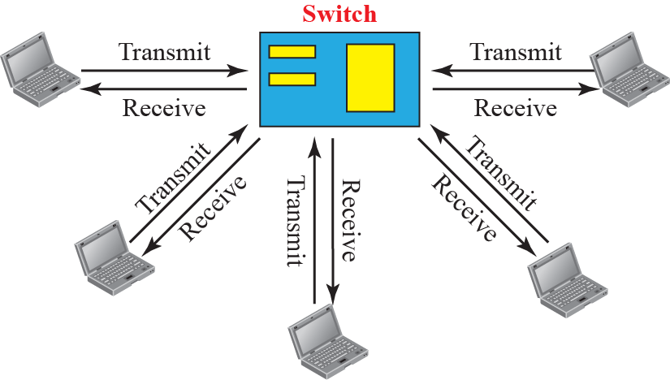
Full – Duplex Switched Ethernet

Slide 33
Fast Ethernet
In the 1990s, Ethernet made a big jump by increasing the transmission rate to 100 Mbps, and the new generation was called the Fast Ethernet
To make it compatible with the Standard Ethernet, the MAC sublayer was left unchanged

Slide 34
Fast Ethernet
But the features of the Standard Ethernet that depend on the transmission rate, had to be changed
Goals of Fast Ethernet:
  Upgrade data rate to 100Mbps
  Make it compatible with Standard Ethernet
  Keep same 48-bit address
  Keep same frame format

Slide 35
Physical Layer
To be able to handle a 100 Mbps data rate, several changes need to be made at the physical layer

Slide 36
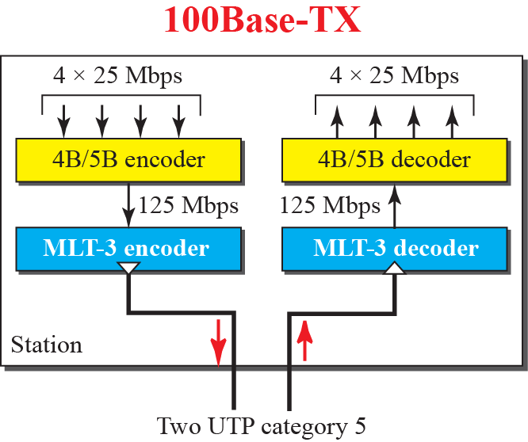
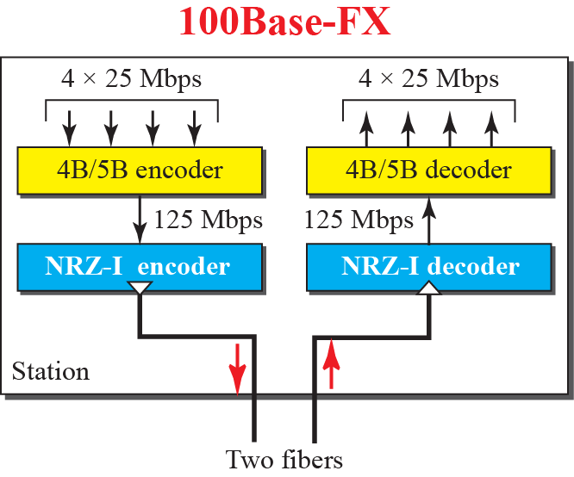
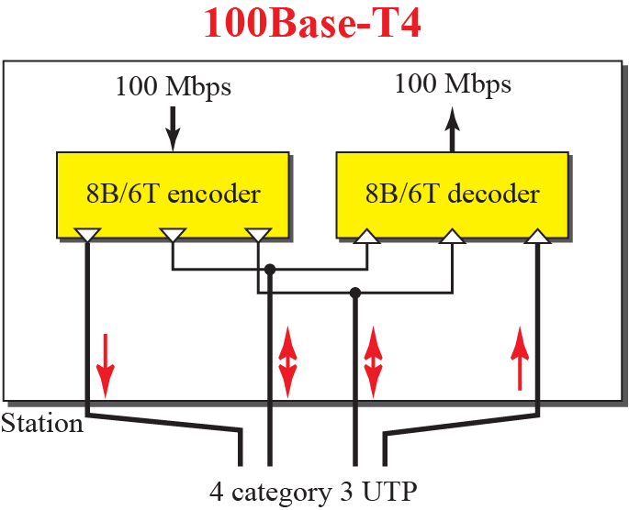
Encoding for Fast Ethernet

Slide 37
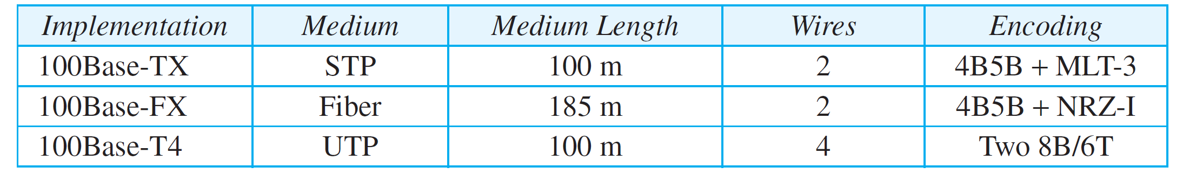
Implementation of Fast Ethernet implementations

Slide 38
Gigabit Ethernet
Need for an even higher data rate resulted in the design of IEEE Standard 802.3z Gigabit Ethernet Protocol (1000 Mbps)

Slide 39
Gigabit Ethernet
The goals of the Gigabit Ethernet were:
  Upgrade the data rate to 1 Gbps
  Make it compatible with standard or Fast Ethernet
  Use same 48 bit address
  Use the same frame format
  Keep same minimum and maximum frame lengths

Slide 40
MAC Sub-layer
A main consideration in the evolution of Ethernet was to keep the MAC sublayer untouched
To achieve a data rate of 1 Gbps, this was no longer possible
Gigabit Ethernet has two distinctive approaches for medium access:
  Half-duplex
  Full-duplex

Slide 41
Physical Layer
The physical layer in Gigabit Ethernet is more complicated than that in Standard or Fast Ethernet
We briefly discuss some features of this layer:

Slide 42
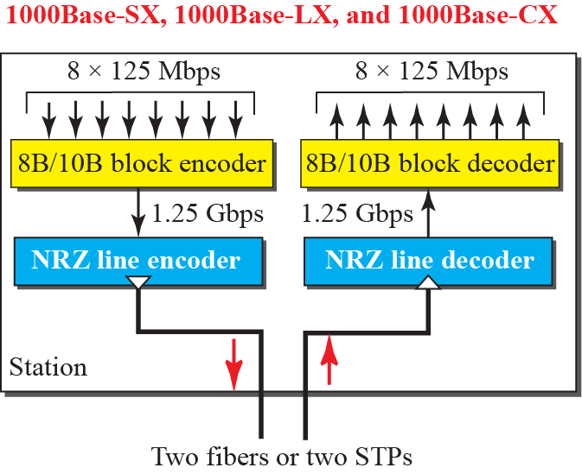
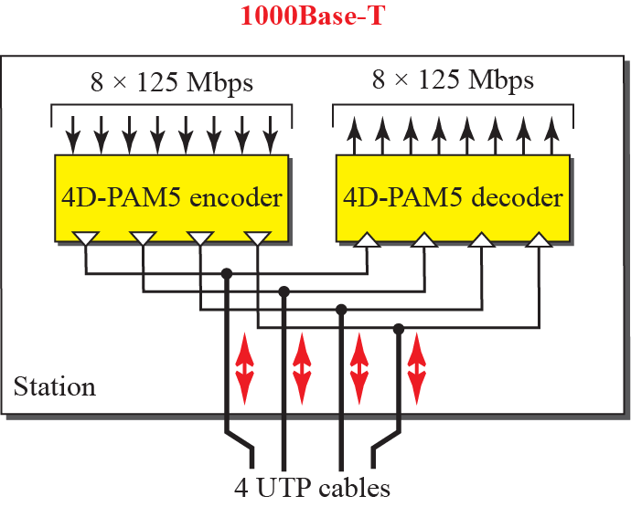
Encoding in Gigabit Ethernet

Slide 43
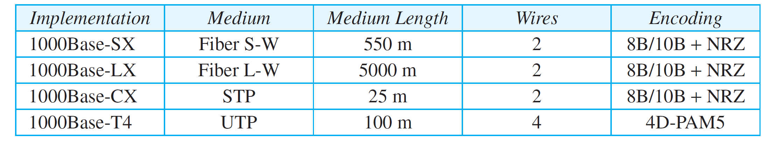
Summary of Gigabit Ethernet Implementations

Slide 44
10-gigabit Ehternet
The idea is to extend the technology, the data rate, and the coverage distance so that the Ethernet can be used in LANs and MANs (metropolitan area network)
The IEEE committee created 10 Gigabit Ethernet and called it Standard 802.3ae

Slide 45
Implementation
10 Gigabit Ethernet operates only in full-duplex mode, which means there is no need for contention; CSMA/CD is not used in 10 Gigabit Ethernet
Four implementations are most common:

Slide 46
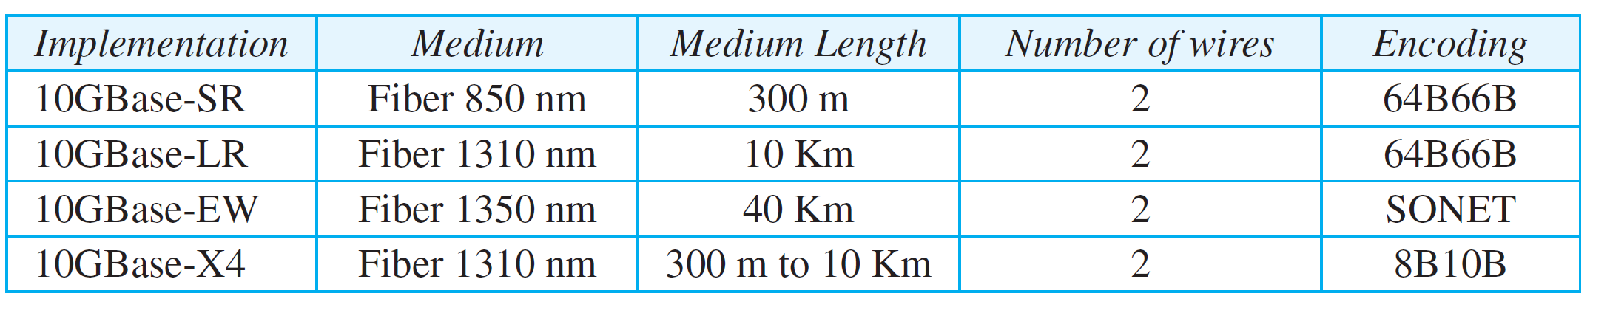
Implementation

