Slide 1
Other Wired Networks
Access Networks
  Networks that connect a small LAN to an ISP
Wide Area Networks
  Wired networks used to transfer data over long distances

Slide 2
Telephone Network
The telephone network had its beginnings in the late 1800s
Plain Old Telephone System (POTS) was originally an analog system using analog signals to transmit voice
With the advent of the computer era, the network, in the 1980s, began to carry data in addition to voice

Slide 3
Telephone Network
During the last decade, the telephone network has undergone many technical changes and the network is now Digital as well as Analog

Slide 4
Major Components
The telephone network is made of three major components:
  Local Loops
  Trunks
  Switching offices
The telephone network has several levels of switching offices:
  End offices
  Tandem offices
  Regional offices

Slide 5
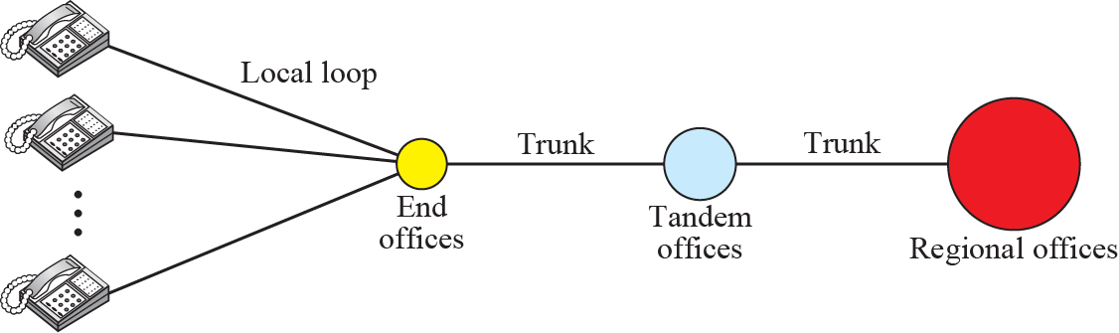
A Telephone System

Slide 6
Local-Access Transport Areas (LATAs)
A LATA can be a small or large metropolitan area
A small state may have a single LATA; a large state may have several LATAs
A LATA boundary may overlap with state boundary; part of a LATA can be in one state, part in another state

Slide 7
Intra-LATA and Inter-LATA Services
Services offered by Telephone companies inside a LATA are called Intra-LATA services and between LATAs are called Inter-LATA services
Carrier that handles Intra-LATA are called a Local Exchange Carrier (LEC) and the ones that handle Inter-LATA are called Interexchange Carriers (IXCs)

Slide 8
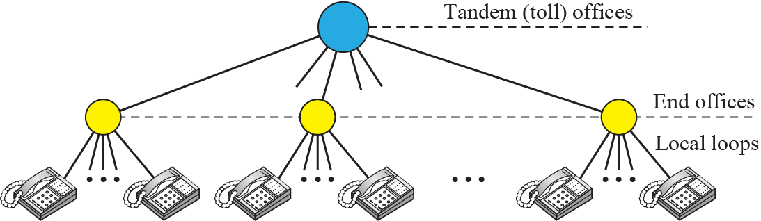
Switching Offices in a LATA

Slide 9
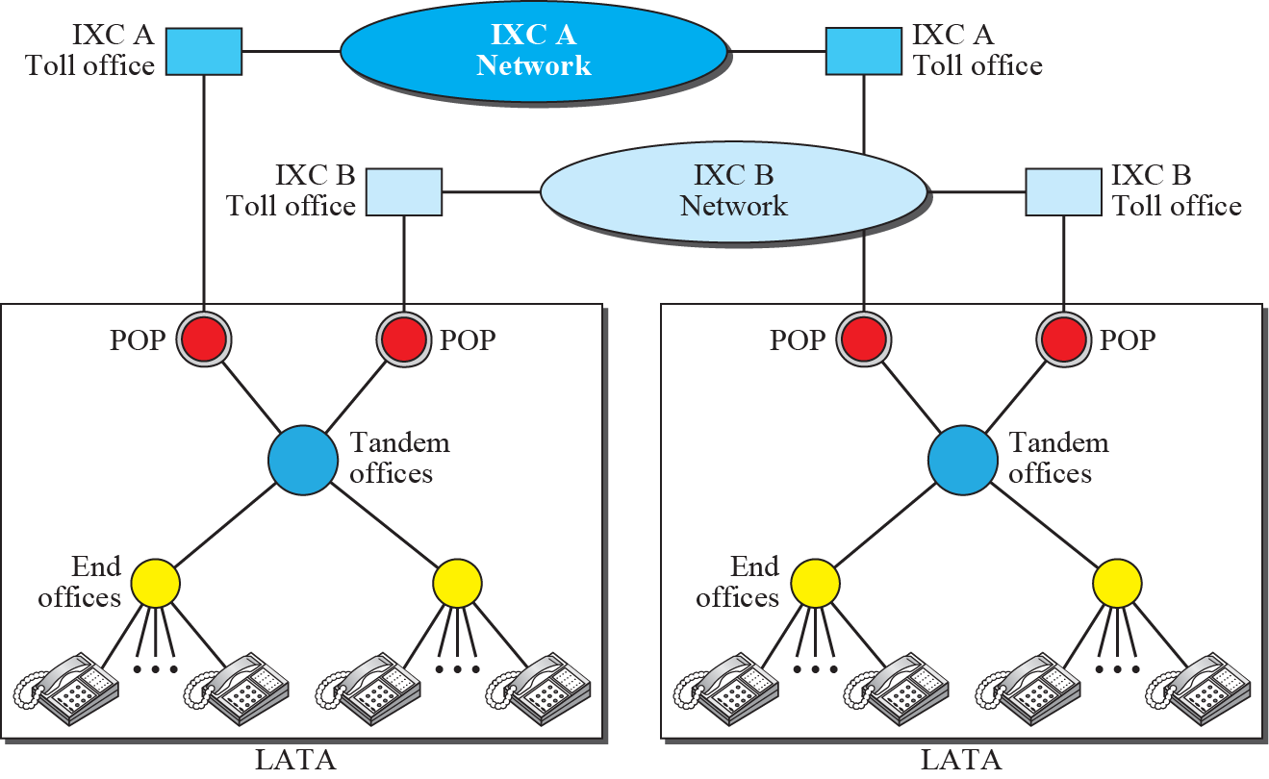
Points of Presence (POPs)

Slide 10
Signaling
The telephone network in the beginning, used a circuit-switched network with dedicated links to transfer voice communication
The operator connected the two parties by using a wire with two plugs inserted into the corresponding two jacks
Later, the signaling system became automatic

Slide 11
Signaling
Rotary telephones were invented that sent a digital signal defining each digit in a multi-digit telephone number
As telephone networks evolved into a complex network, the functionality of the signaling system increased

Slide 12
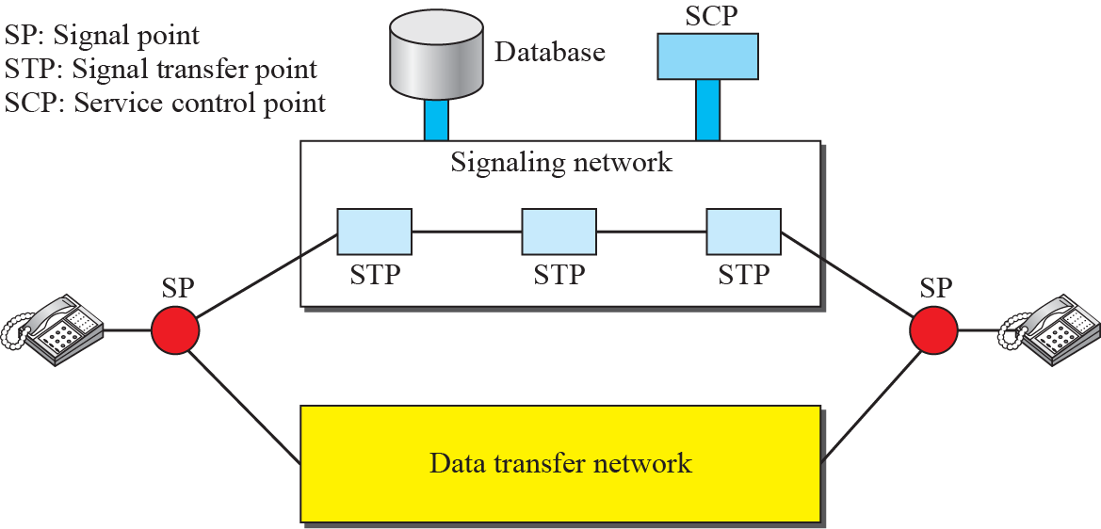
Data Transfer and Signaling Network

Slide 13
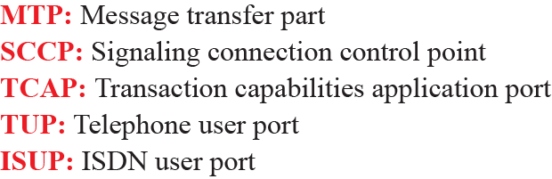
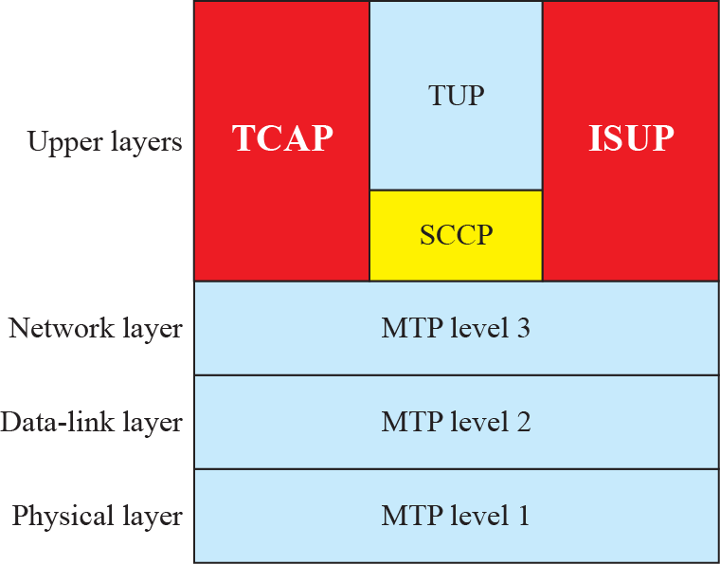
Layers in SS7

Slide 14
Services
Telephone companies provide two types of services:
  Analog Services
    Analog Switched Services
    Analog Leased Services
  Digital Services
    Switched /56 Service
    Digital Data Service

Slide 15
Digital Subscriber Line (DSL)
After traditional dial-up modems reached their peak data rate, telephone companies developed another technology, DSL, to provide higher-speed access to the Internet
DSL supports high-speed digital communication over the existing telephone

Slide 16
Digital Subscriber Line (DSL)
DSL technology is a set of technologies, each differing in the first letter (ADSL, VDSL, HDSL, and SDSL)

Slide 17
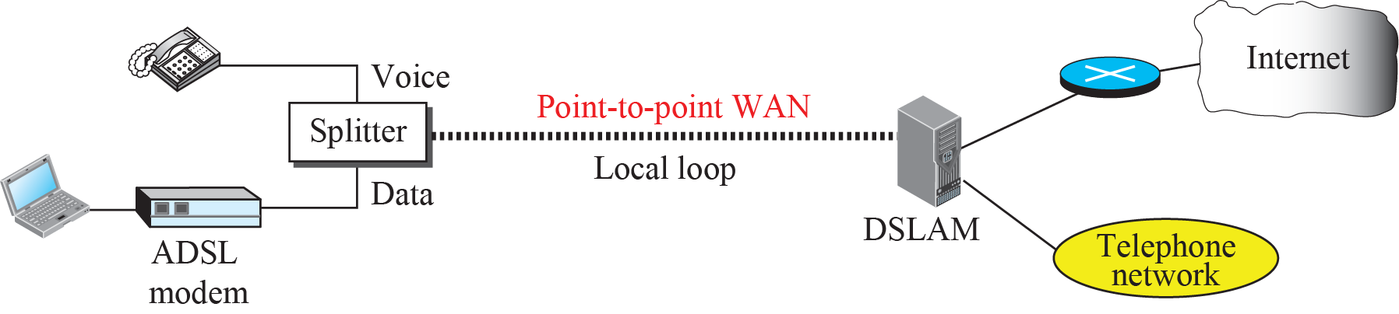
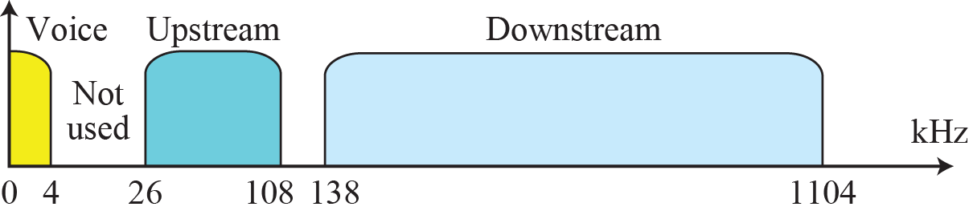
ADSL Point-to-Point Network

Slide 18
Cable Network
The Cable TV networks were initially created to provide remote subscribers access to TV programs
Cable networks enabled access to remote broadcasting stations via microwave connections
Cable TV also found a good ISP market by using some of the channels originally designed for video

Slide 19
Traditional Cable Networks
Cable TV started to distribute broadcast video signals to locations with poor or no reception in the late 1940s
It was called community antenna television (CATV) because an antenna at the top of a tall hill or building received the signals from the TV stations

Slide 20
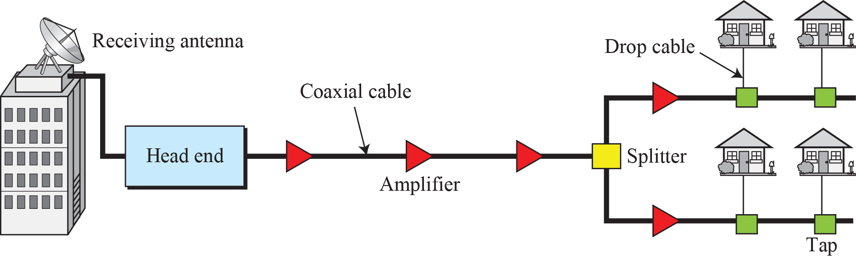
Traditional Cable TV Network

Slide 21
Hybrid Fiber Coaxial (HFC) Network
Second generation of cable network is called a Hybrid Fiber-Coaxial (HFC) network
The network uses a combination of fiber-optic and coaxial cable

Slide 22
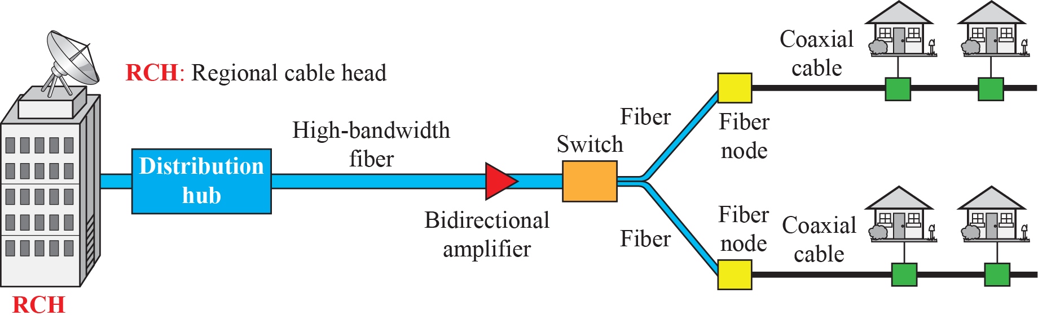
Hybrid Fiber-Coaxial (HFC) Network

Slide 23
Cable TV for Data Transfer
Cable companies are now competing with telephone companies for the residential customer who wants high-speed data transfer
DSL technology provides high-data-rate connections for residential subscribers over the local loop BUT UTP is susceptible to Interfence

Slide 24
Cable TV for Data Transfer
This imposes an upper limit on the data rate. A solution is the use of the cable TV network

Slide 25
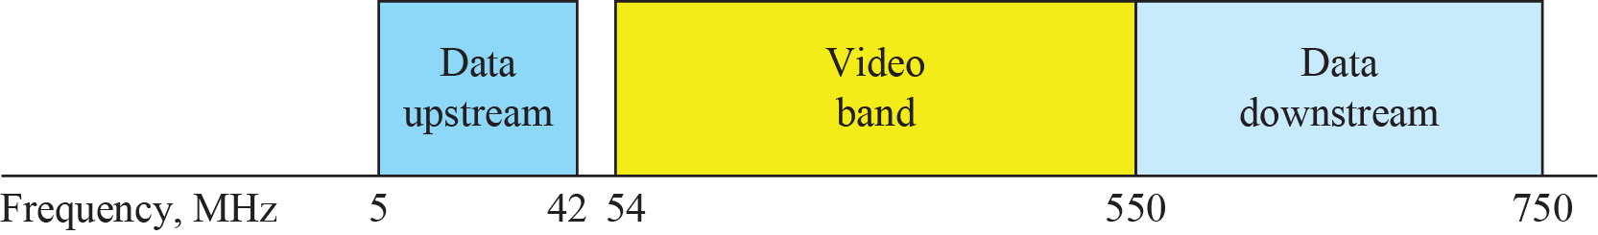
Division of Coaxial Cable Band by CATV

Slide 26
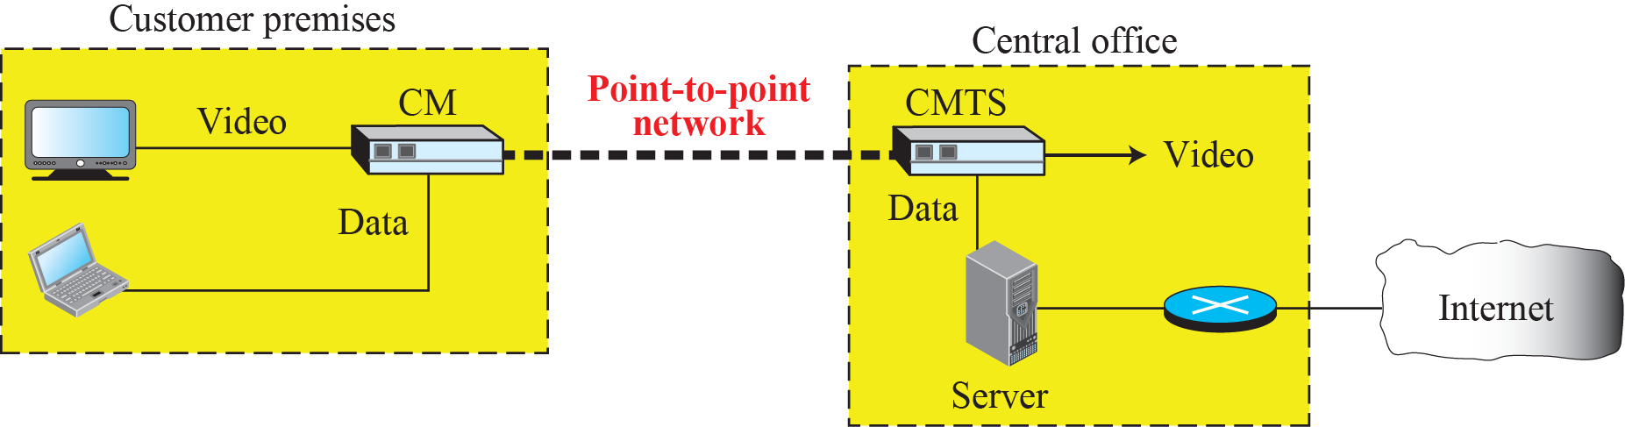
Cable Modem Transmission System (CMTS)

