Slide 1
Synchronous Optical Network (SONET)
A wide area network (WAN) that is used as a transport network to carry loads from other WANs
ITU–T standard called Synchronous Digital Hierarchy (SDH)
Architecture of a SONET system consists of signals, devices, and connections

Slide 2
SONET Architecture
Signals
  Synchronous Transport Signals (STS)
  Optical Carriers (OCs)
  Synchronous Transport Module (STM)
SONET Devcies
  STS Mux/Demux
  Regenerators
  Add-Drop Multiplexer and Terminals
Connections
  Section
  Line
  Path

Slide 3
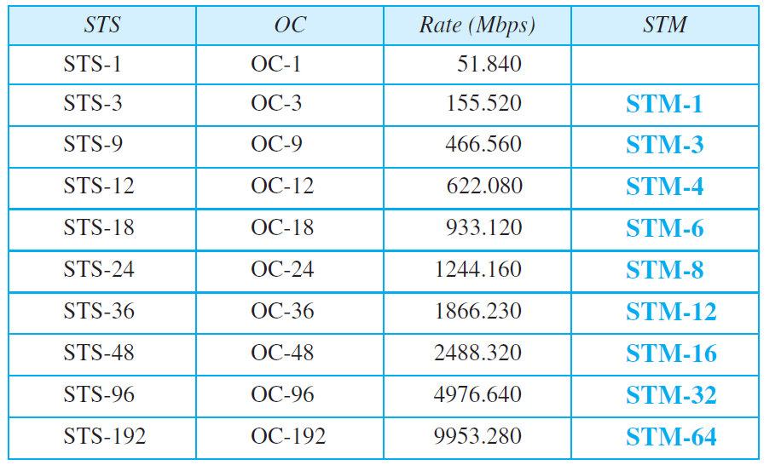
SONET Signals

Slide 4
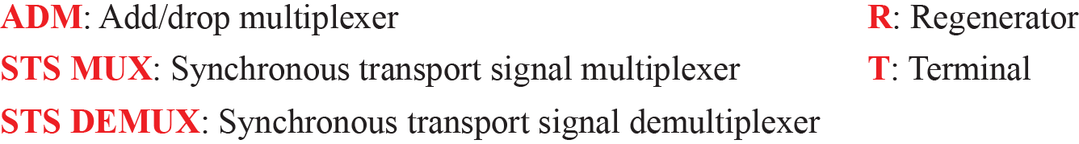
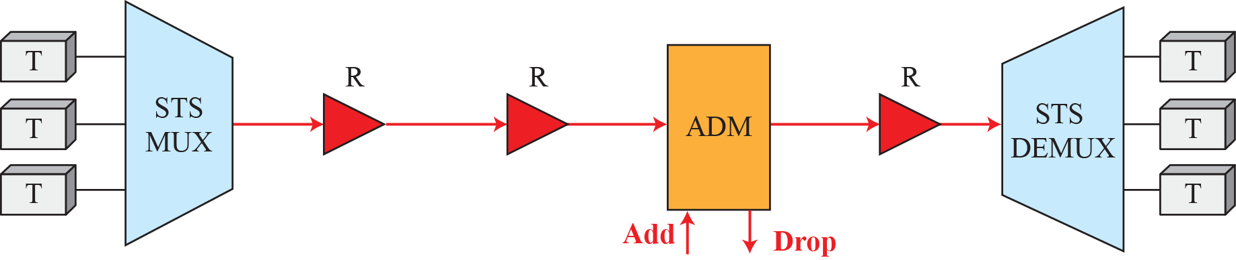
SONET Devices

Slide 5
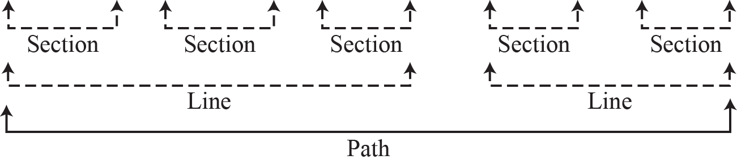
SONET Connections

Slide 6
SONET Layers
The SONET standard includes four functional layers:
  The Path Layer
  The Line Layer
  The Section Layer
  The Photonic Layer
The layers correspond to both the physical and the data-link layers

Slide 7
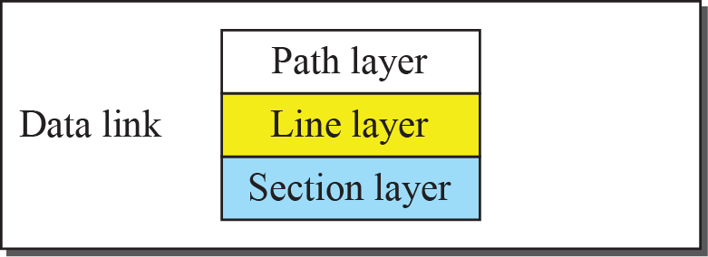
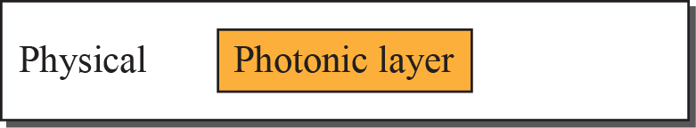
SONET Layers

Slide 8
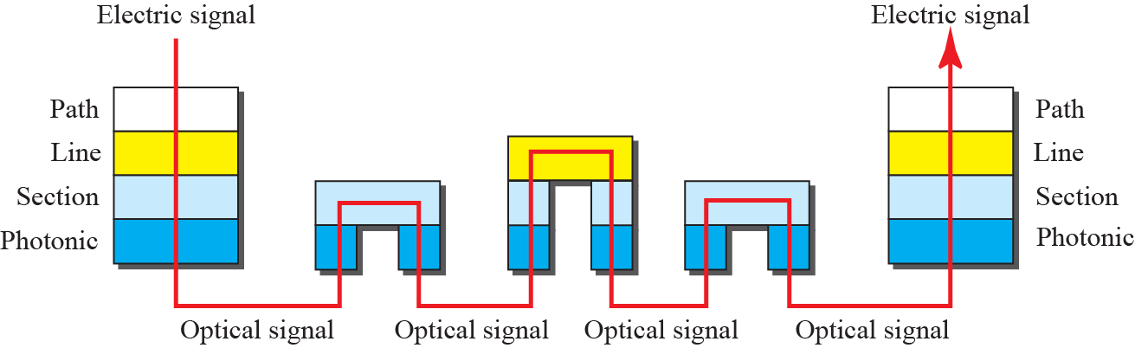
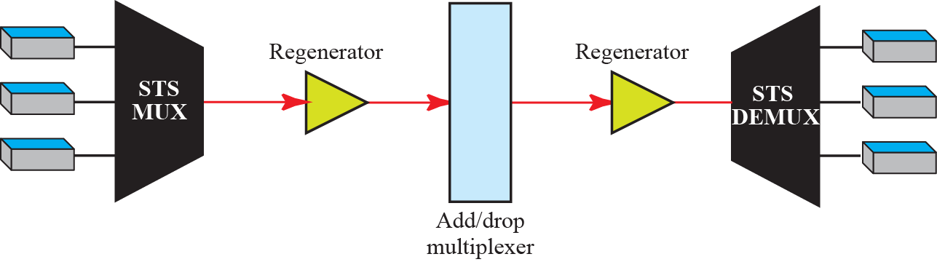
Device-Layer Relationship in SONET

Slide 9
SONET Frames
Each synchronous transport signal STS-n is composed of 8000 frames
Each frame is a two-dimensional matrix of bytes with 9 rows by 90×n columns
STS-1 frame is 9 rows by 90 columns (810 bytes), and an STS-3 is 9 rows by 270 columns (2430 bytes)

Slide 10
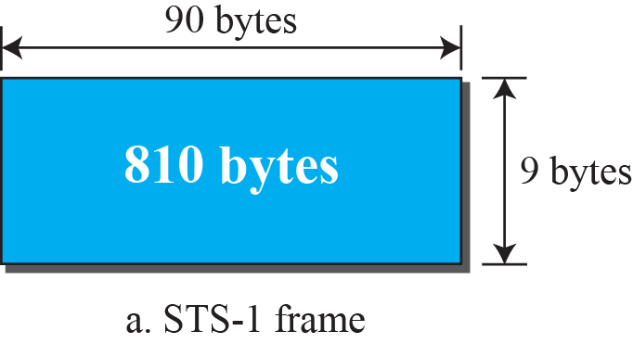
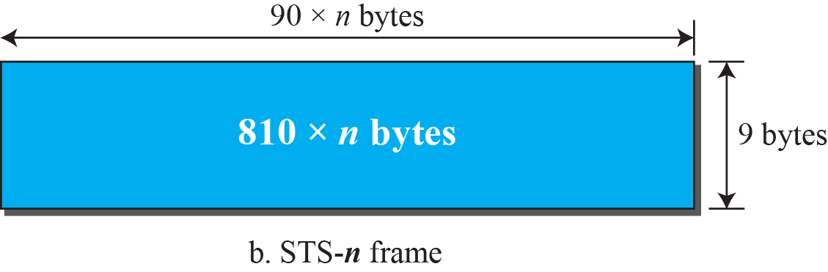
An STS-1 and an STS-n Frame

Slide 11
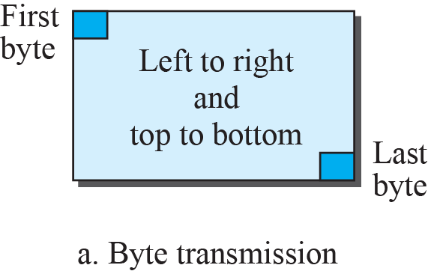
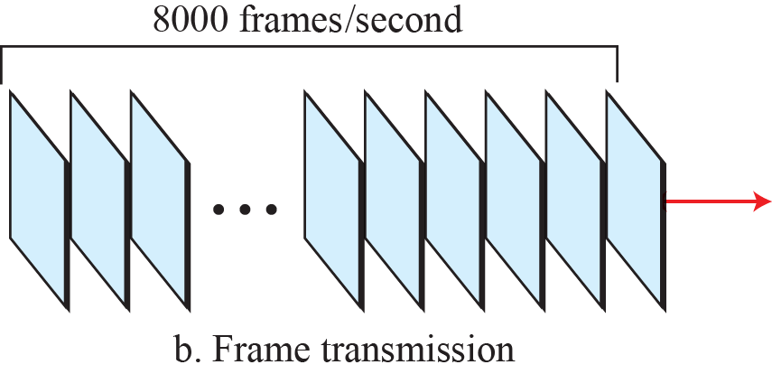
STS-1 Frames in Transition

Slide 12
Example
Find the data rate of an STS-1 signal

Slide 13
Example
Find the data rate of an STS-3 signal

Slide 14
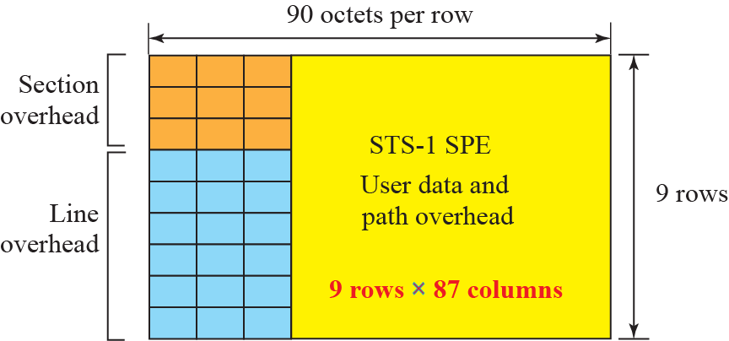
STS-1 Frame Format

Slide 15
STS Multiplexing
In SONET, frames of lower rate can be synchronously time-division multiplexed into a higher-rate frame
For example, three STS-1 signals (channels) can be combined into one STS-3 signal (channel), four STS-3s can be multiplexed into one STS-12, and so on

Slide 16
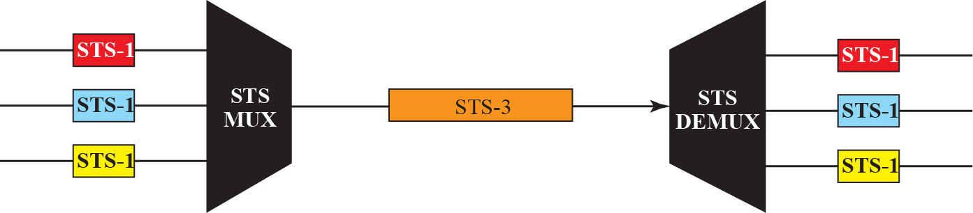
STS Multiplexing/Demultiplexing

Slide 17
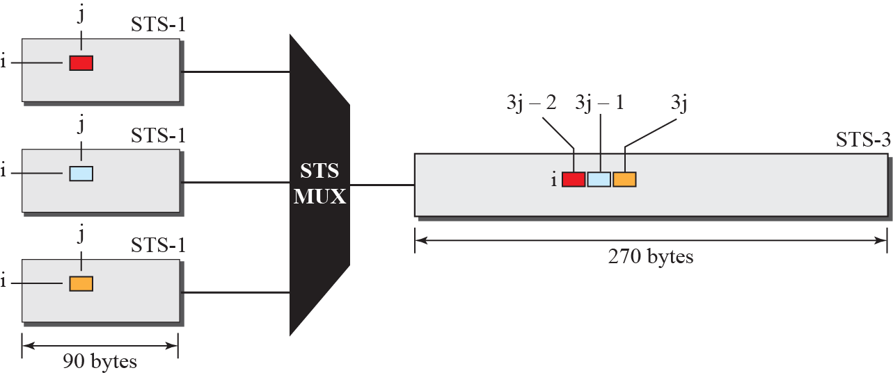
Byte Interleaving

Slide 18
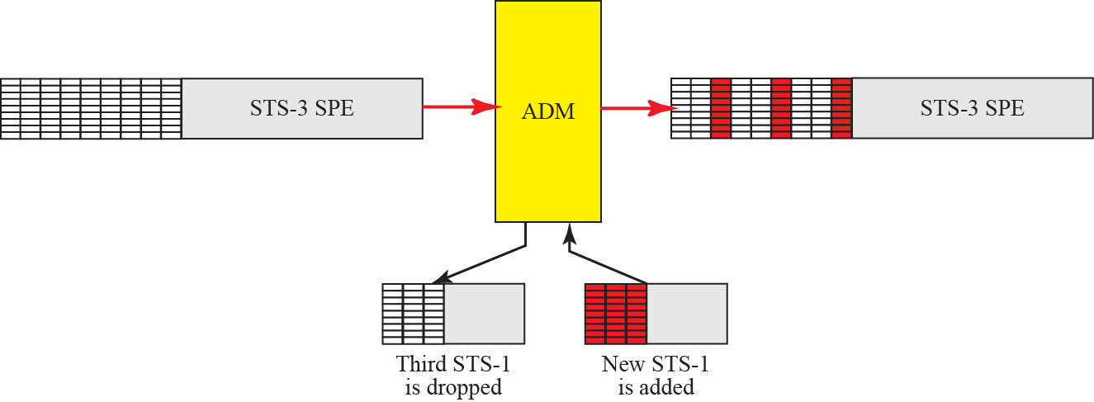
Add/Drop Multiplexer

Slide 19
SONET Networks
SONET network can be used as a high-speed backbone carrying loads from other networks such as ATM or IP
We can roughly divide SONET networks into three categories:
  Linear Networks
  Ring Networks
  Mesh networks

Slide 20
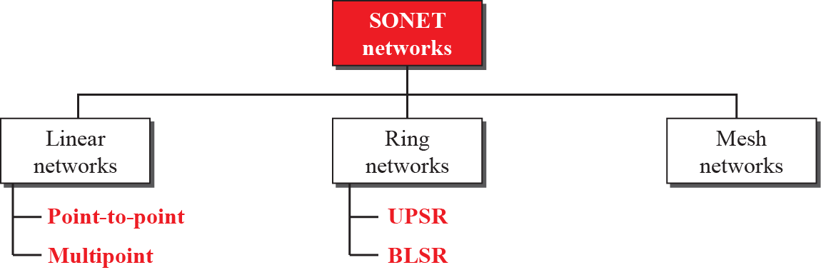
Taxonomy of SONET Networks

Slide 21
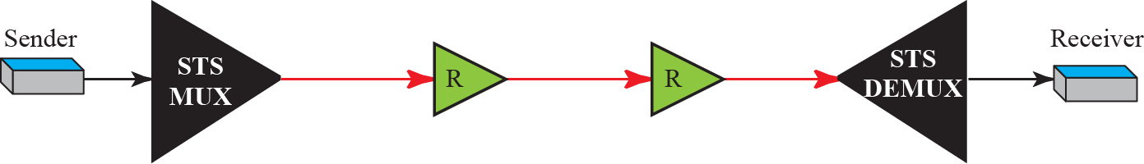
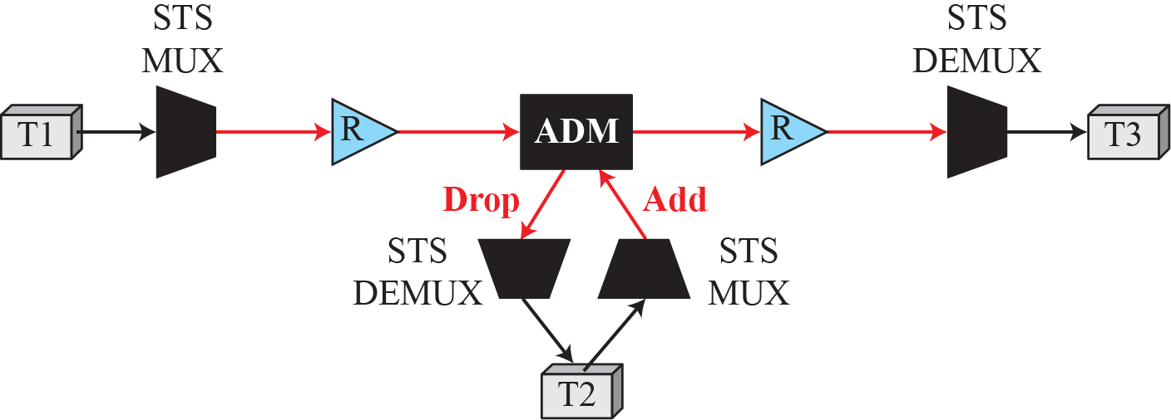
SONET Networks – Linear Networks

Slide 22
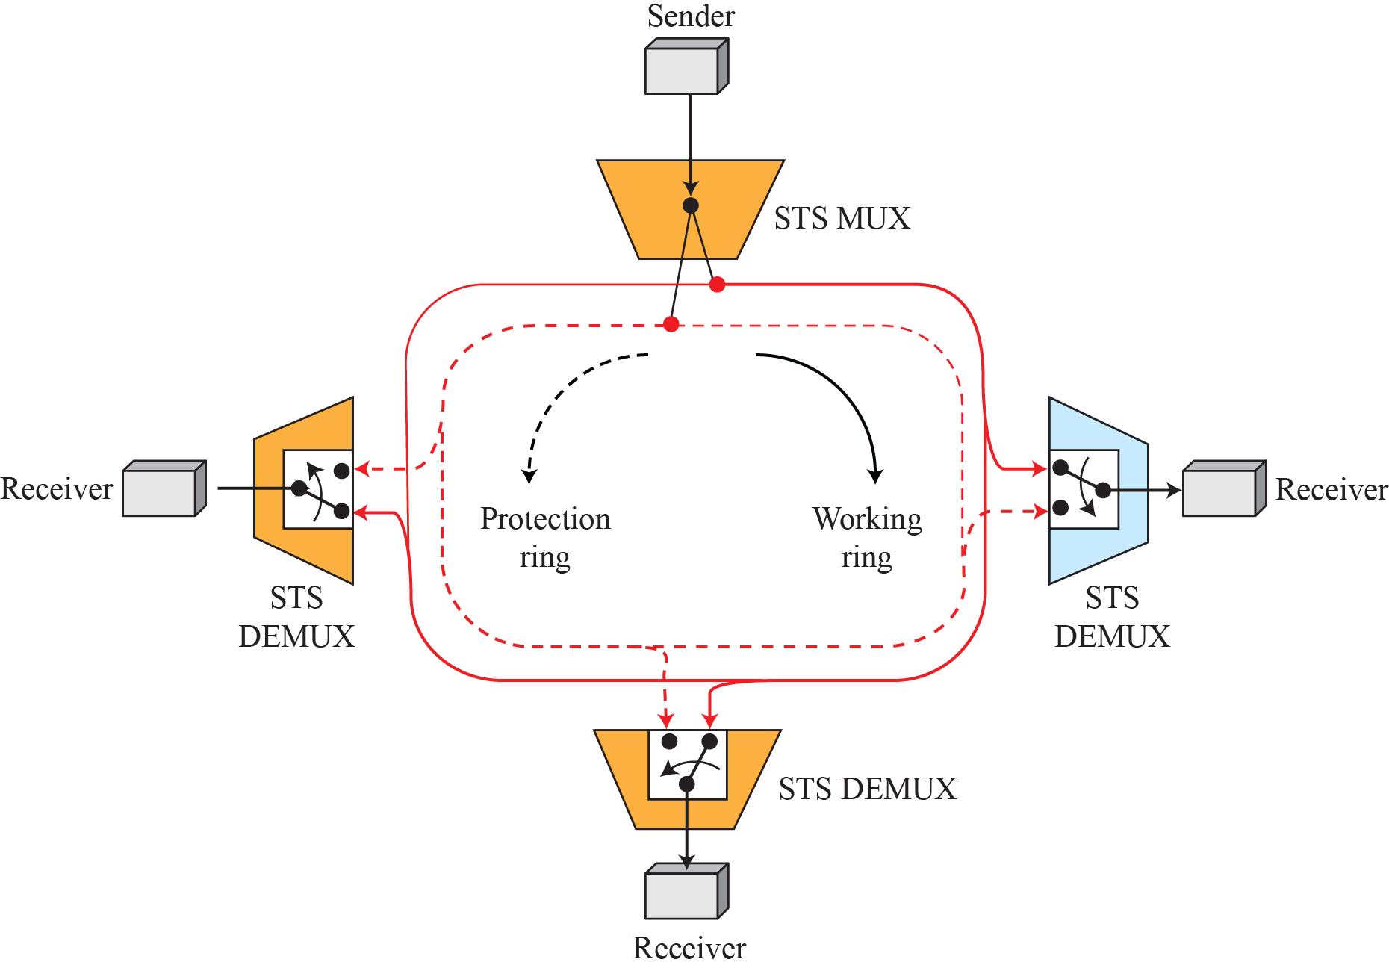
SONET Networks – Ring Networks

Slide 23
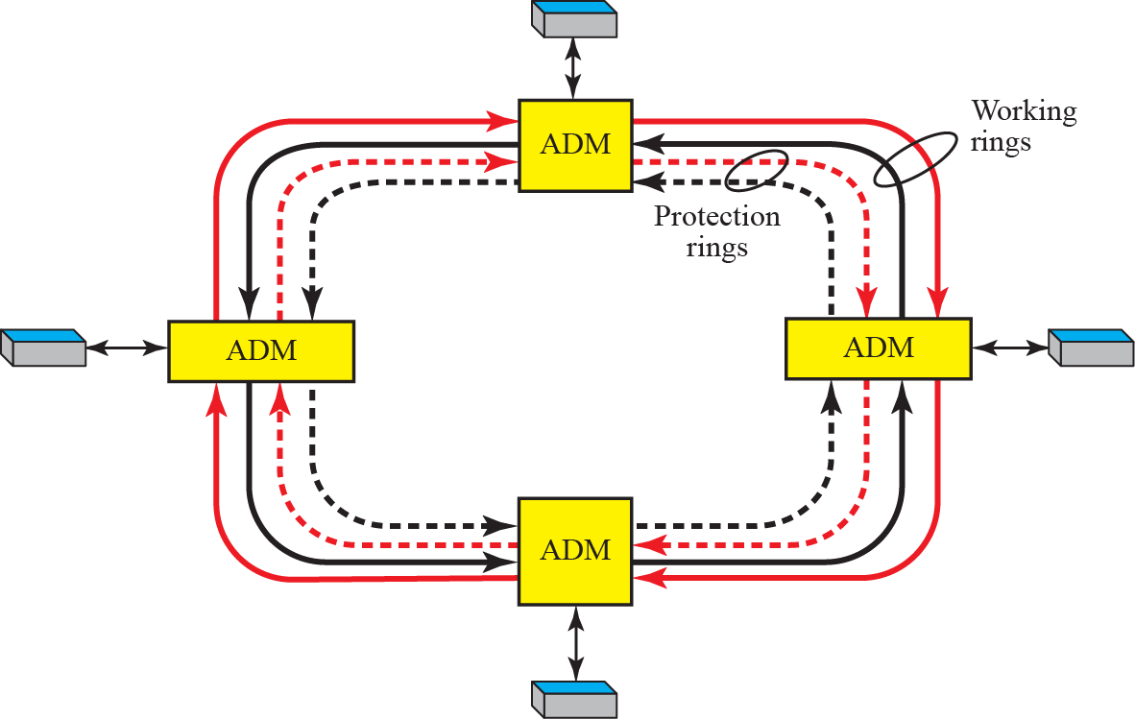
SONET Networks – Ring Networks

Slide 24
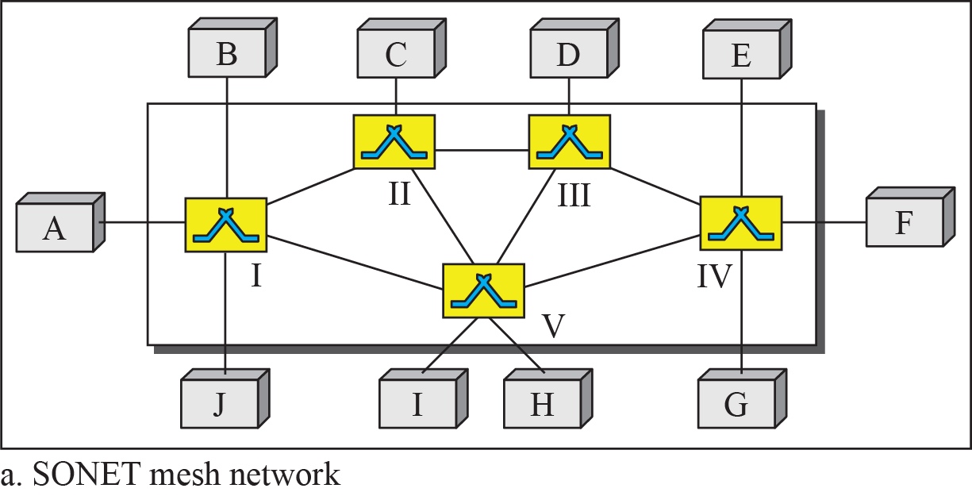
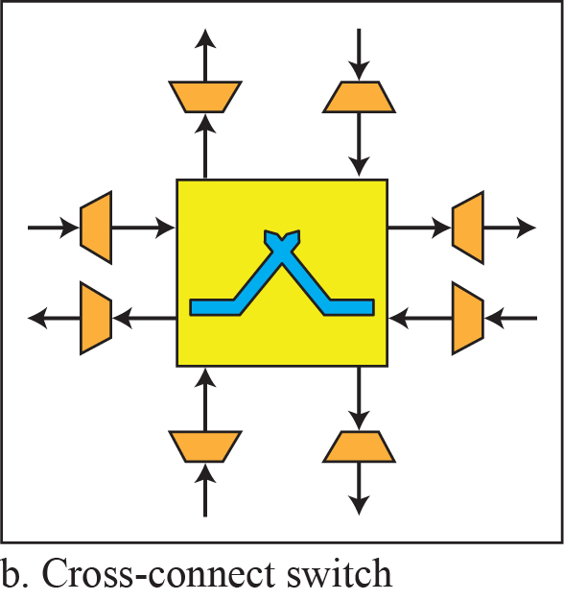
SONET Networks – Mesh Networks

Slide 25
ATM
Asynchronous Transfer Mode (ATM) is a switched wide area network based on the cell relay protocol designed by the ATM forum
The combination of ATM and SONET will allow high-speed interconnection of networks

Slide 26
Problems
Some of the problems associated with existing systems are:
  Frame Networks
  Mixed Network Traffic
Solution
  Cell Networks
  Asynchronous TDM

Slide 27
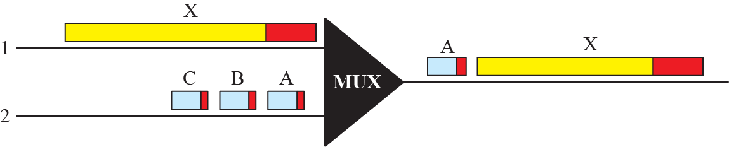
Multiplexing using Different Frame Size

Slide 28
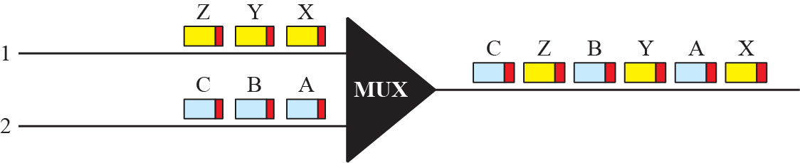
Multiplexing using Cells

Slide 29
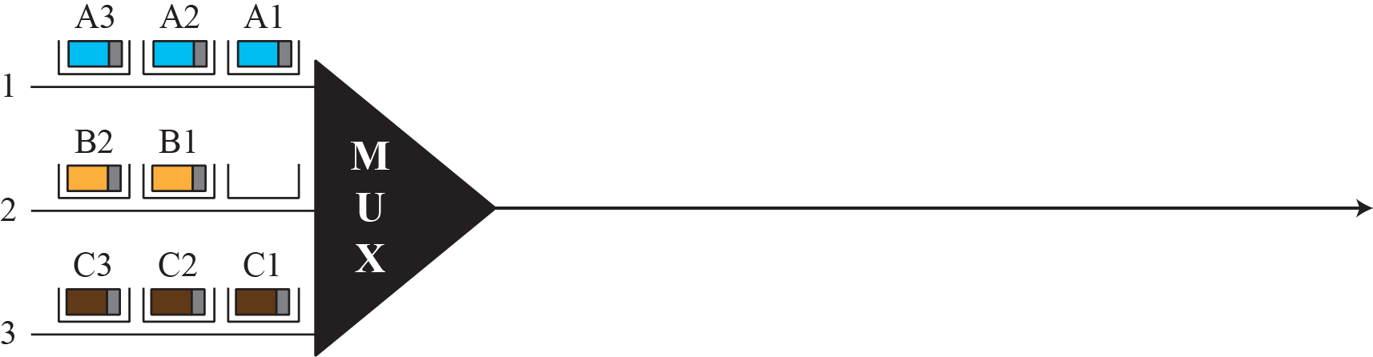
ATM Multiplexing

Slide 30
Architecture
ATM is a cell-switched network
The user access devices, called the endpoints, are connected through a user-to-network interface (UNI) to the switches inside the network
The switches are connected through network-to-network interfaces (NNIs)

Slide 31
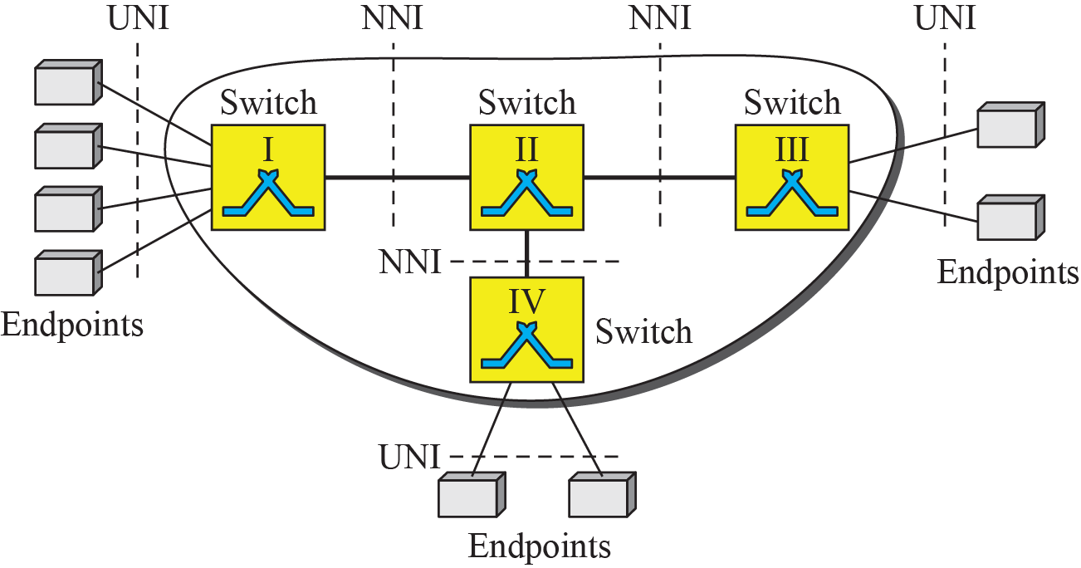
Architecture of an ATM Network

Slide 32
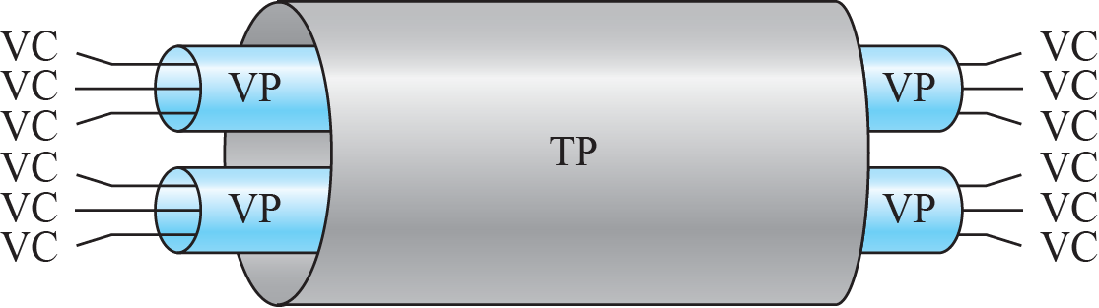
TP, VPs, and VCs

Slide 33
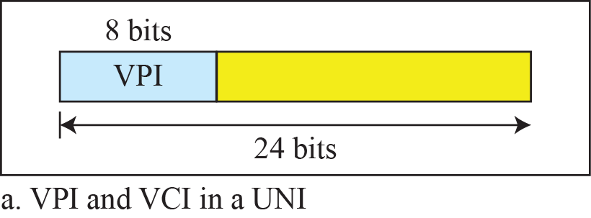
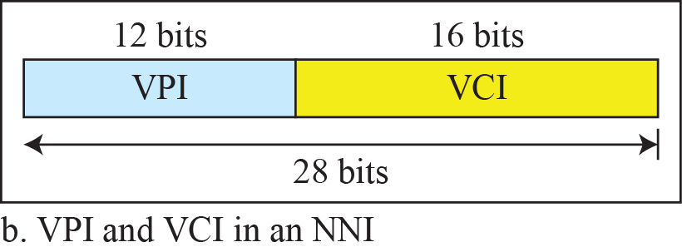
Virtual connection identifiers in UNIs & NNIs

Slide 34
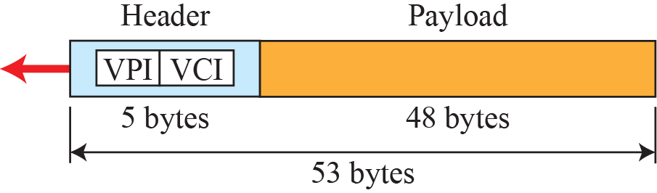
An ATM Cell

Slide 35
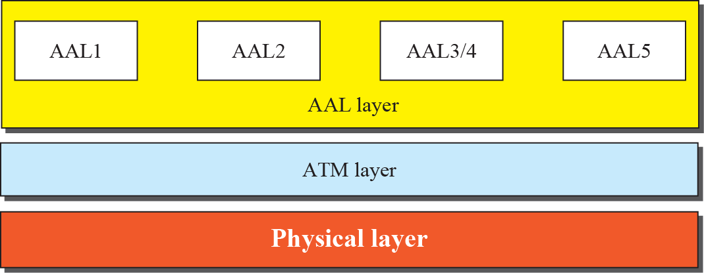
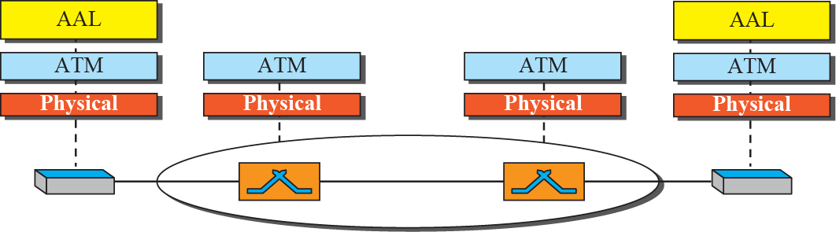
ATM Layers

