Slide 1
Connecting Devices
Hosts and networks do not normally operate in isolation
Connecting devices connect hosts together to make a network or connect networks together to make an internet
Connecting devices can operate in different layers of the Internet model

Slide 2
Connecting Devices
Three kinds of connecting devices:
  Hubs
  Link-layer switches
  Routers

Slide 3
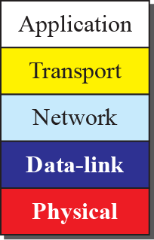
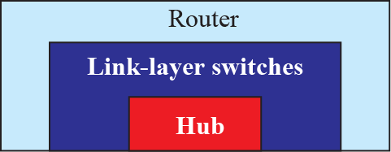
Three Categories of Connecting Devices

Slide 4
Hubs
Hub is a device that operates only in the physical layer
Signals that carry information within a network can travel a fixed distance before attenuation impacts the data
A hub (repeater) receives a signal and, before it becomes too weak or corrupted, regenerates it

Slide 5
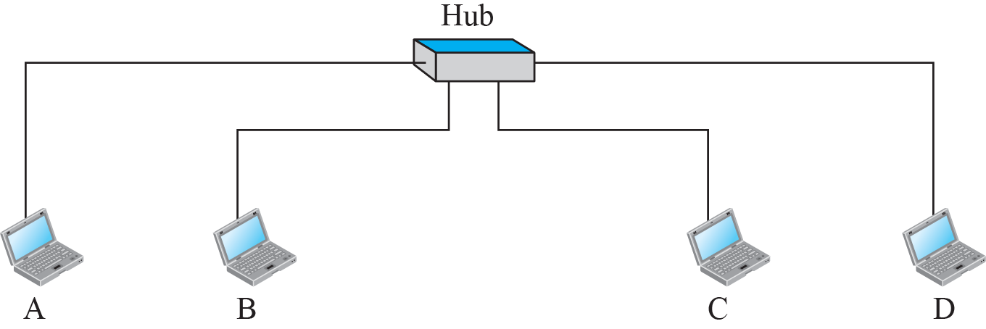



Hub

Slide 6
Link-Layer Switches
A link-layer switch (or switch) operates in both the physical and the data-link layers
As a physical-layer device, it regenerates the signal it receives
As a link-layer device, the link-layer switch can check the MAC addresses (source and destination) contained in the frame

Slide 7
Switch versus Hub
Switch has the ‘Filtering’ capability
Unlike hub, a switch can check the destination address of a frame and decide on outgoing port
Switch eliminates collisions and does not require carrier sensing
Switches connect heterogeneous devices

Slide 8
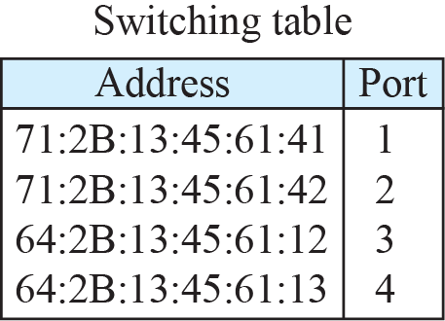
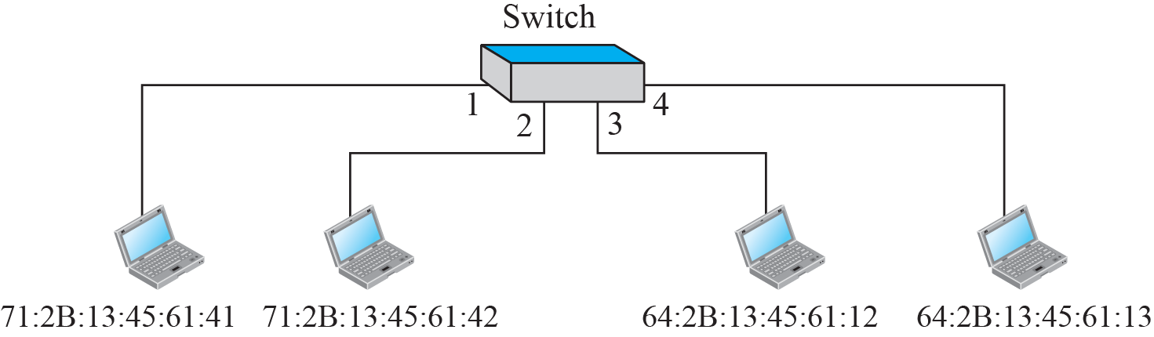
Link-Layer Switch

Slide 9
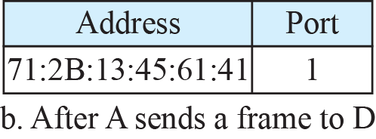
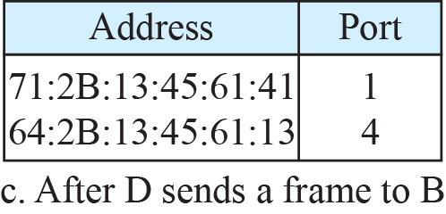
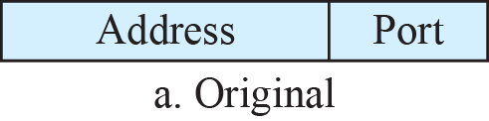
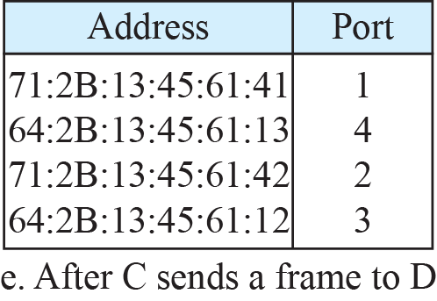
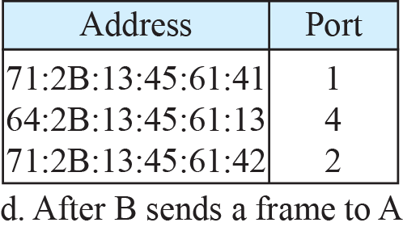

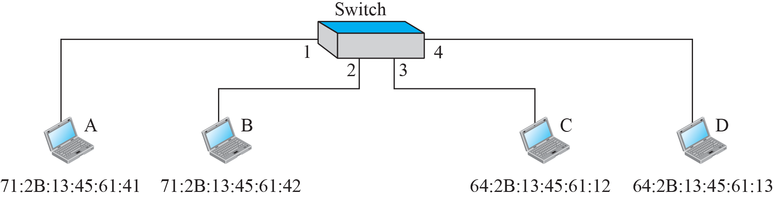
Learning Switch

Slide 10
Loop Problem in a Switch
Redundant switches create Loops in the system
Created when two or more broadcasting LANs are connected by more than one switch

Slide 11
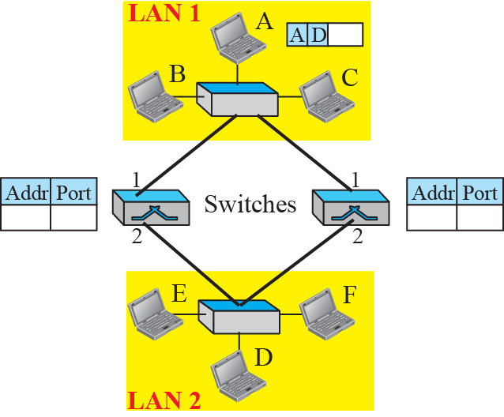
Loop Problem in a Learning Switch (Part a)

Slide 12
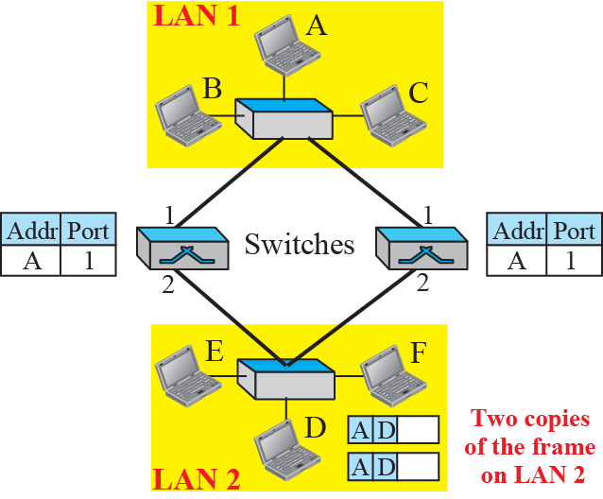
Loop Problem in a Learning Switch (Part b)

Slide 13
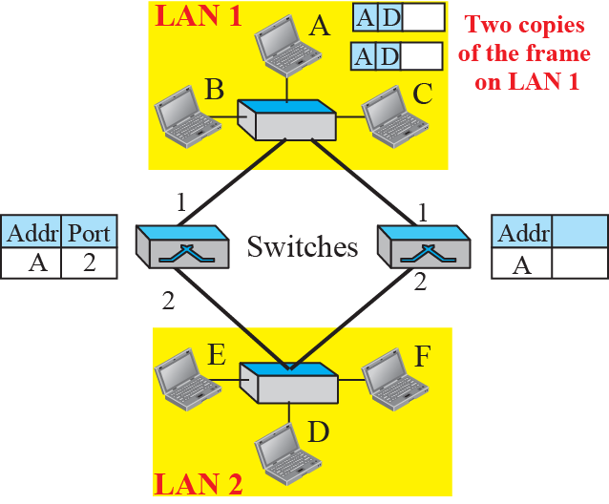
Loop Problem in a Learning Switch (Part c)

Slide 14
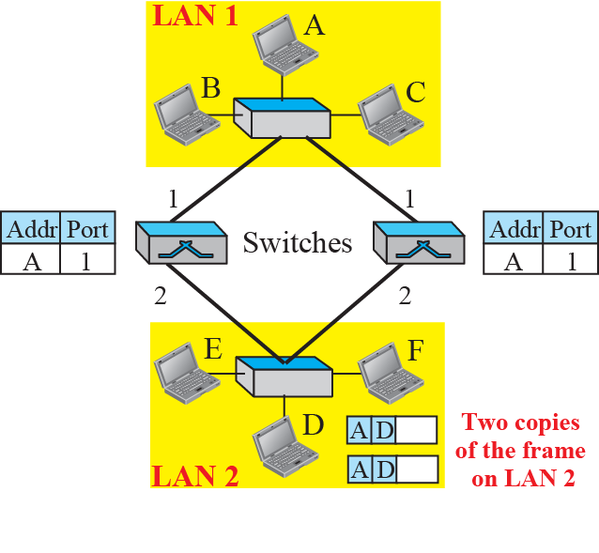
Loop Problem in a Learning Switch (part d)

Slide 15
Spanning Tree Algorithm
In graph theory, Spanning Tree is a graph in which there is no loop
In a switched LAN, this means creating a topology in which each LAN can be reached from any other LAN through one path only (no loop)
To find the spanning tree, we assign a cost (metric) to each LAN link

Slide 16
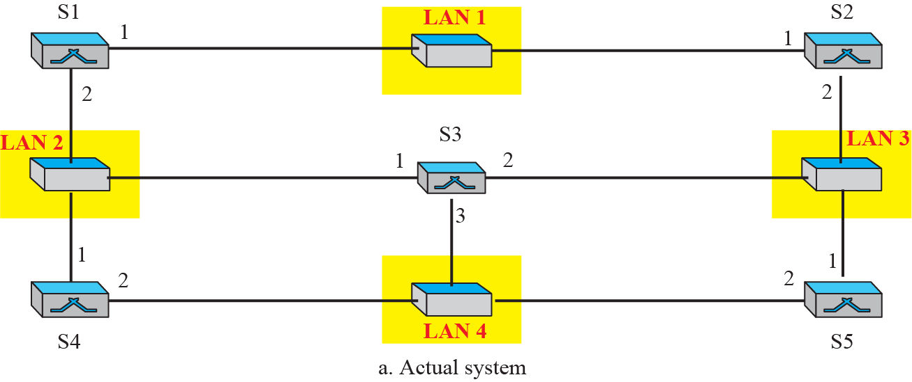
A system of Connected LANs and its Graph (Part a)

Slide 17
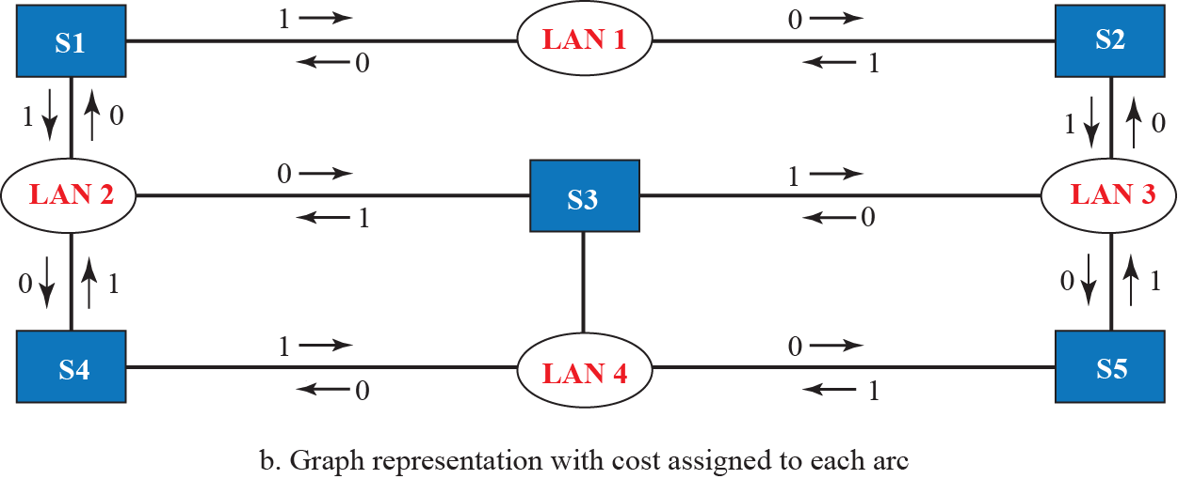
A System of Connected LANs and its Graph (Part b)

Slide 18
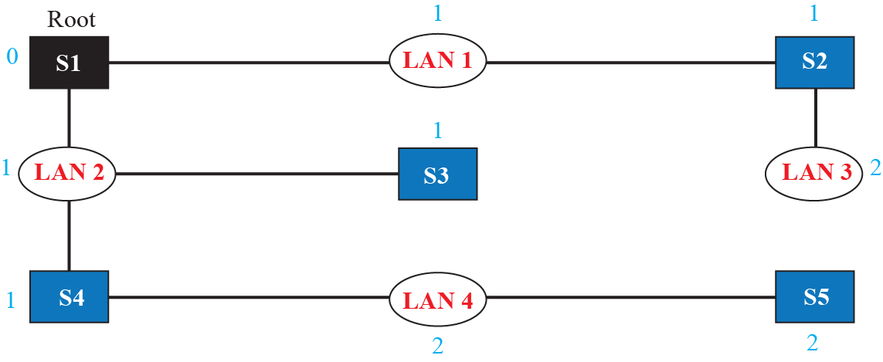
Finding Shortest Path/Spanning Tree for a Switch

Slide 19
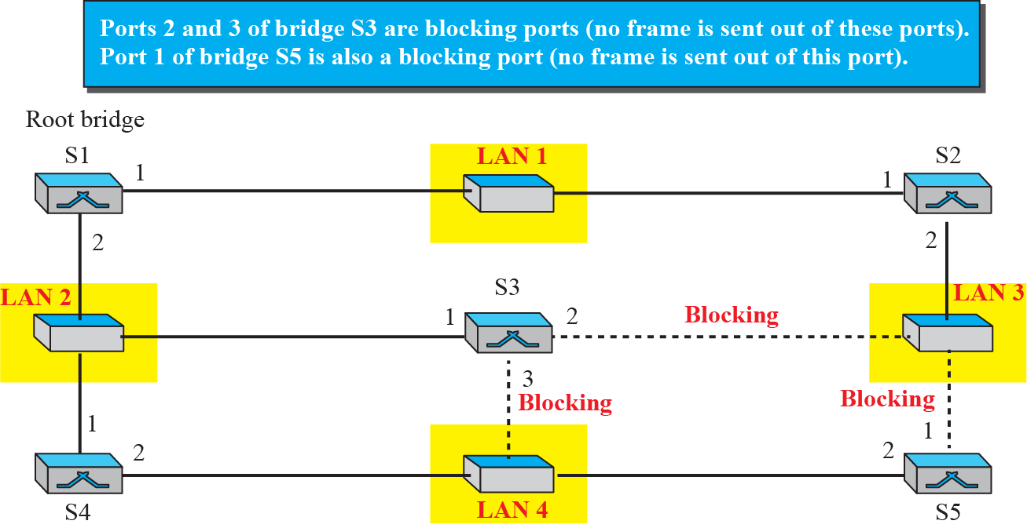
Forwarding & Blocking Ports after using Spanning Tree

Slide 20
Routers
We compare routers to two-layer switch and a hub
A router is a three-layer device; it operates in the physical, data-link, and network layers

Slide 21
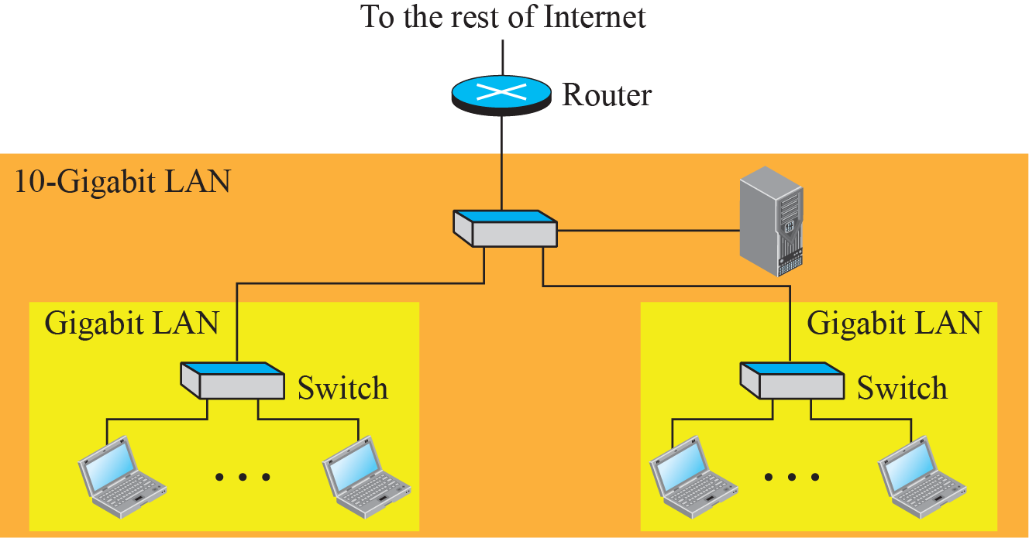
Router vs. Switch
Three differences between a router and a repeater or a switch:
A router has a physical and logical (IP) address for each of its interfaces.
A router acts only on those packets in which the link-layer destination address matches the address of the interface at which the packet arrives.
A router changes the link-layer address of the packet (both source and destination) when it forwards the packet.

Slide 22
VIRTUAL LANS (VLAN)
A VLAN is a LAN configured by software, not by physical wiring
A station is considered part of a LAN if it physically belongs to that LAN i.e. The criterion of membership is geographic
Provides a virtual connection between two stations belonging to two different physical LANs

Slide 23
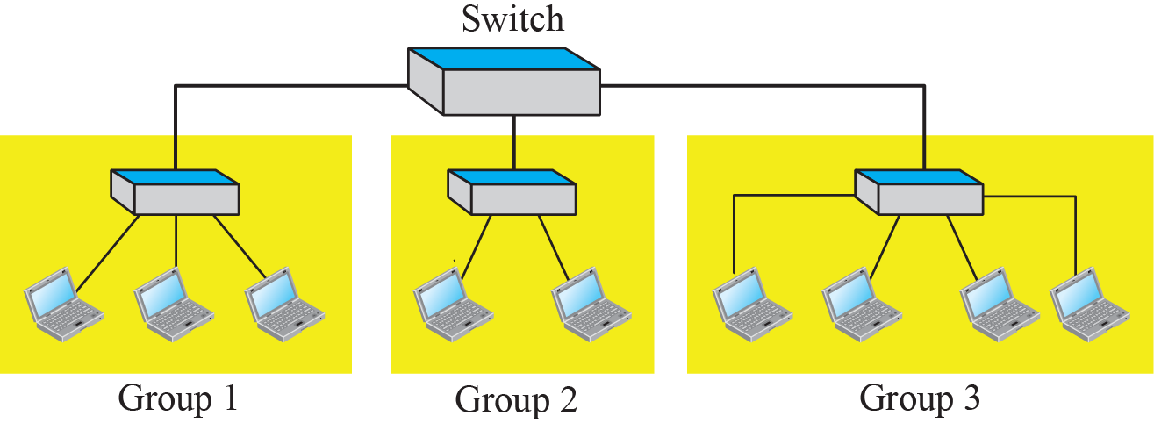
A Switch Connecting three LANs

Slide 24
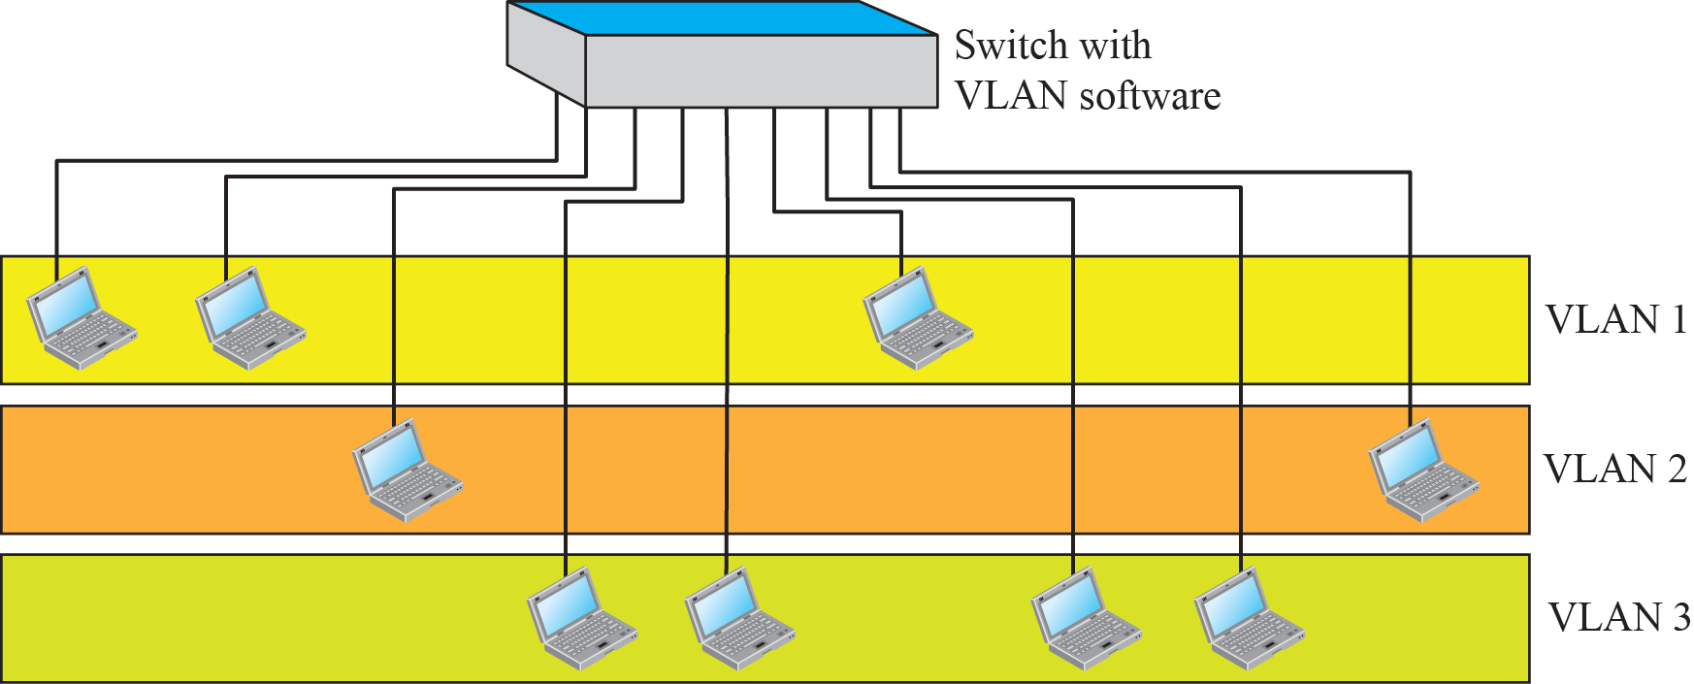
A Switch using VLAN Software

Slide 25
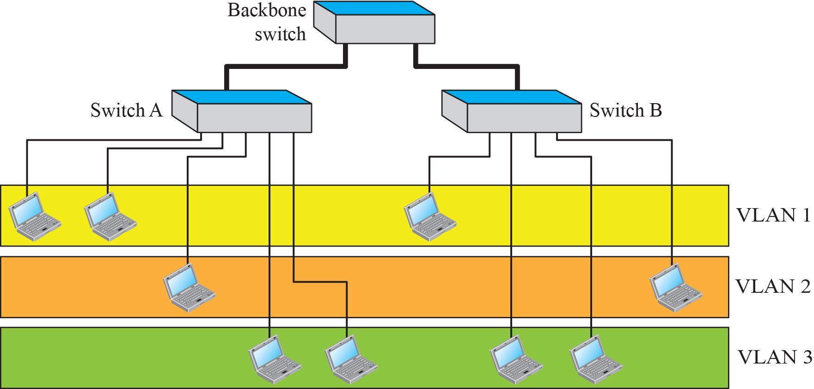
Two Switches in a Backbone using VLAN Software

Slide 26
Membership of a VLAN
What characteristic can be used to group stations in a VLAN?
Vendors use different characteristics such as interface numbers, port numbers, MAC addresses, IP addresses, IP multicast addresses, or a combination of two or more of these

Slide 27
Configuration of a VLAN
How are the stations grouped into different VLANs?
Stations are configured in one of three ways:
  Manually
  Semi-Automatically
  Automatically

Slide 28
Communication between Switches
In a multi-switched backbone, each switch must know:
  Which station belongs to which VLAN; and
  The membership of stations connected to other switches

Slide 29
Communication between Switches
Switch A must know the membership status of stations connected to switch B, and switch B must know the same about switch A. Three methods have been devised for this purpose: table maintenance, frame tagging, and time-division multiplexing.

Slide 30
Advantages of using VLANs
Cost and Time Reduction
Creating virtual Workgroups
Security

Slide 31
Comparison of Modern Access Technologies
Telco
HFC
FTTx

Slide 32
Comparison of Modern Access Technologies

Slide 33
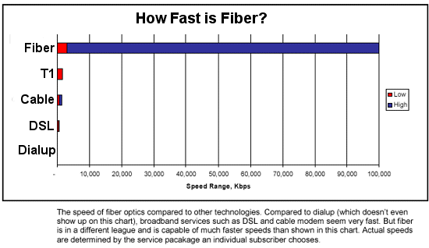
Fiber – The Medium of the Future!

Slide 34
Fiber To The Curb (FTTC)
An access network in which fiber is used for part, but not the entire link from the provider to the end-user
An optical to electrical (O/E) conversion takes place somewhere near the end-user
The terminal network segment of a FTTC network is usually twisted pair or coaxial cable

Slide 35
Fiber To The Curb (FTTC)
The final optical receiver in a FTTC network typically serves several customers

Slide 36
Fiber To The Curb (FTTC)

Slide 37
Fiber To The Home (FTTH)
Need: High-speed data, reliable voice and high-quality video
Problems:
  How to get high speed lines out to each customer?
  How to future-proof the architecture?
Solution: FTTH

Slide 38
Fiber To The Home (FTTH)
Fiber-to-the-home (FTTH) is the installation of optical fiber from a telephone switch directly into the subscriber’s home
It is one of the latest access technologies
FTTH is also referred to as Fiber-to-the-Building (FTTB)

Slide 39
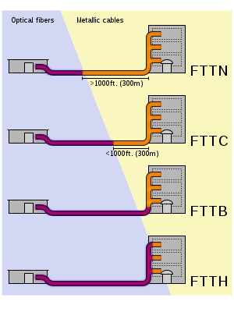
Fiber To The Home (FTTH)

